Slide 1
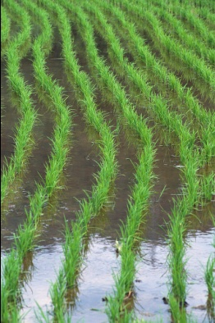
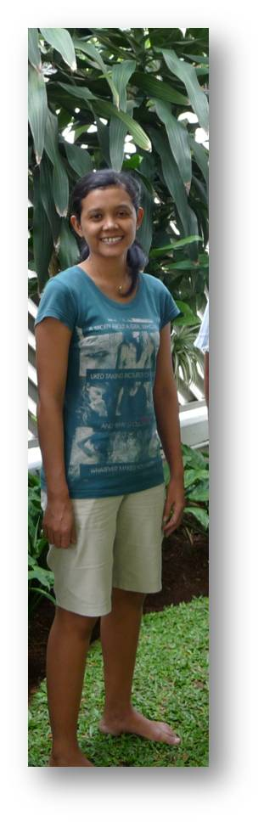
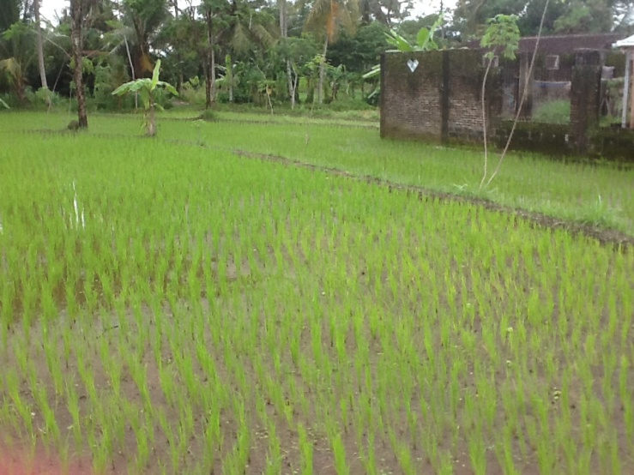
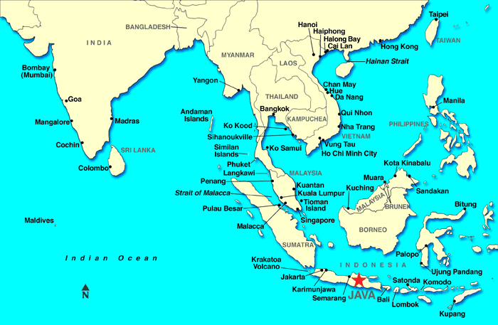
Risa the Rice Farmer
Risa lives in Indonesia on the island of Java
and she grows rice close to her village.
If she has a good year she will be able to harvest 3 rice
crops per year.
rice padi

Slide 2
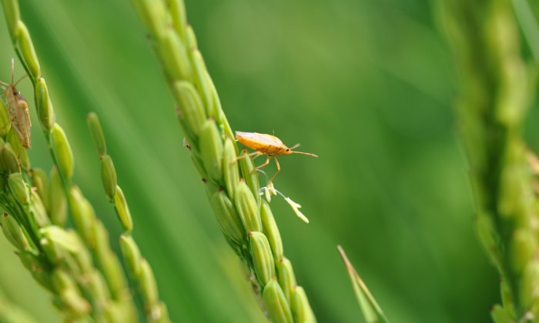
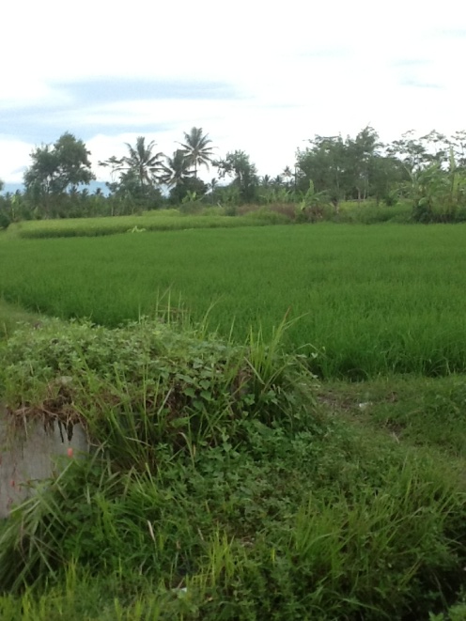
Risa the Rice Farmer
Risa’s field is in an area where the soil is quite rich in
minerals because of volcanic eruptions in the past. Risa
needs to try to make sure the yield of rice is high but she does not
want to use more fertiliser than she needs to as it is so expensive.
Last year she had a lot of damage of her crop from insect pests and
she knows that the soil in her padi is low in potassium.

Slide 3
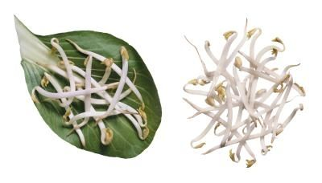
Risa the Rice Farmer
Getting 3 rice crops this year is essential to Risa but she
knows that she could have a problem with low nitrogen
levels in the soil.
Before she makes all her plans she will be considering
all the alternatives and taking advice. She might try growing mung beans in the dry season – that has been good in the past.
Germinating mung beans
This website might help Risa.
http://webapps.irri.org/nm/id/_0js.php

Slide 4
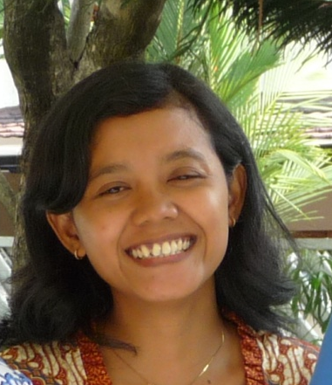
Risa the Rice Farmer
Your job is to list all the factors which Risa needs to
consider. You will need to think about the type of soil
she has; why she might have had problems with insect pests; why she might grow mung beans; what strain 3 rice crops might put on her soil and the costs of fertilisers. What might be the best fertiliser mix (NPK)?
Advice for Risa

