Slide 2
To inspire, enthuse and support STEM educators for the benefit of all learners.
When: Tues 9th and Wed 10th May 2023
Where: Merck BioReliance, West of Scotland Science Park, Glasgow
Cost: Fully funded, thanks to The Biochemical Society
Target delegates: Secondary or further education science teachers (teaching biology and/or chemistry) at state-funded schools and colleges in Scotland.
Placement requirements: Funding must be used to support placements with biotechnology employers and research institutes in Scotland.

Slide 3
What is the SSPP?
Aim: To connect educators with industry partners, reflecting responsibilities outlined in the Career Education Standard and the GTCS Standards for Middle Leadership.
The programme offers educators a valuable insight into the world of work:
Employment strategies, e.g. school leaver, apprenticeship, degree
Roles within a Life Sciences organisation
Process for recruitment
Relevant skills and abilities
The SSPP will help you contextualise the curriculum for learners, enhancing the learning and teaching by relating content to current and relevant local STEM industries and issues.

Slide 4
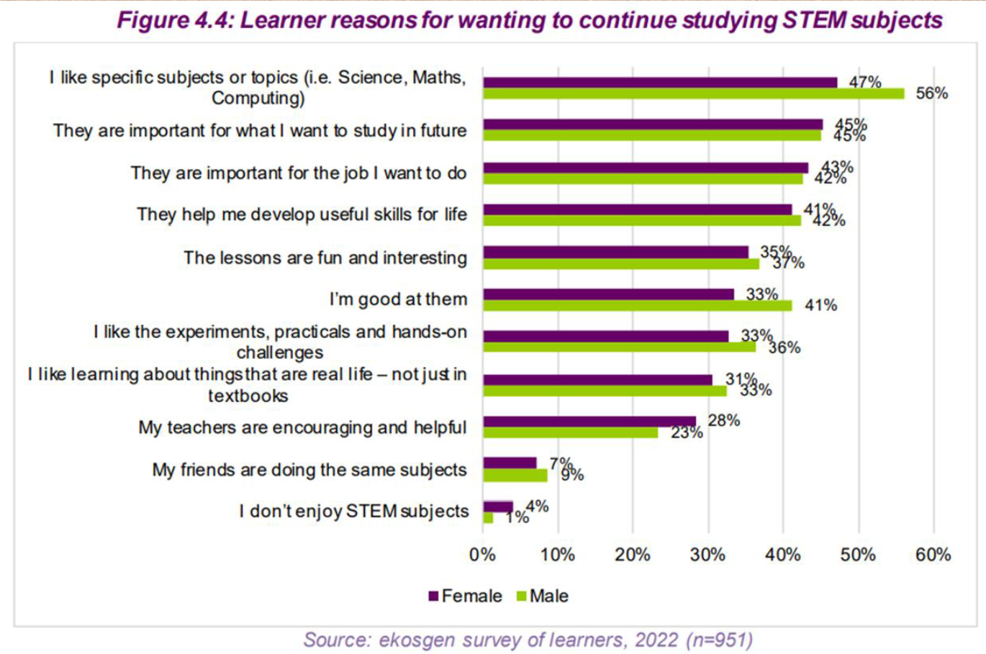
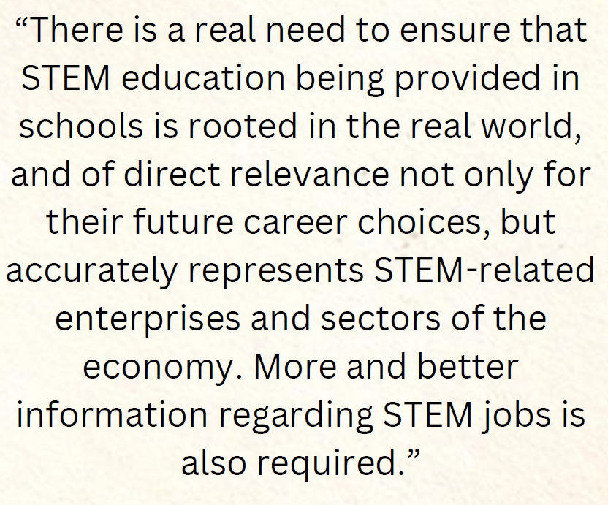
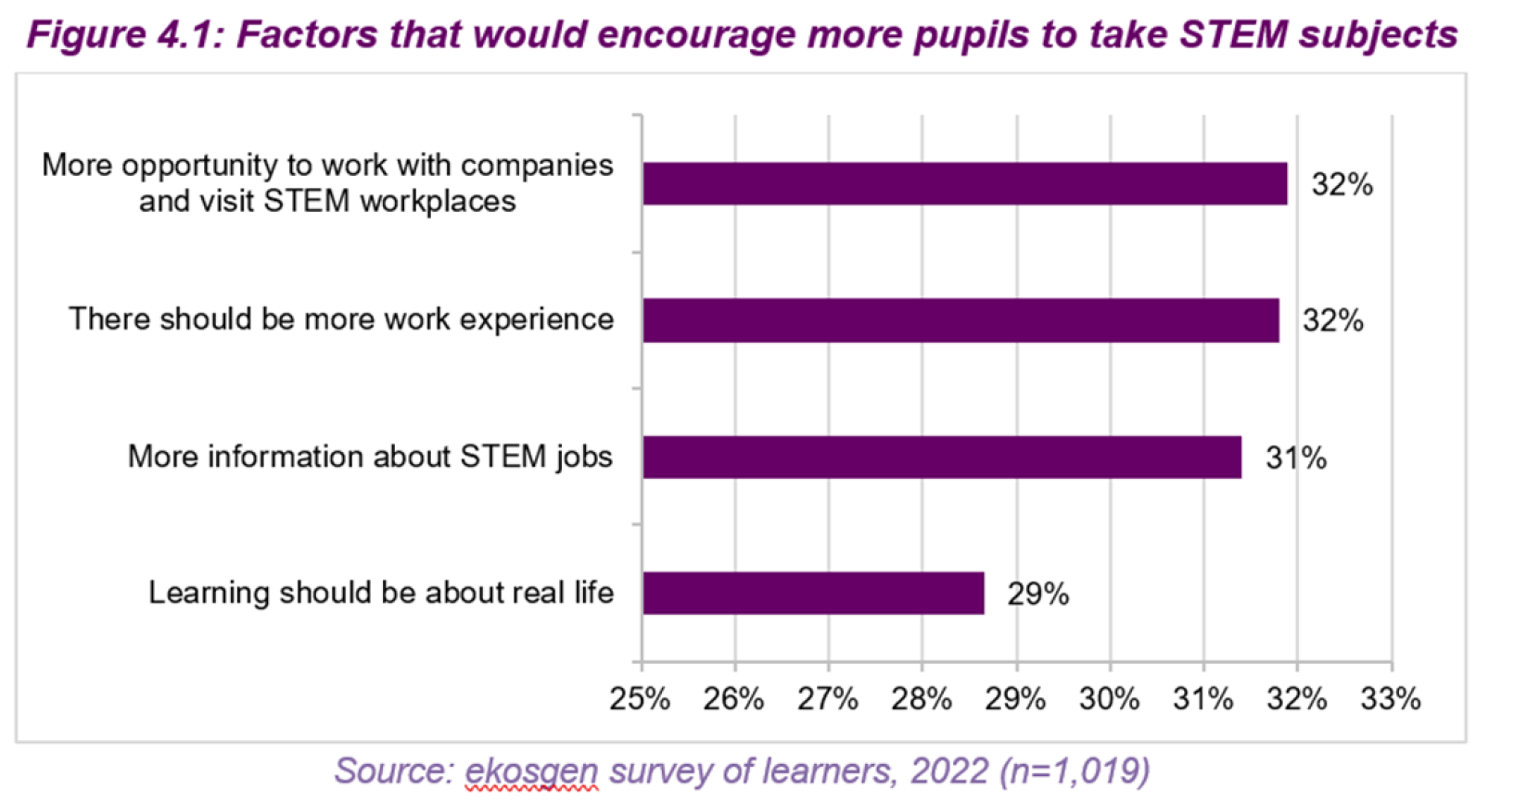

Slide 5
Who are Merck?
Contract testing services for biopharmaceutical industry.
Testing, development and manufacture of biopharmaceuticals.
Leading provider of Good Manufacturing Practice (GMP) and Good Laboratory Practice (GLP).
We are passionate about highlighting the impact STEM education can make on healthcare and local communities. We strive to foster an interest in STEM from an early age and aspire to ignite a love for STEM within future generations in Scotland. The SSPP aims to forge long-term connections between us and you.

Slide 6
Who are Merck?
Cutting-edge work performed within Scotland’s Life Sciences sector, e.g. automated methodologies, sequencing, rapid molecular methods, that generate multiple large data sets to assess bacterial and viral contaminants that may be present in client and patient samples.
We want to provide a hands-on experience for teachers visiting our site, while providing insight into GMP and GLP. This is relevant to the Skills for Work courses, e.g. National 5 Health Sector and Laboratory Science.

Slide 7
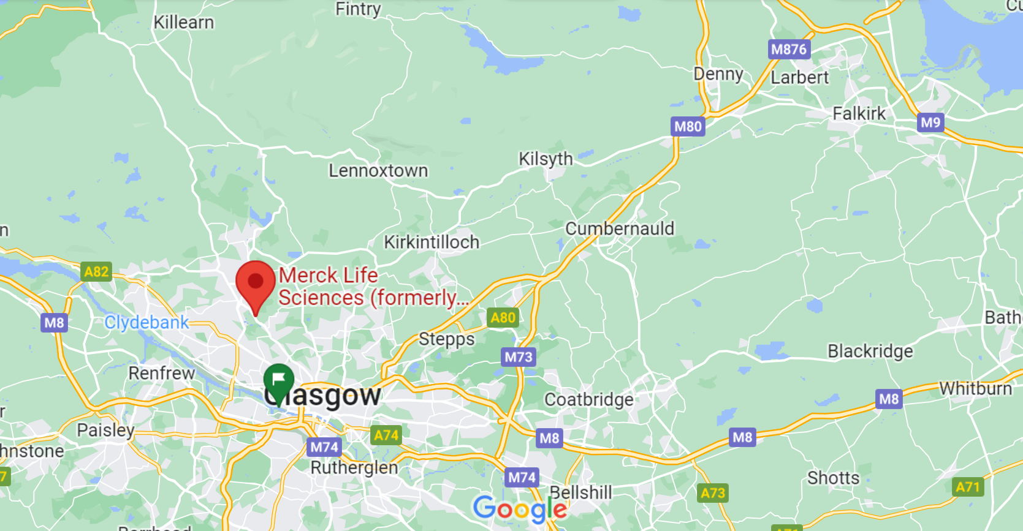
Where are Merck?
Merck BioReliance, West of Scotland Science Park, Glasgow

Slide 8
Programme Structure
2-day placement at Merck BioReliance in Glasgow. This is not a residential offer. Travel expenses will be reimbursed. Lunch and refreshments will be provided.
The placement will provide a range of practical training opportunities, demonstrating how Merck perform aseptic technique, analyse GMP studies and will also discuss the impact to medicines, patients and gene products.
Delegates will be given a complete overview of a Contract Testing Services Company to understand the skills required for careers in STEM and the Life Sciences industry.

Slide 9
Delegates
As a group, you will document your experiences, collating photos, video footage and perhaps short interview material or quotes that reflect your time in Merck BioReliance.
You will share aspects of your experience on social media.
There will be a follow-up recall day (Tues 6th June, TBC) during which you will work together to create a learner resource about STEM careers in the Life Sciences industry. This will be shared with the wider Scottish teaching profession.
You will also be in a position to speak with Merck about suitable potential Nuffield projects they could offer learners.

Slide 10
Delegates – who will you be?
Teacher/lecturer of Biology and/or chemistry
Aspiring to, or currently occupying, a leadership position
STEM or DYW lead
In a school delivering Skills for Work courses
Realistically, probably living reasonably close to Merck.
Able to be out of school on 9th-10th May, and for the recall day.

Slide 11
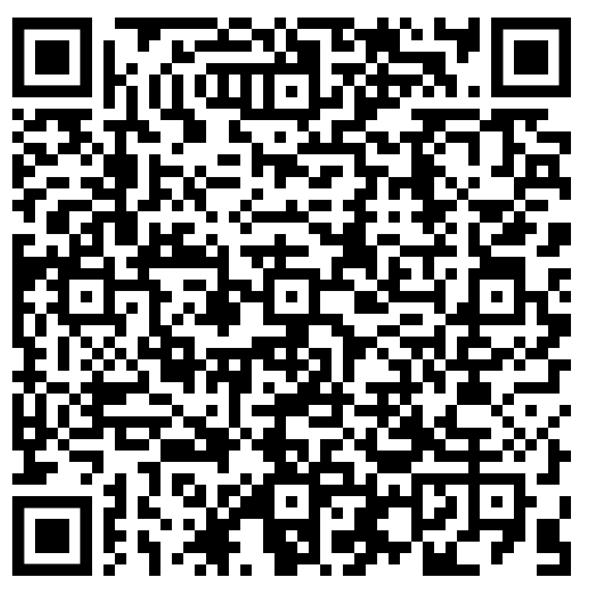
What next?
If you’re interested, complete an application form on our website.
https://tinyurl.com/bb5xu79h

Slide 12
