Slide 1
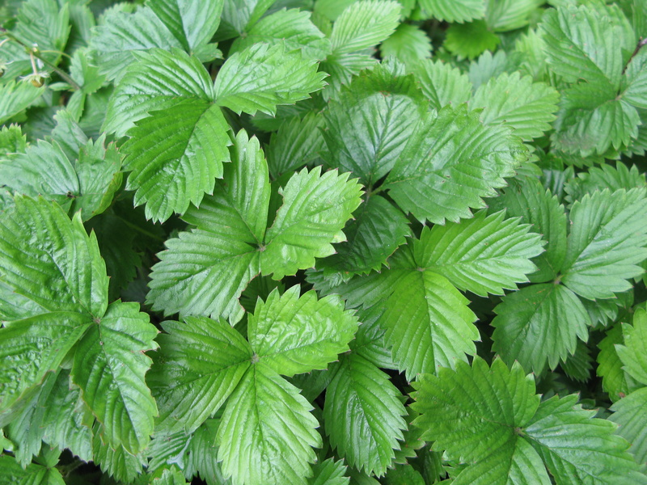
PLANT GROWTH
Nitrogen Deficiency
deficiency usually appears on
older leaves first
because nitrogen is a part of the chlorophyll molecule, a major deficiency symptom is chlorosis (yellowing of leaf)
slow growth and stunted plants
lower protein means fewer leaves
reduced yield

Slide 2
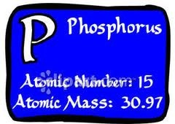
PLANT GROWTH
Phosphorus Deficiency
deficiency usually appears on
older leaves first
leaves turn a dark green or purple
in colour
overall stunting of plants especially roots
roots often turn red or purple in colour and likely to suffer from root-rot
reduced yield

Slide 3
PLANT GROWTH
Potassium Deficiency
deficiency usually appears on
older leaves first
yellowing along leaf margins
decreased disease resistance
slow growth and poorly developed
root system
small and shrivelled grain or fruit
reduced yield

