Slide 1
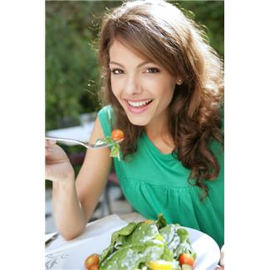
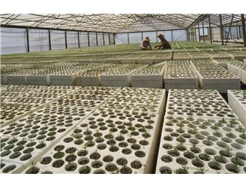
Hermione the Horticulturalist
Hermione is a Horticulturalist and she works for ‘Fresh-Grow’
near Dundee in Scotland. Their main commercial crop is tomatoes which they grow in huge poly-tunnels

Slide 2
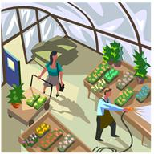
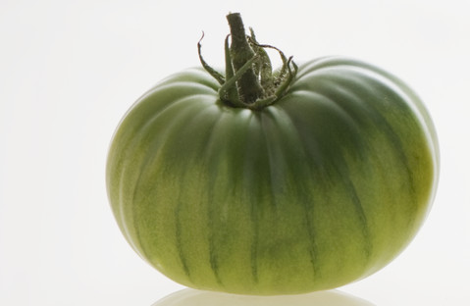
Hermione the Horticulturalist
If Fresh-Grow are going to be successful Hermione has
to make sure that she gets maximum yield with minimum
costs. Last season Hermione had a problem with greenback, a disease which causes the fruit to remain hard and unripe. Fertilisers high in potassium help to control greenback but too much potassium can cause blossom-end rot. There was also an outbreak of red spider mite which caused no end of problems.

Slide 3
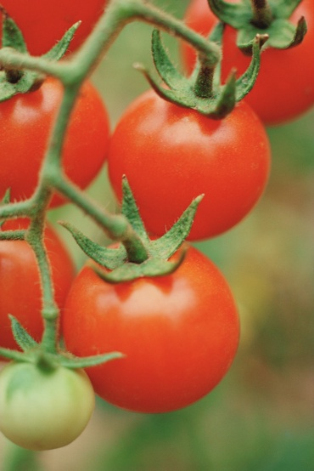
Hermione the Horticulturalist
Hermione knows she needs to fertilise her tomatoes but she needs to
get it right. Changing the variety of tomato she plants to ‘Shirley’
might help to control greenback but her customers might not like
that variety so much. Too little nitrogen will cause low yield and too
much causes the leaves to grow more than the fruit.
The spider mites are also an issue and Hermione is interested in
trying ‘biological’ control.
This website might help Hermione
http://www.defenders.co.uk/pest-problems/red-spider-mite.html

Slide 4
Hermione the Horticulturalist
Your job is to consider all the things which Hermione has to think
about and come up with a list of what should be in her fertiliser and
some of the other things she needs to take into consideration.
For example what should she do about the pests and diseases?
Advice for Hermione

