Slide 1
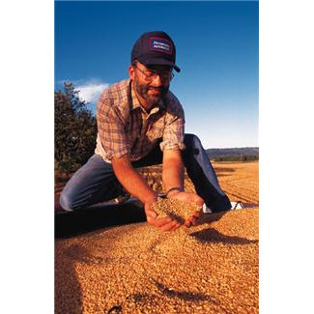
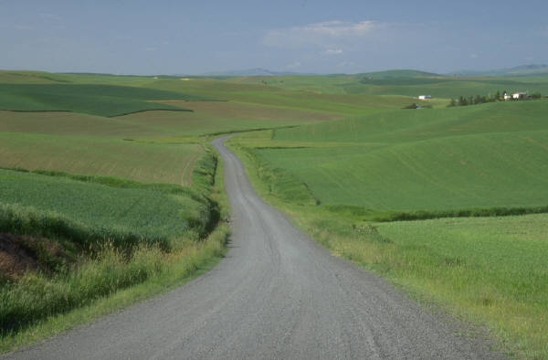
Fred the Farmer
Fred farms in central Scotland. His main cash crop is wheat.
Fred’s farm is in an area where rainfall is high and the soil is acidic.

Slide 2
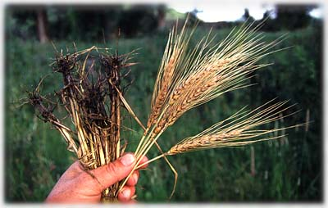
Fred the Farmer
Last year was not a good year for Fred and his crop yield was low.
His wheat plants had fewer leaves than normal and some of the older
leaves were yellow in colour. Also when he checked the roots he
found that they were purple in colour and showing signs of rot.

Slide 3
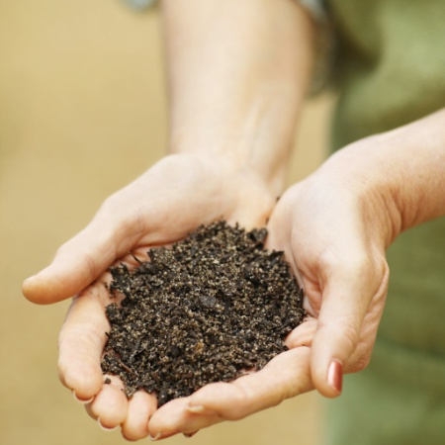
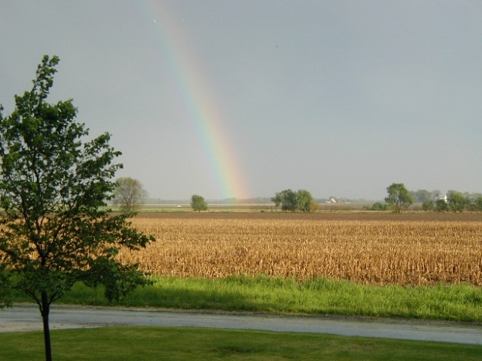
Fred the Farmer
Fred needs to make sure that his crop is more successful this year.
Last year was terribly wet and, of course, he does not know what the
weather will be like this year. He knows that his soil can easily become
water-logged and he does not want to cause eutrophication in the loch
nearby . Fred prefers organic solutions and is taking advice from
this web-site before he decides what to do.
http://www.farm-wise.co.uk/fertiliser_recommendations.html

Slide 4
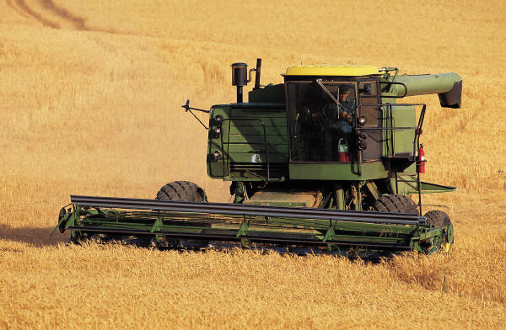
Fred the Farmer
Your job is to give try to work out what advice Fred should be given.
You will need to think about the climate, the soil (pH, soil crumbs,
water content), the crop, and the best fertiliser mix (NPK). You need
to check the reasons for problems he had last year and consider
Fred’s preferences and concerns.
Advice for Fred:
Another photo of Fred

