Slide 1
Biology on your doorstep
Activity 1 observation / definition of living things
Activity 2 close observation / biodiversity
Activity 3 sampling / distribution / identification
Activity 4 “I’m a worm, get me out of here”

Slide 2
Activity 1
Key characteristics of living things:
Movement
Respiration
Sensitivity
Growth
Reproduction
Excretion
Nutrition

Slide 3
Activity 2
Close observation
biodiversity
abundance
identification

Slide 4
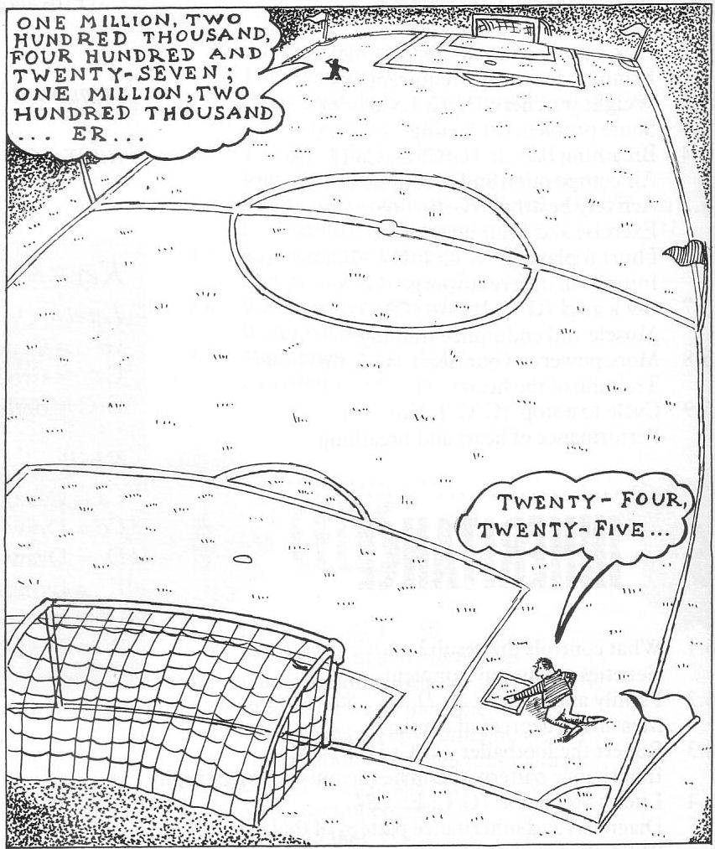
Activity 3
Sampling
abundance
distribution
identification
interconnectedness

Slide 5
Activity 4

Slide 6
www.survivalrivals.org
Supplied free to every secondary school as part of the Darwin 200 celebrations.
I’m a worm…. For 11-14 year olds
Natural selection is explored by producing spaghetti ‘worms’ of different colours, observing which ones the birds prefer to eat and monitoring how the populations change over time.

Slide 7
Survival Rivals: I’m a Worm Get Me Out of Here kit
Item | Description | Quantity
1 | Spaghetti | 500g
2 | Food colouring - red | 1
3 | Food colouring - green | 2
4 | Food colouring - black | 1
5 | 5ml plastic pipette | 3
6 | RSPB bird identification book | 1
7 | Bird food | 1
8 | Plastic bags | pack
9 | Disposable gloves | 50 pairs
10 | Twine | 1
11 | Golf tees | 20
12 | Bird key | 1

Slide 8
S1 class – Biggar High School
Context -
unit on Living Things and Their Environment
Adaptations → Natural selection

Slide 9
13 How will data be presented & analysed
Poster, film clips etc
1 Worm colours 3
2 Background colour green - grass
12 How will data be recorded ?
Table - notebooks
11 What do we do at weekend?
1 local volunteer
3 Bird feeding area
Bushes - protection
Planning
10 Count worms thrown out of feeding area? No
4 Distribution of food
Spread randomly
9 Count ½ eaten worms? No
8 Method to count & replace
10min collect, calculation
5 How many worms ?
20 of each colour
7 When to count worms
3 periods – 1 Saturday
volunteer
6 Length of worms 5cm

Slide 10
The process -
Groups took responsibility for making planning decisions
1 period spent planning
1 period making the worms
Followed suggestions –
Fed birds for one week, chilli
10 mins at start of period to count, do calculation and replace worms
Homework – researched birds in area
Made a wormery and ‘ecosystem’

Slide 11
What they found
Mostly green worms in population after 2 weeks
some brown, a few red
Calculation was the hardest bit, but everyone ‘got it’ eventually
Pupils really enjoyed the activity
All were able to discuss – population, camouflage, natural selection, survival of the fittest

