Slide 1


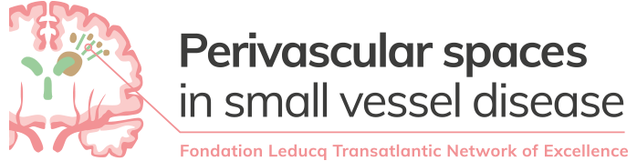

MRI: Our window to the living brain
Our growing brain
British Science Week 2022
Michael S Stringer
Medical Physicist, University of Edinburgh

Slide 2
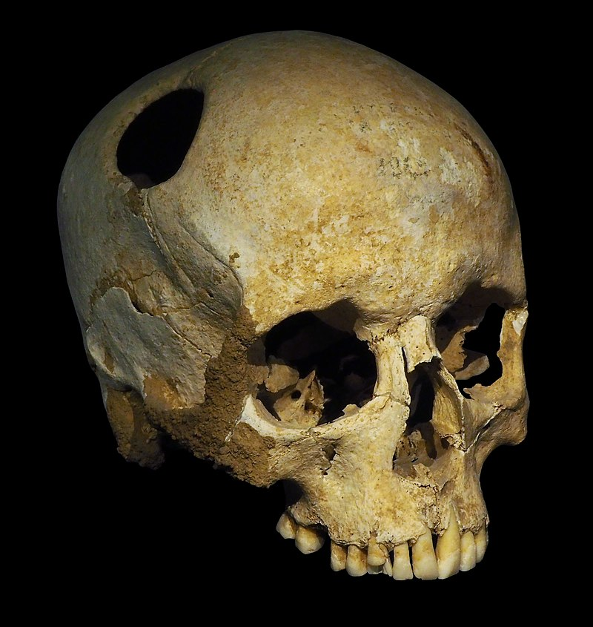
Introduction – Where to start?
I
Indeed the first evidence we have of surgery is on the brain (known as trepanation)
Understanding our brains is a key part of our quest to knowing ourselves and, both individually and as a species, why we act the way we do
  “The unexamined life is not worth living”

Slide 3
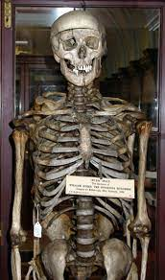
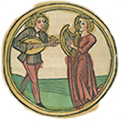

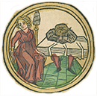
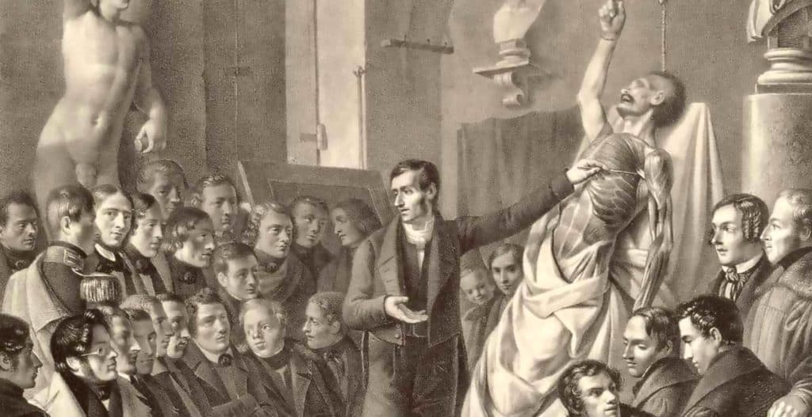
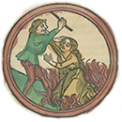
Introduction – Where to start?
Sanguine
Melancholic
While we can learn a lot about the brain from surgical approaches there are limitations
  It is very invasive – which can disrupt the systems we want to study
  Involves risk – hard to find volunteers, and cannot do it multiple times
Similarly limitations to anatomy – inherently static
Phlegmatic
Choleric

Slide 4
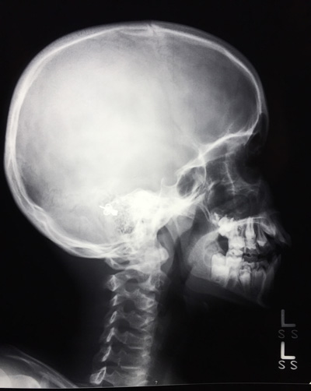
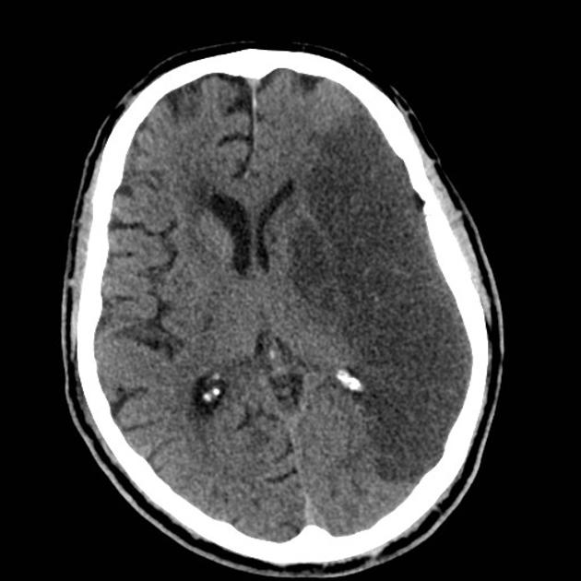
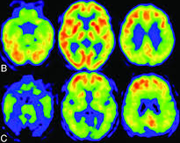
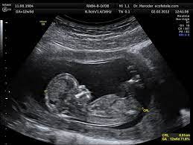
Introduction – Where to start?
Imaging can help solve these problems, but again there were challenges to overcome
  X-rays did not give good soft tissue contrast
  Ultrasound waves cannot penetrate the skull
  Radioactive tracers can be used with special detectors – but need to minimise exposure, not widely available, label single compound

Slide 5
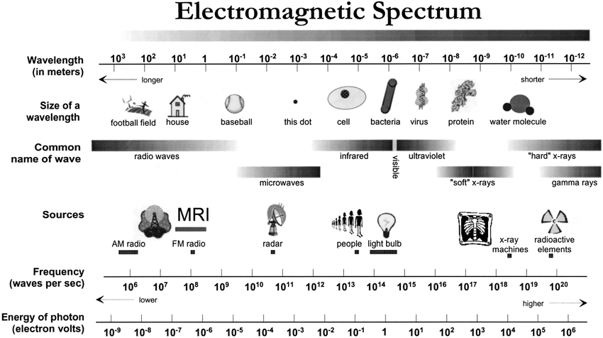
Introduction – Where next?

Slide 6
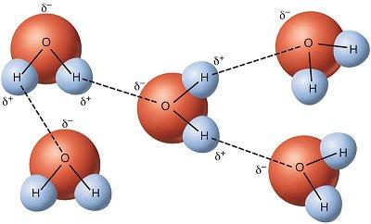
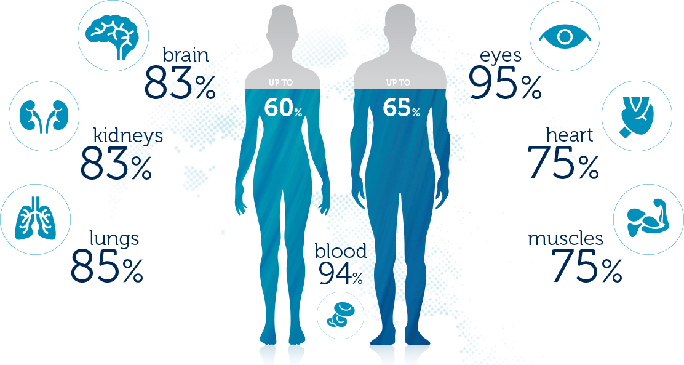
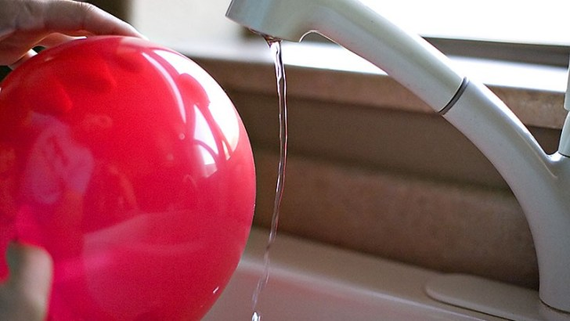
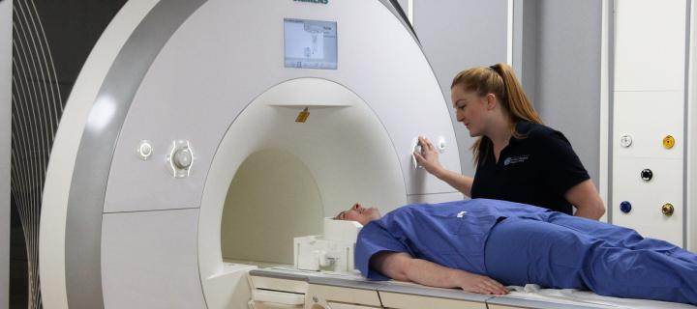
Magnetic Resonance Imaging
Magnetic resonance imaging (MRI) uses powerful magnets to image the human body
Our bodies are mostly (~ 65%) water
Hydrogen bonding gives water a slight magnetic charge – so it can be attracted and repelled
  e.g. static electricity and running water

Slide 7
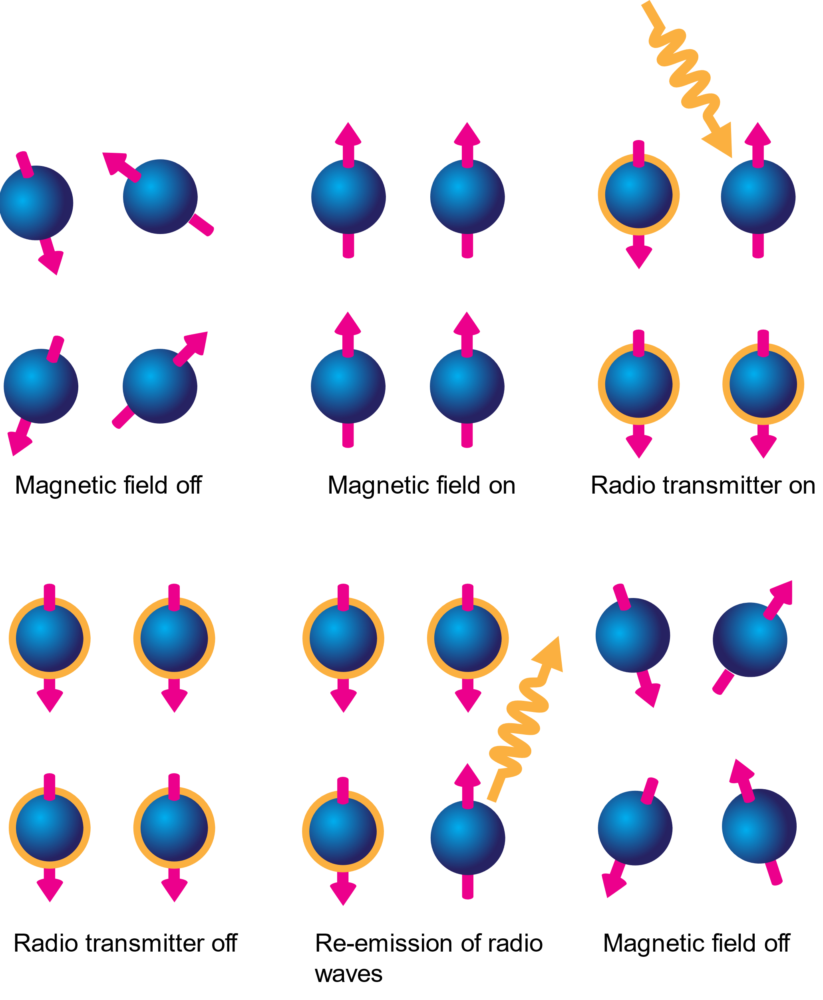
Magnetic Resonance Imaging
Normally water molecules are randomly distributed
When we apply a strong magnetic field the overall (net) magnetisation aligns with the main magnet
By applying a radiofrequency (RF) pulse we upset this balance until it is turned off
When the molecules return to their original state energy is released as an RF wave

Slide 8
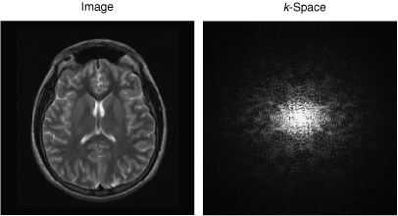
Magnetic Resonance Imaging
From this we get an image that does not look like much
But after applying a mathematical transformation we get images which are incredibly useful:
  Diagnosing different conditions
  Exploring how the brains works
  Understanding how our brains grow and change

Slide 9
MRI for diagnosis
First whole body scanner for humans was built in Aberdeen
From 1981 to 1983 1,000 patients were scanned
In Scotland alone >100,000 MRI scans are now performed per year

Slide 10
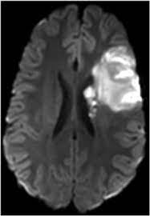
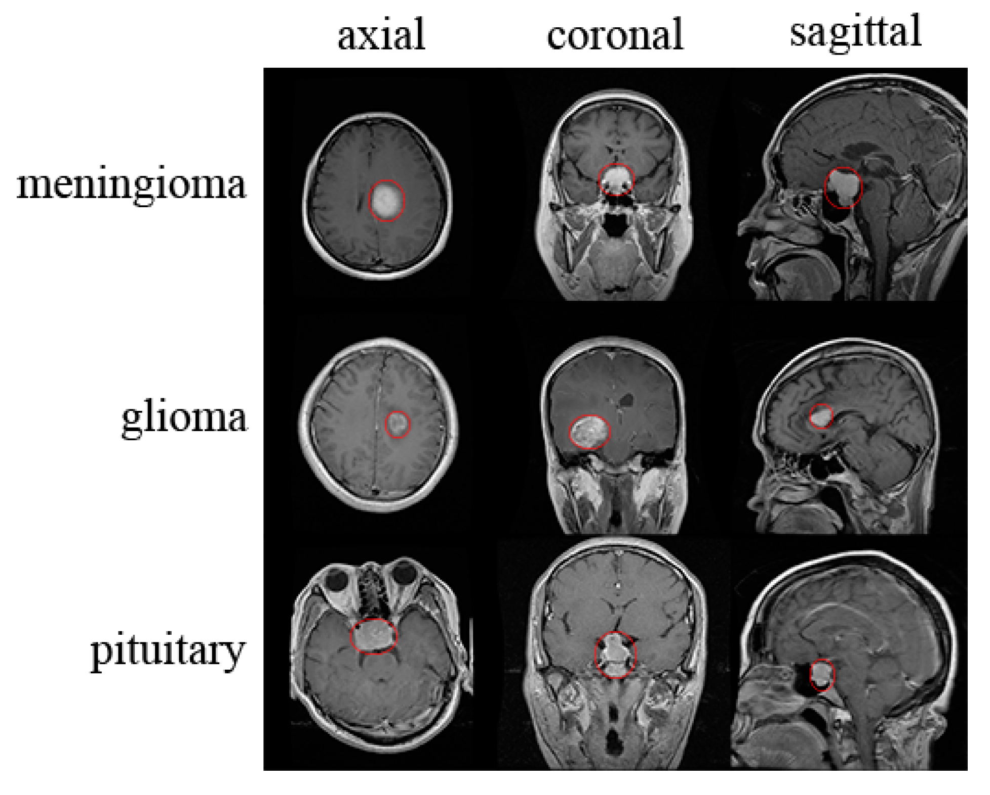
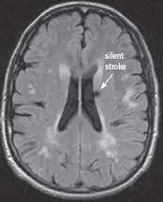
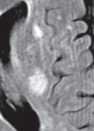
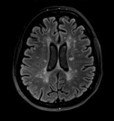
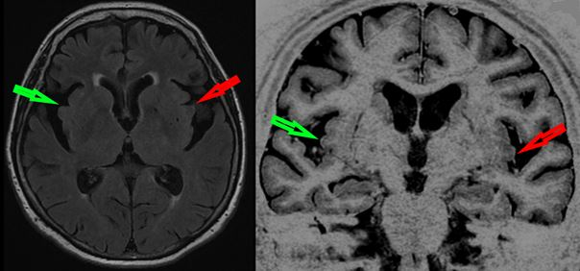
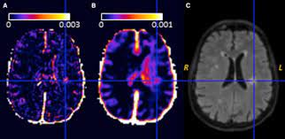
MRI for diagnosis
MRI is widely used as part of the diagnostic process for several conditions, including:
  Stroke
  Dementias and Alzheimer’s disease
  Multiple sclerosis
  Brain tumours

Slide 11
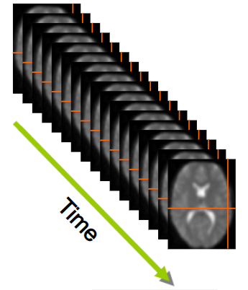
MRI to understand how the brain works
When we use different parts of your brain there is an increased demand for oxygen and energy, which are transported through the blood stream
Functional MRI (fMRI) indirectly measures changes in blood flow based on the amount of O₂ carried
By monitoring changes over time we can find which parts of the brain are connected and work together

Slide 12
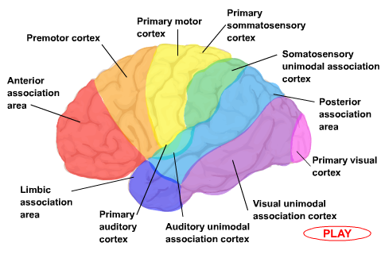
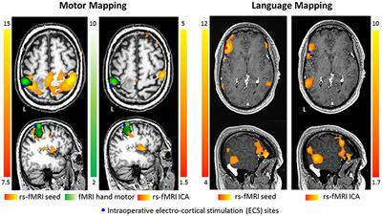
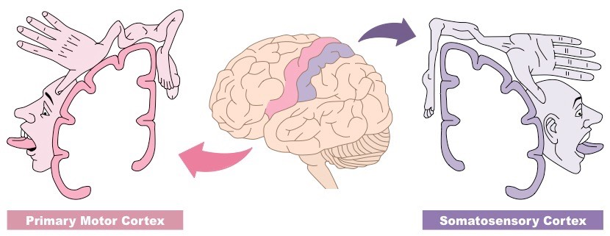
MRI to understand how the brain works
Function is localised to different parts of the brain, allowing us to map specific tasks & sensations
Imaging allows us to account for individual variation e.g. using fMRI for surgical planning to try to avoid/minimise damage

Slide 13
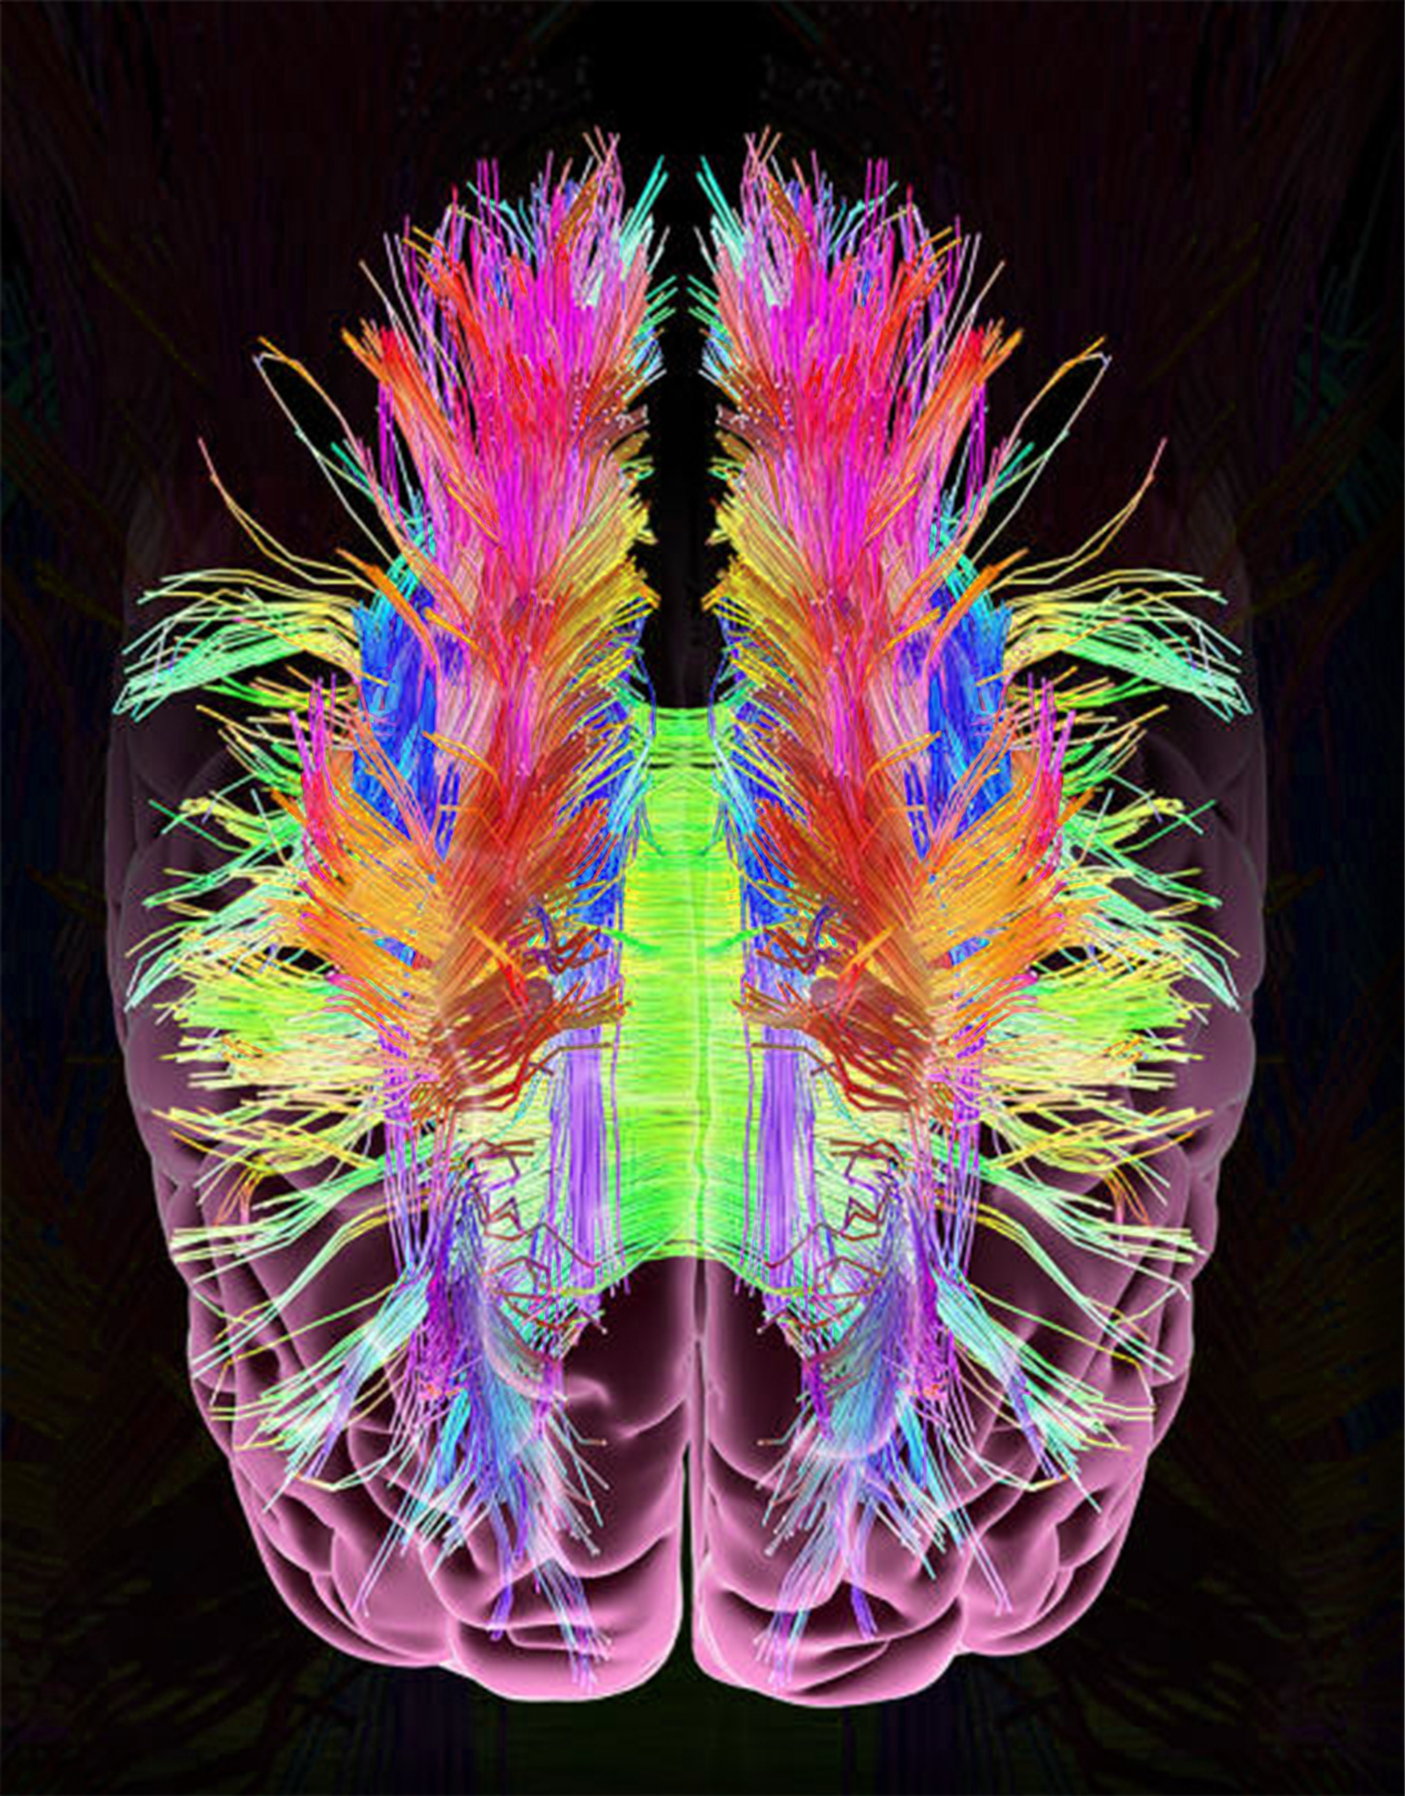
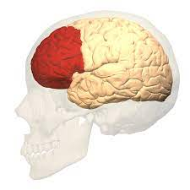
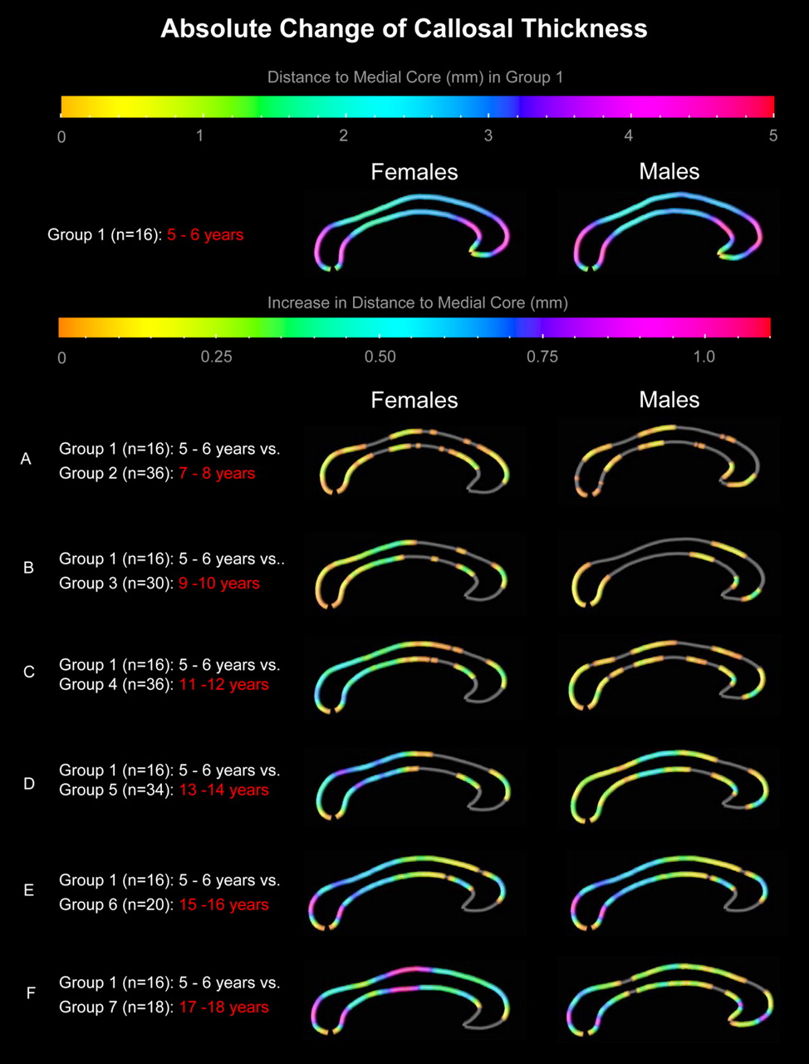
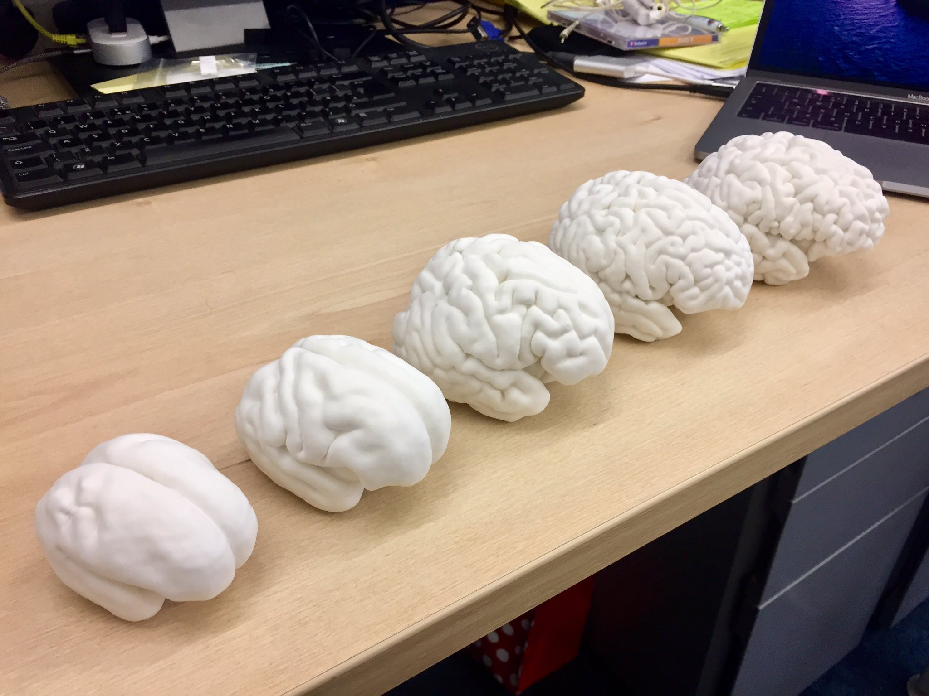
MRI to understand how our brain grows
Not fully developed until age of 25
Prefrontal cortex – integrates information, executive function – is amongst last to develop
Over this period connections in the brain strengthen (myelination)
3D printed brains at 26, 30, 34, 38 & 42 weeks

Slide 14
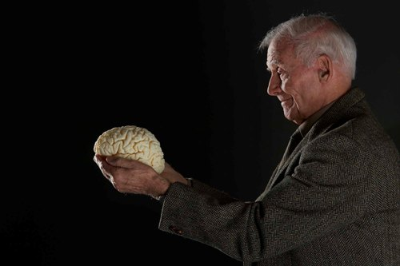
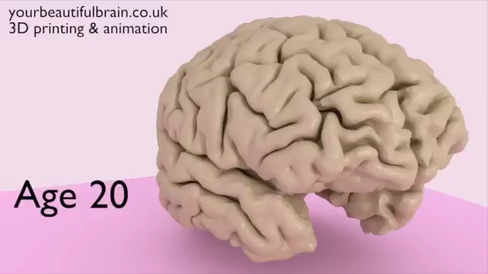
MRI to understand how our brain changes
As we age our brains also change:
  They become noticeably smaller
  Over time damage occurs
Several studies try to understand the factors behind better brain ageing
  Many we can control: eating well, not smoking, exercising, education etc

Slide 15
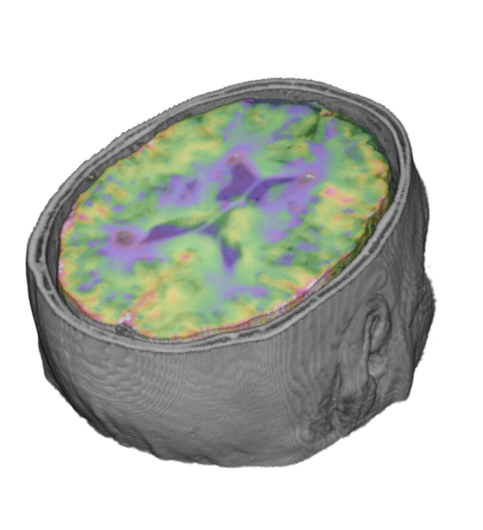
Conclusion
MRI is an incredibly important tool, helping to understand our brain, how it works and changes
Technical and methodological advances have huge potential to improve knowledge of how the brain works
With time this may lead to more accurate diagnosis and help develop better treatments

Slide 16

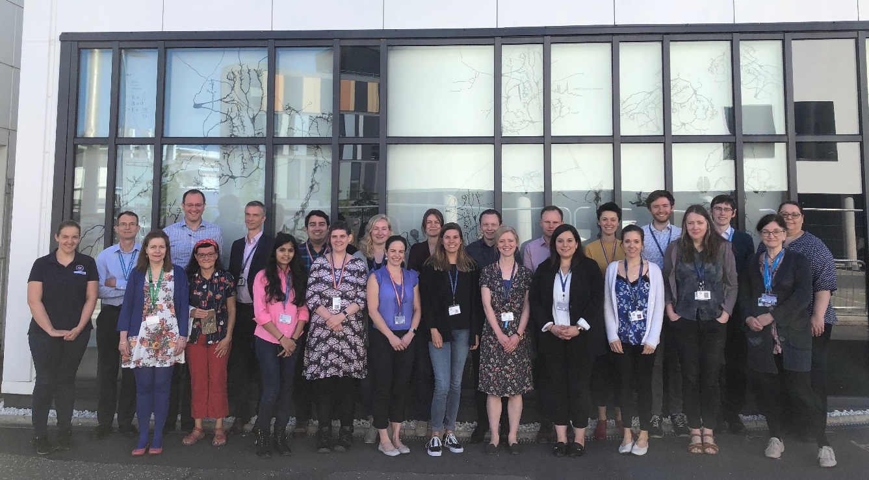
Acknowledgements

