Slide 1

Investigating the effect of plant fertilisers on algal growth
Kate Andrews
Margaret Louis

Slide 2

Life on Earth
5 Food production
c. Fertilisers can leach into fresh water, adding extra, unwanted nitrates. This will increase algal populations which can cause algal blooms. Algal blooms reduce light levels, killing aquatic plants. These dead plants, as well as dead algae, become food for bacteria which increase greatly in number. The bacteria use up large quantities of oxygen, reducing the oxygen availability for other organisms.
Investigate the effect of fertilisers on plant growth.
Investigate the effect of fertiliser concentration on algal growth.

Slide 3
Assignment
The purpose of the assignment is to assess the application of skills of scientific inquiry and related biology knowledge and understanding.
This component allows assessment of skills which cannot be assessed through the question paper; for example, the handling and processing of data gathered as a result of experimental work/fieldwork, and research skills.

Slide 4
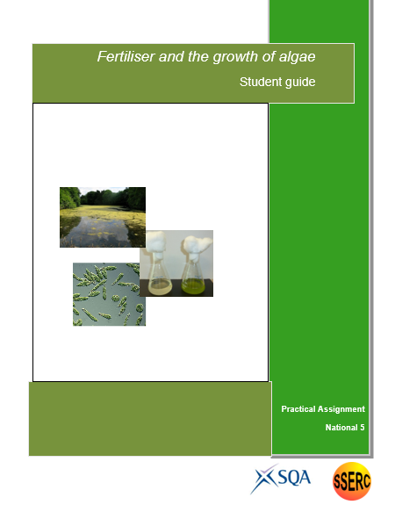
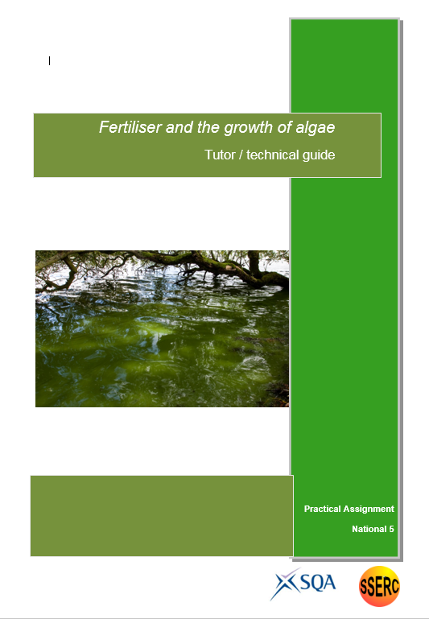

Slide 5
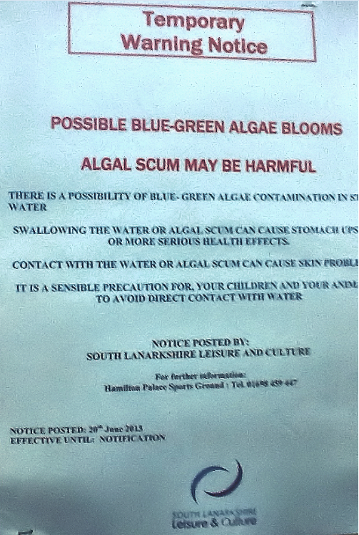
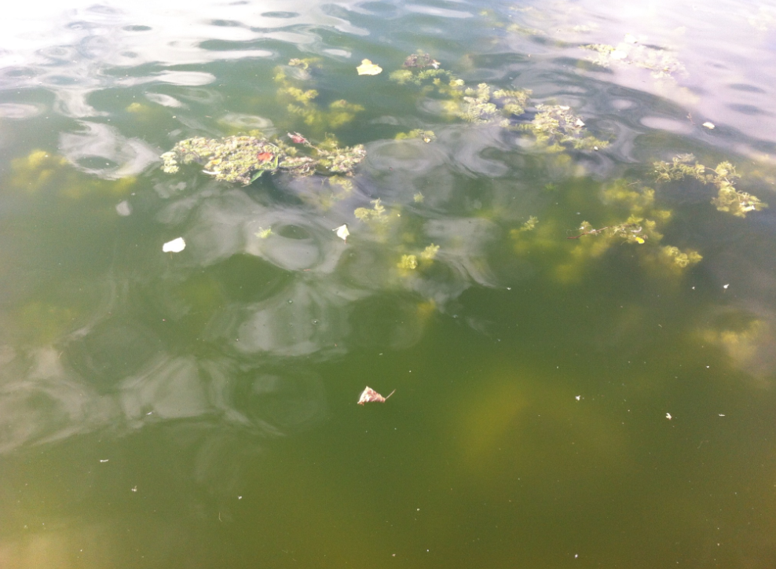

Slide 6
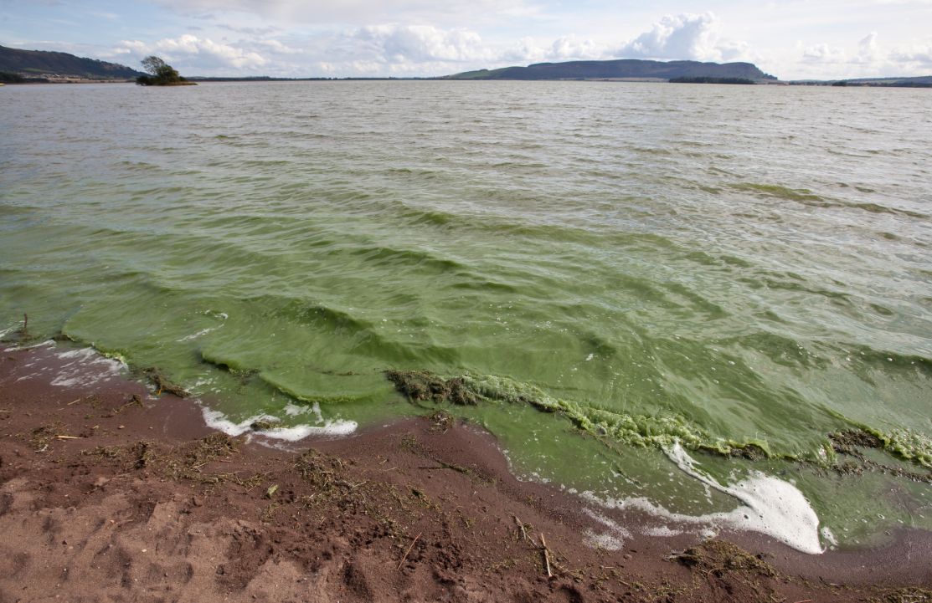

Slide 7

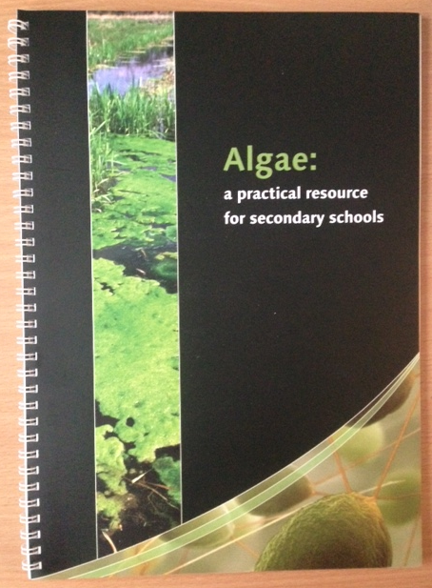
Grow algae for 7 – 10 days in distilled water and in fertiliser
Take colorimeter readings – absorbance at regular intervals

Slide 8
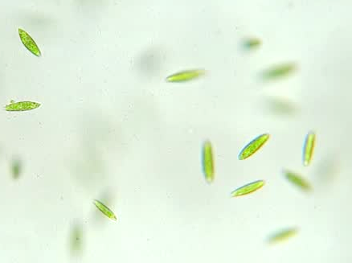
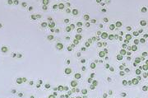
Euglena
- Unicellular freshwater eukaryote algae
Shape variable from long and thin up to 100 μm to
spheres of ~ 20 μm
Motile (2 flagella)
Used extensively as a model organism in the study of cell biology and biochemistry
Chlorella
Unicellular freshwater eukaryote algae
Spherical, non-motile, 2 – 10 μm
Used by Calvin in the study of CO₂ assimilation in plants

Slide 9
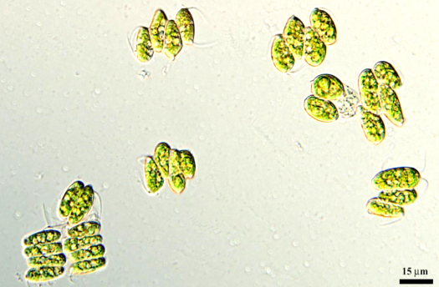
Scenedesmus
- Freshwater eukaryote
Can exist as unicells; also as coenobia of four or eight cells, 11 – 18 μm long
Used by SSERC to make ‘algal balls’ for the study of
photosynthesis and respiration

Slide 10
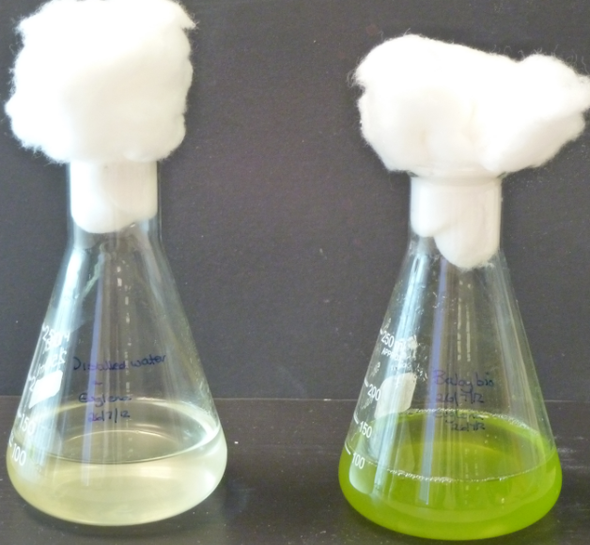
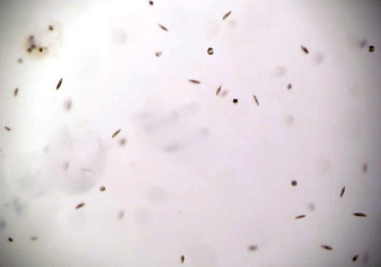
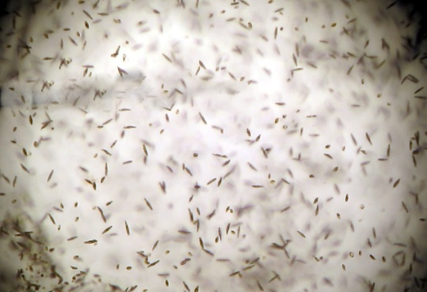
Euglena gracilis

Slide 11
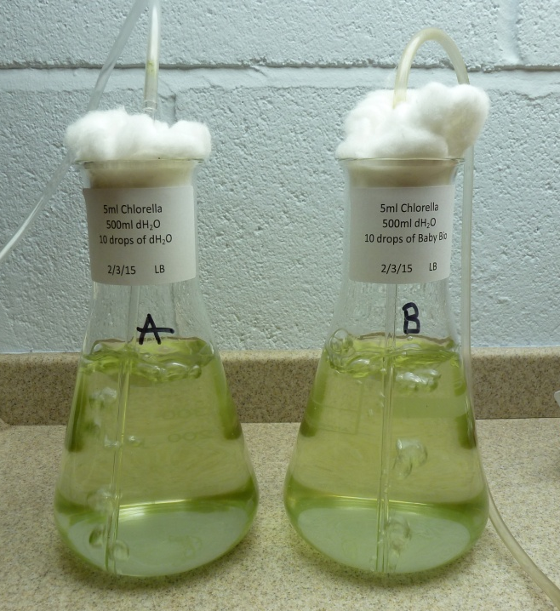
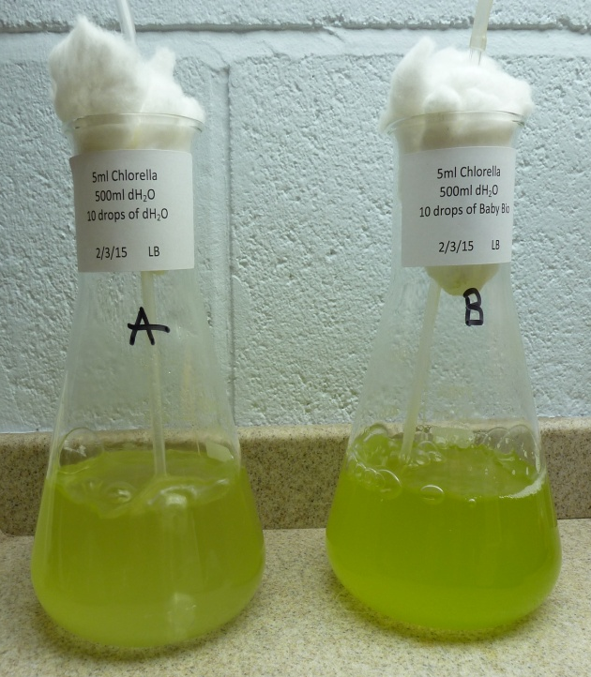
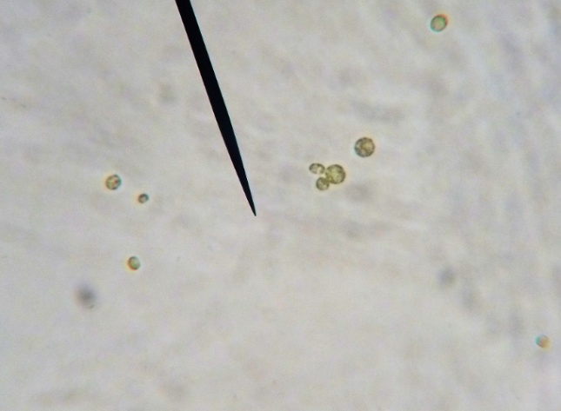
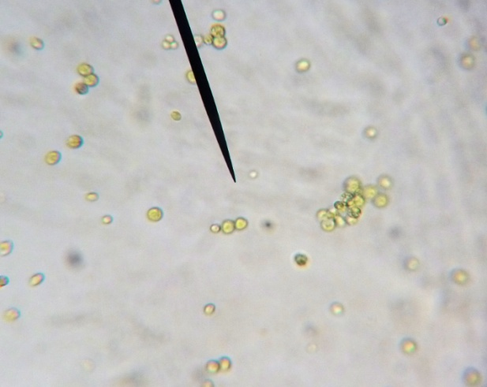
Chlorella
Day 1
Day 11

Slide 12
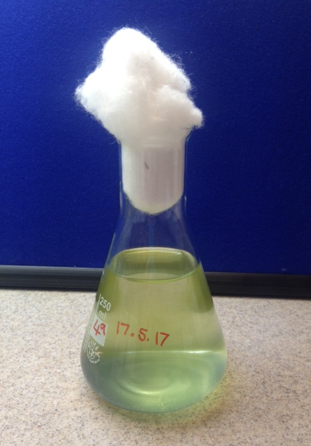
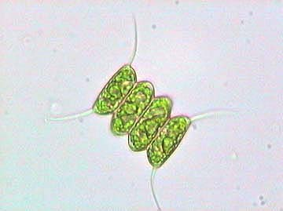
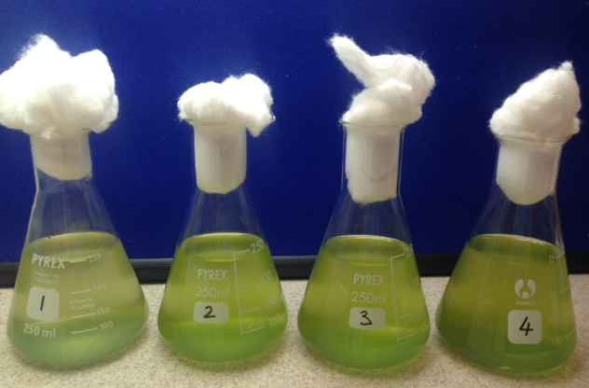
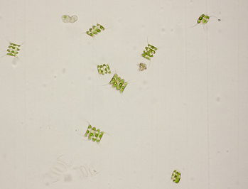
Scenedesmus quadricauda

Slide 13
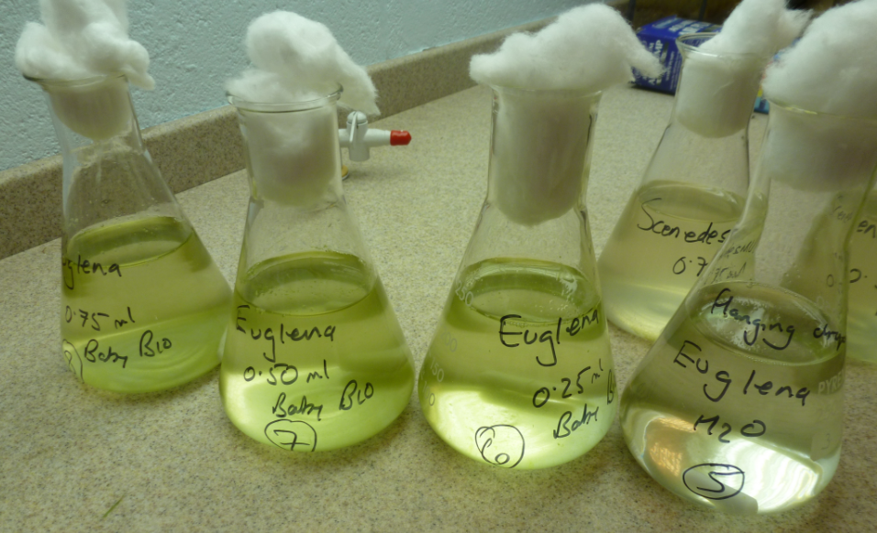
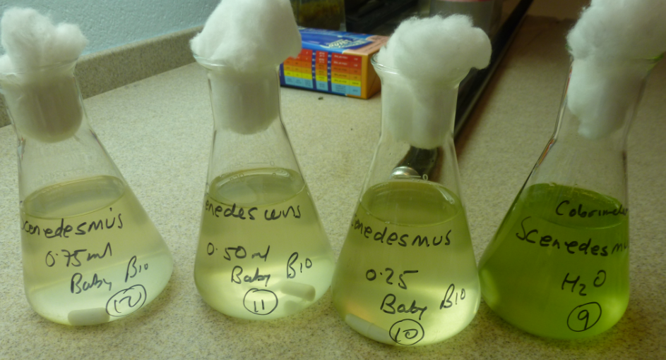
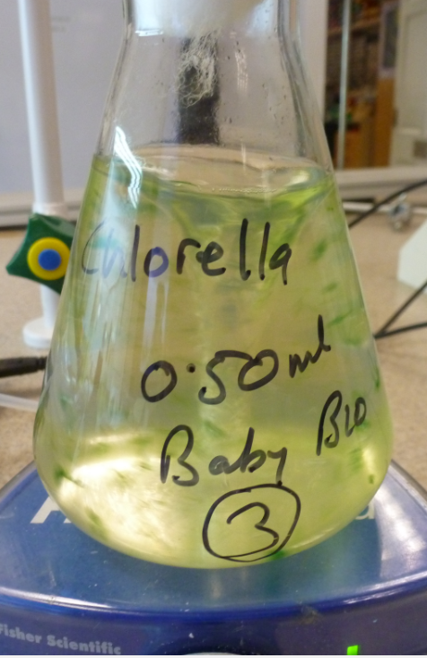
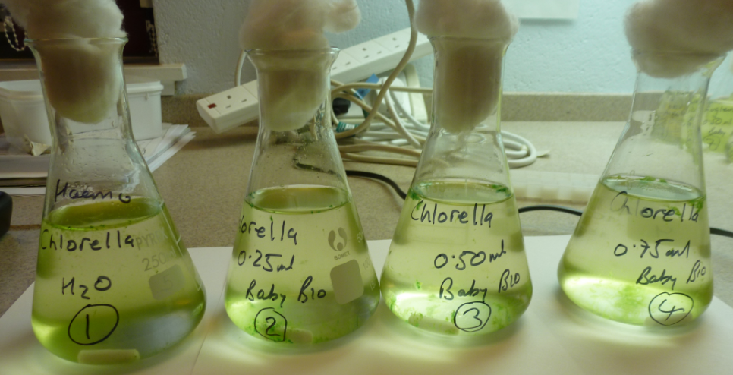

Slide 14
Observing algae
Hanging drop / cavity slide
Counting algae - estimating population size
Direct – count cells using a haemocytometer
Indirect – absorbance using a colorimeter

Slide 15
Basic method
Flasks each containing a culture of algae and different concentrations of liquid plant fertiliser are set up.
Flasks are placed near a light source.
Cultures left to grow for ~ 10 days
Population size estimated at regular intervals by measuring the absorbance of samples of the cultures using a colorimeter.
In this case, absorbance is the extent to which cells in the culture scatter a beam of light of particular wavelength as it passes through the culture.
A ‘control cuvette’ for each is used to zero the colorimeter each time readings are taken.
Control cuvettes are frozen after the first colorimeter readings are taken and thawed out for use when subsequent readings are taken.

Slide 16
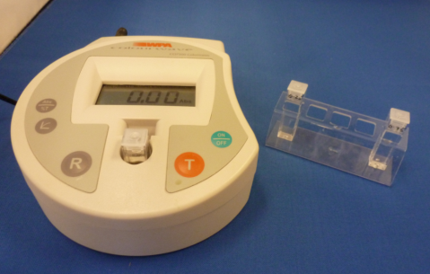
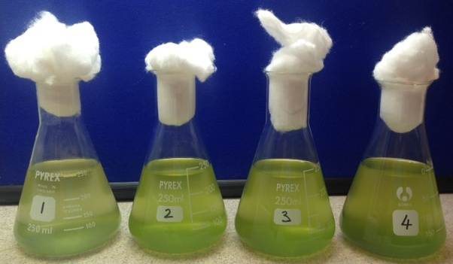
Comparing the algal populations using a colorimeter
Use control cuvette 1 to calibrate the colorimeter for Flask 1 (665 nm).
Gently swirl Flask 1 to mix the contents and, using a clean pipette, transfer 3 cm³ algal suspension into a clean cuvette. Place the pipette in the discard jar.
Place the cuvette in the colorimeter, read and record the absorbance. Empty the cuvette back into Flask 1. Place the used cuvette in the discard jar.
Repeat steps 1 – 4 using control cuvette 2 and Flask 2.
Repeat steps 1 – 4 using control cuvette 3 and Flask 3.
Repeat steps 1 – 4 using control cuvette 4 and Flask 4.
Absorbance 650 nm

Slide 17
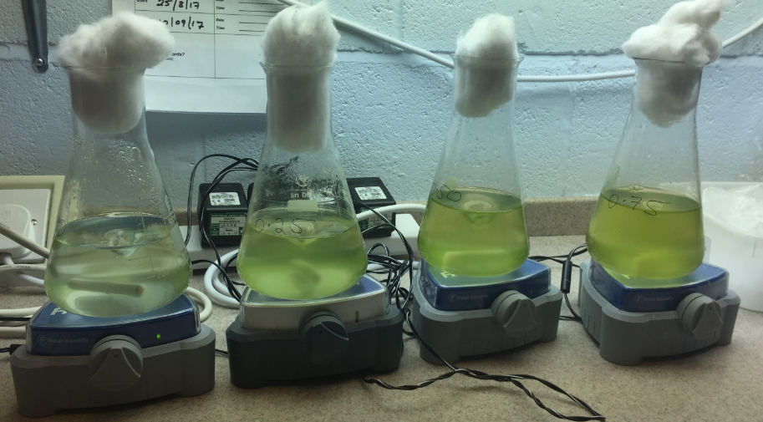
Chlorella – range of concentrations
Day 11

Slide 18
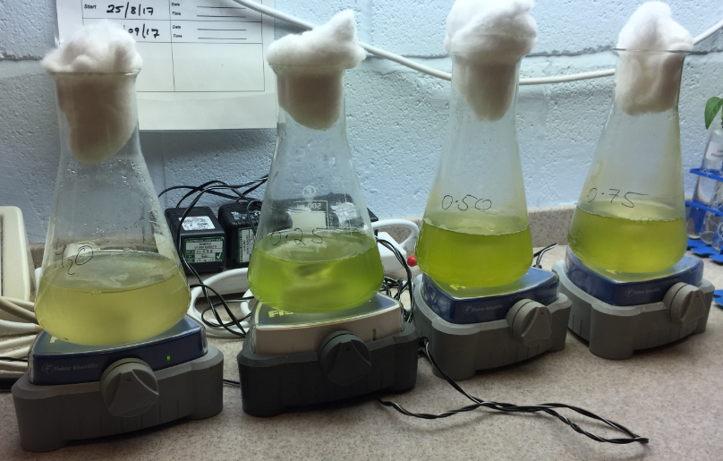
Chlorella – range of concentrations
Day 17

Slide 19
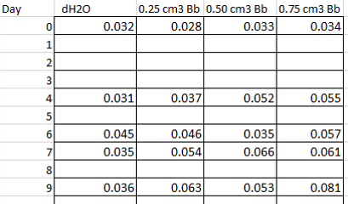
Scenedesmus grown in Baby Bio of varying concentration

Slide 20
Links to data / information
http://www.odec.ca/projects/2013/beso13s/Results.html
http://2014hs.igem.org/Team:UCL_Academy/Algae_Experiments
http://www.chemeurope.com/en/whitepapers/126294/how-physics-discovered-toc.html
http://www.bbc.co.uk/education/guides/ztb2pv4/revision/2
https://www.sciencedaily.com/terms/eutrophication.htm
https://www.sciencedaily.com/terms/algal_bloom.htm

