Slide 1



Digital Microscopy
Kate Andrews
Margaret Louis

Slide 2
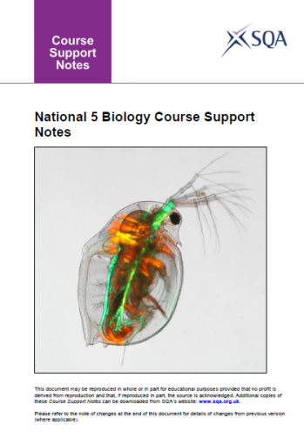
Cell Biology
1 Cell structure
Numeracy activities on cell size to investigate cell length and breadth.
2 Transport across cell membranes
Osmosis is the movement of water molecules from a high water concentration to a lower water concentration through a selectively permeable membrane.
Investigate diffusion and osmosis using visking tubing and/or mass/length of plant tissue, bleeding in plant cells, plant cell plasmolysis, mass changes in egg (shell removed by soaking in vinegar) in syrup/water.

Slide 3
Use the microscope and software to
  Record an image
  Label an image appropriately
  Measure cell size

Slide 4
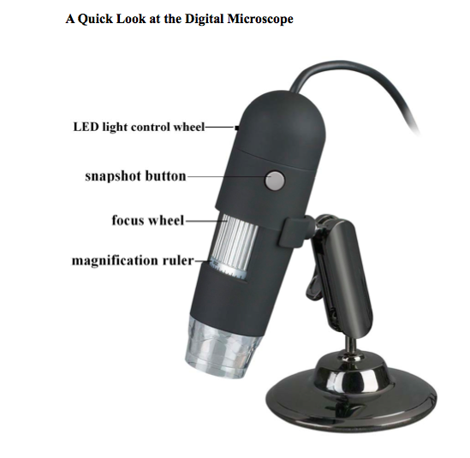

Slide 5
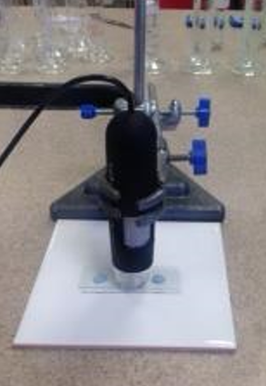

Slide 6
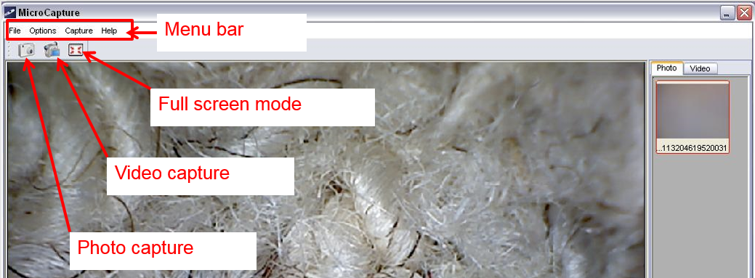

Slide 7
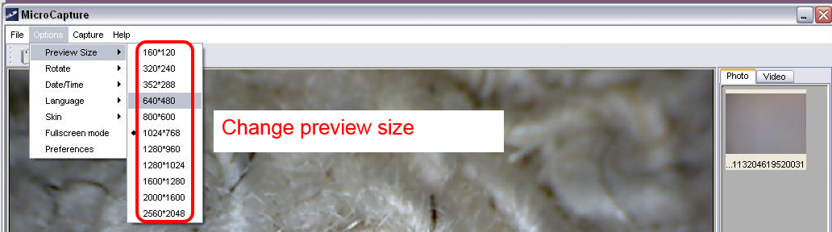

Slide 8
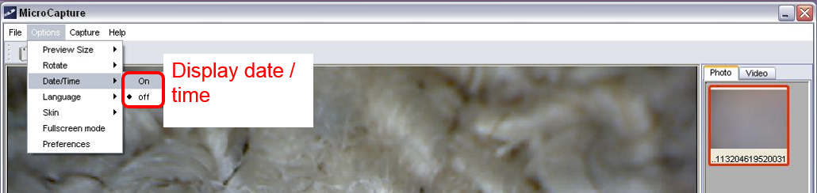

Slide 9
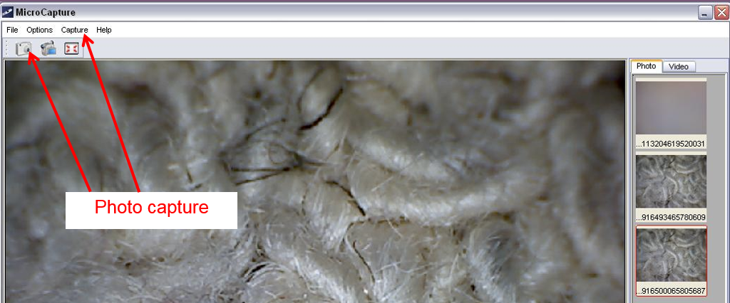

Slide 10
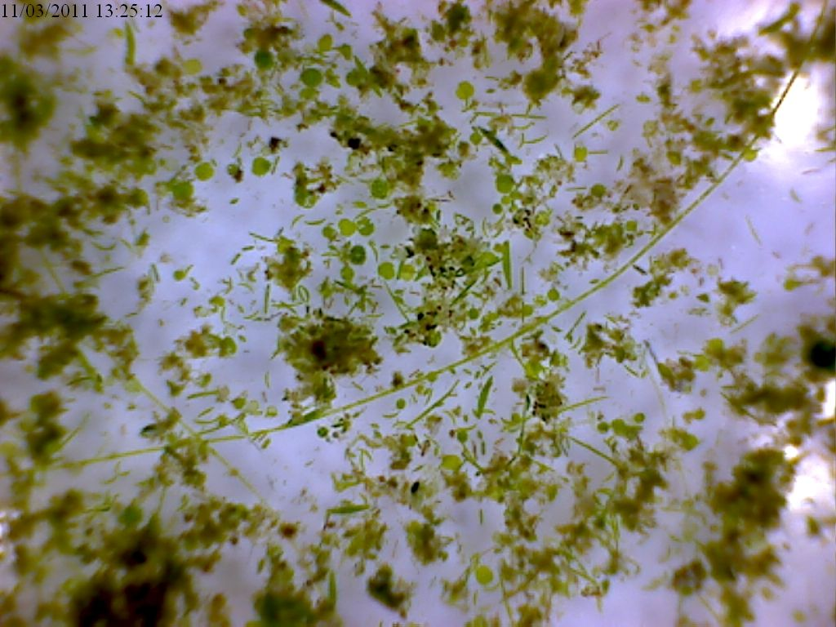
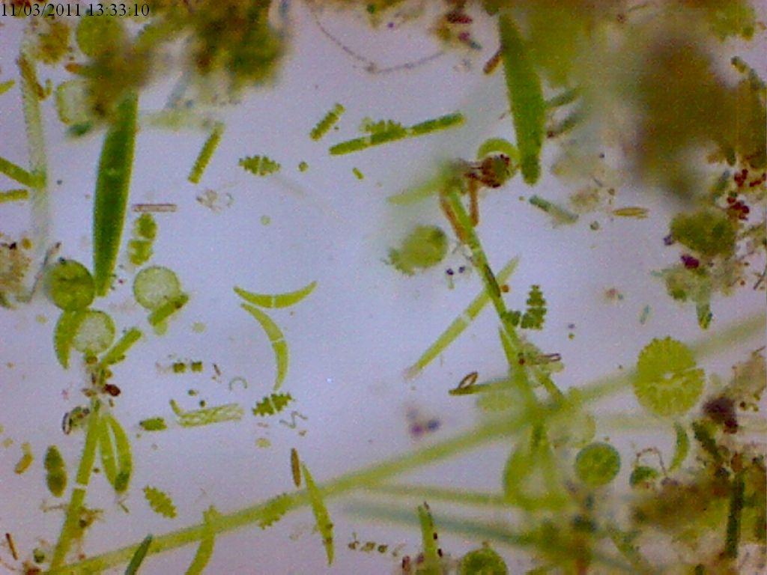

Slide 11
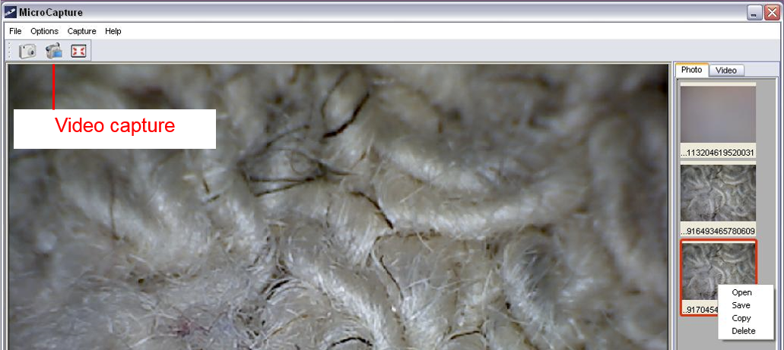

Slide 12
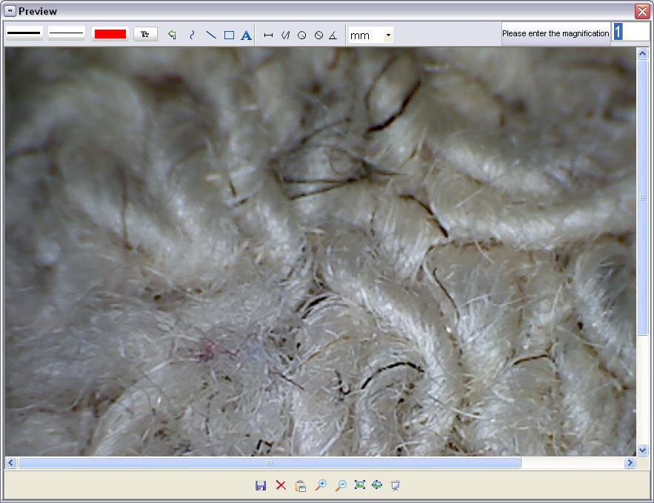
Colour
Format text
Undo
Text
Save

Slide 13
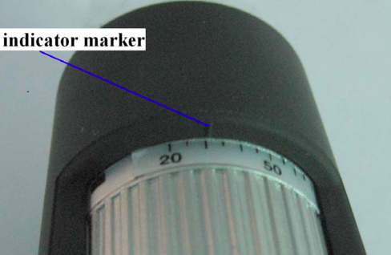

Slide 14
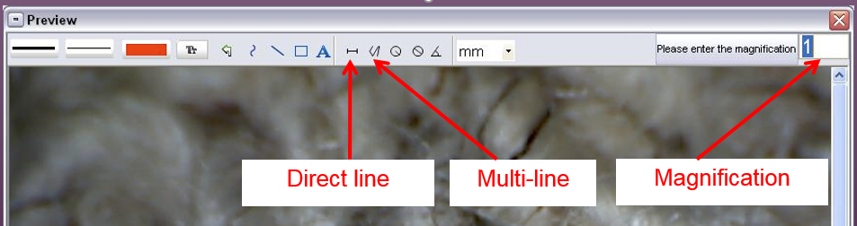

Slide 15
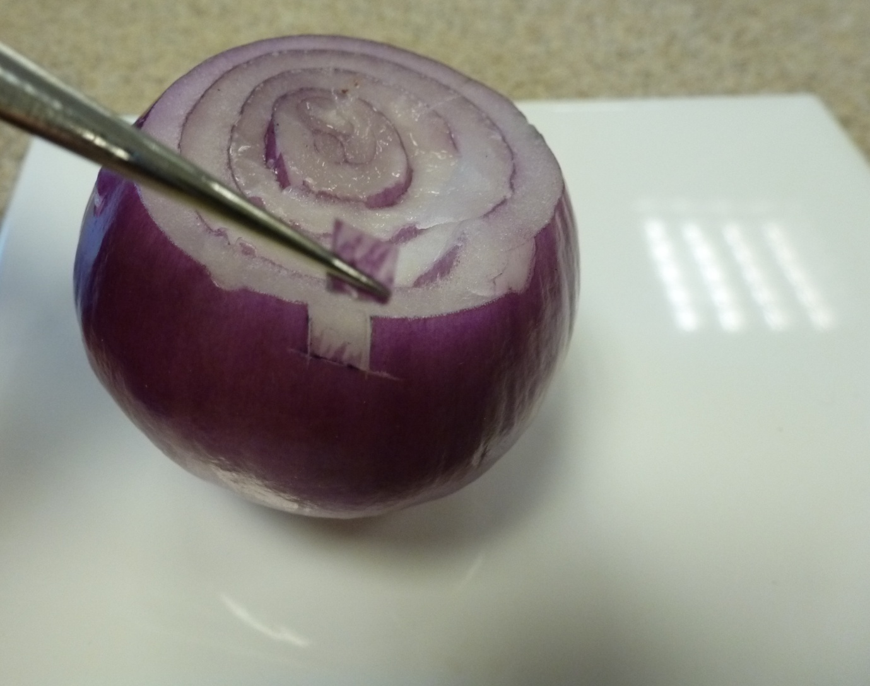

Slide 16
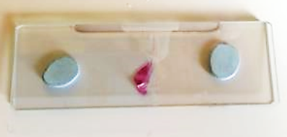
Set up slide
  Red onion peel in water
  Second slide raised on four small pieces of Blu-tack
Set up microscope above onion and focus
Record image

Slide 17
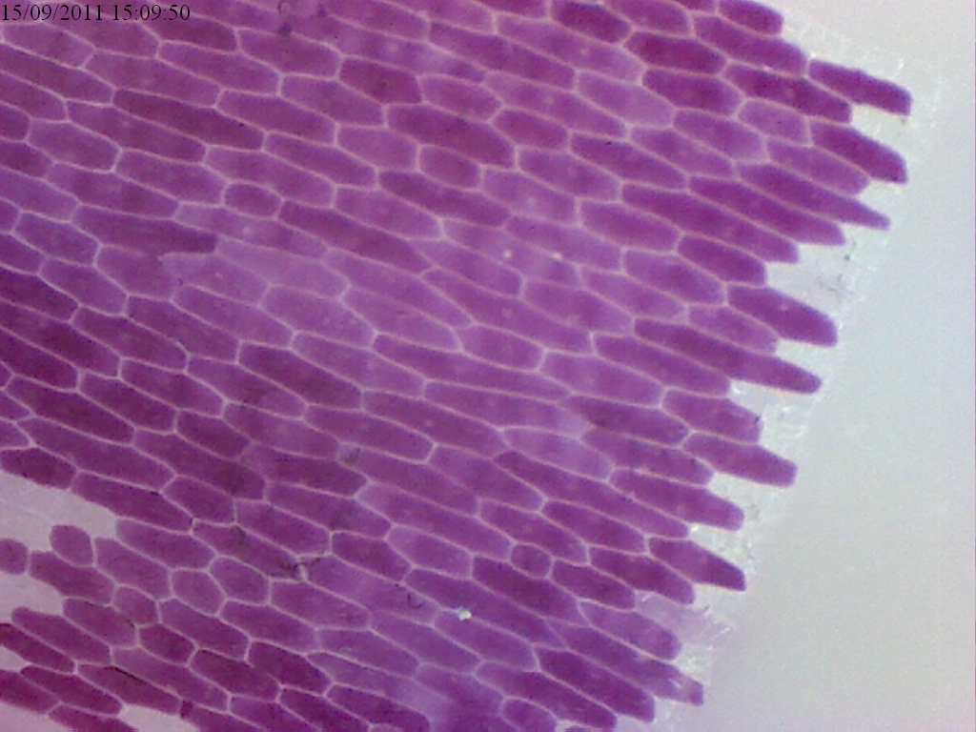

Slide 18
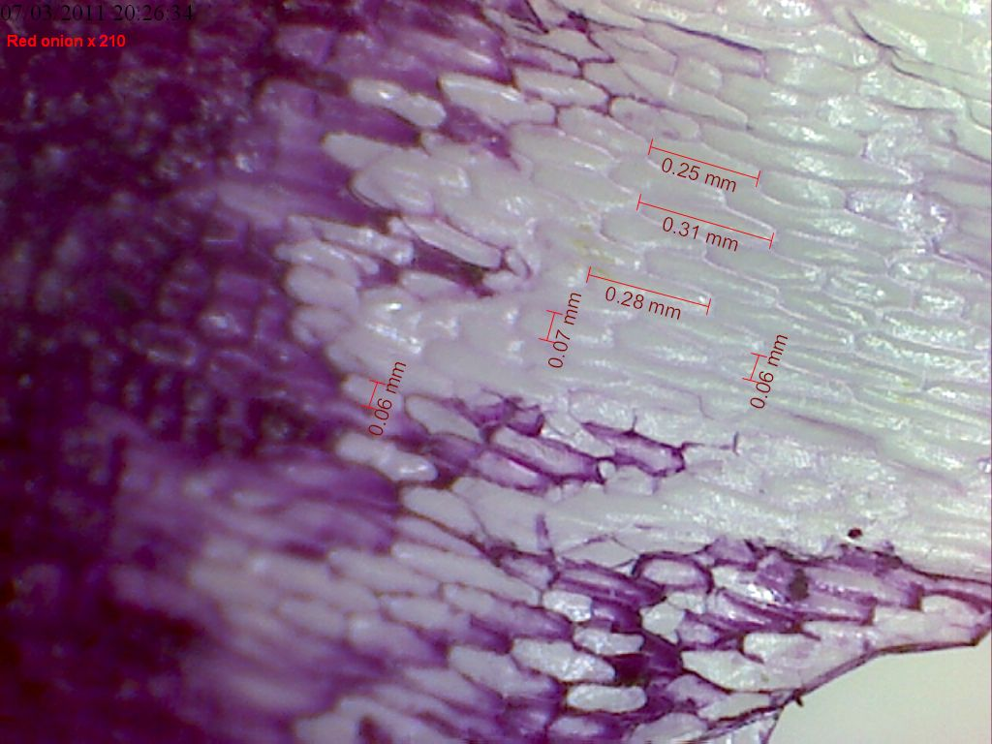
Measure cells

Slide 19
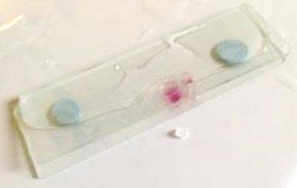
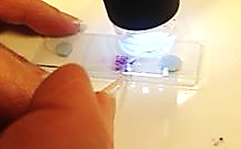
Observing plasmolysis in action
Choose two salt crystals that will fit in between the slides
Using the cocktail stick push one crystal in between each side of the slides and into the water surrounding the onion tissue

Slide 20
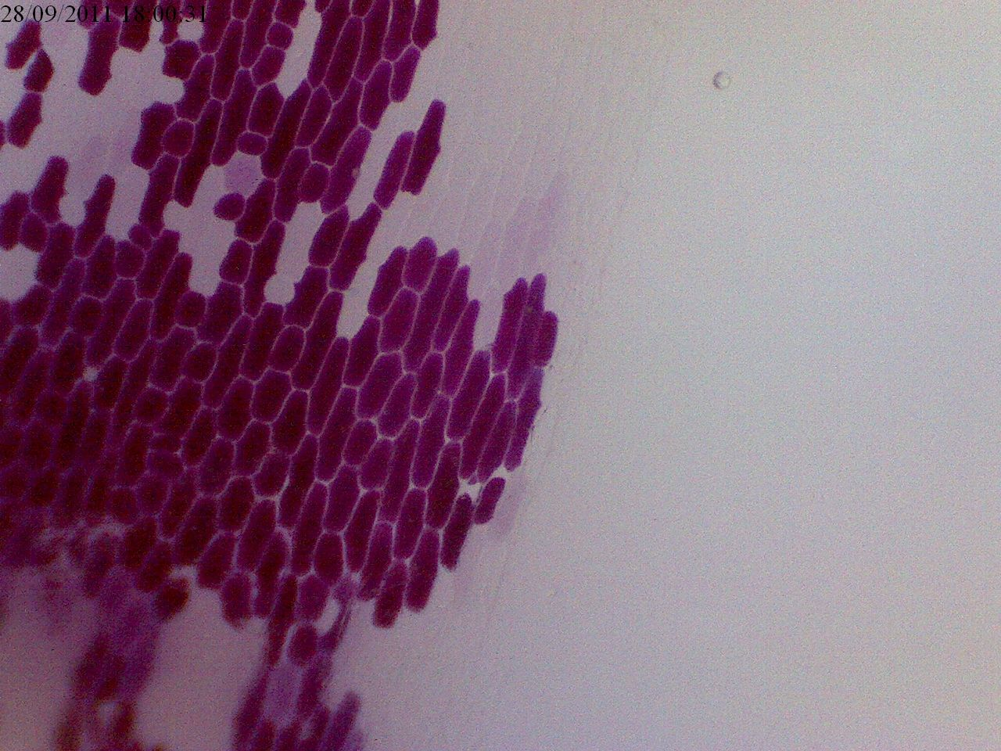

Slide 21
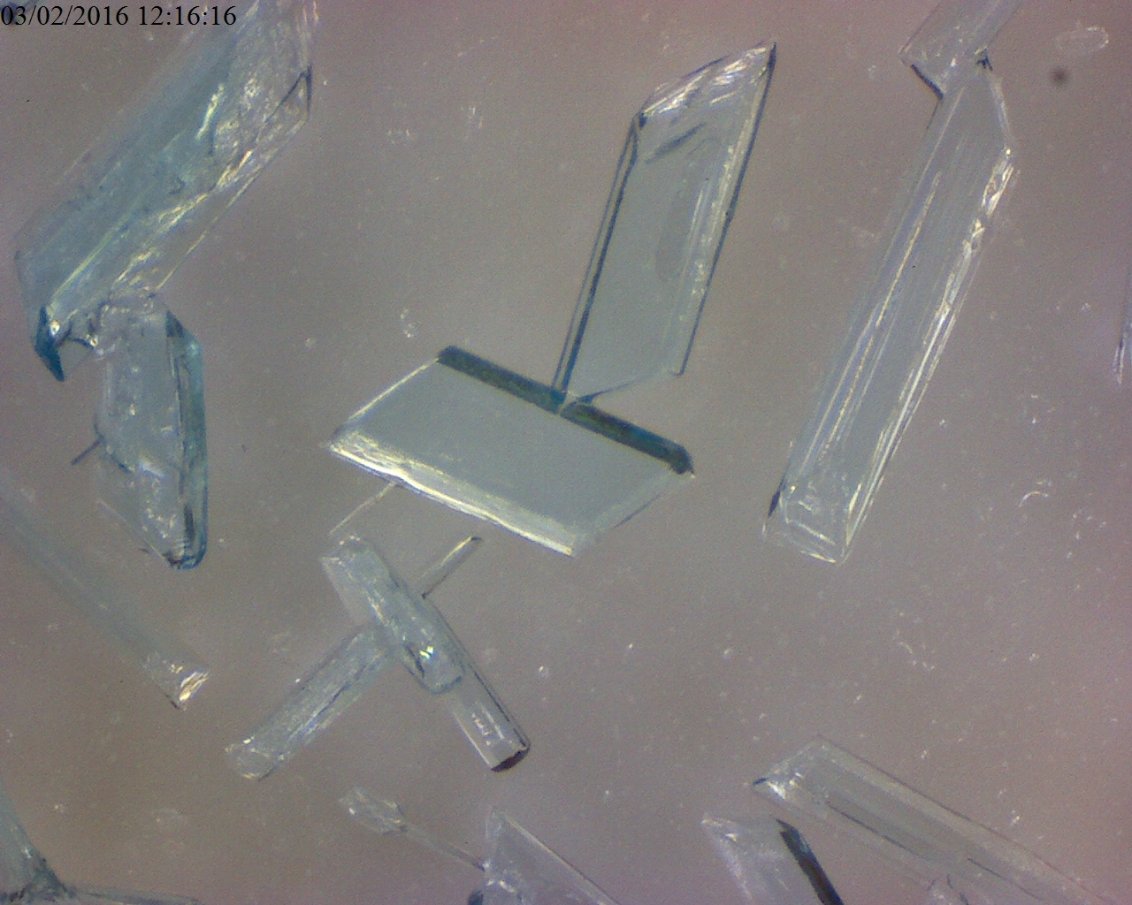

Slide 22
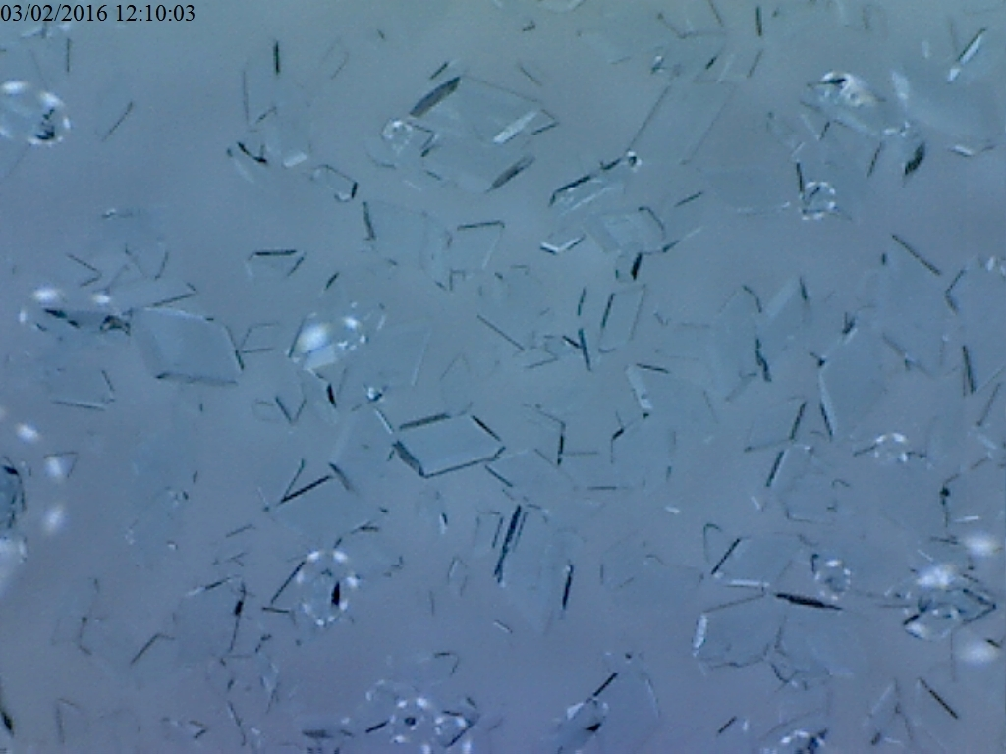

Slide 23
Time lapse

