Slide 1


The Workshop
‘U Gotta Switch’
Links to curriculum for excellence:
Planet Earth - Energy sources and sustainability
Level 3
By investigating renewable energy sources and taking part in practical activities to harness it, I can discuss its benefits and potential problems
SCN 3D2

Slide 2
Welcome to the communities of
Cloudy Island
Skisdale
Surfsville
Sun City

Slide 3
Climate chaos is changing the weather. TV News items report that
It’s getting hotter and wetter
Wind and storm events are happening more often
Flooding is more likely
We get less snow than ever before

Slide 4
In some communities, storms have knocked out power cables several times, causing power-cut chaos.

Slide 5
So….. where does their electricity come from now?
Large National Power Stations

Slide 6
What powers generators in UK power stations?
20 years ago, Oil, Gas and Coal
Now– mostly oil & gas

Slide 7
But . . .
Climate change is a major threat
Burning fossil fuels releases carbon dioxide into the air…..
This adds to global warming by the greenhouse effect
leading to even more storms and floods, crop failure, diseases etc.

Slide 8
The move to ‘Net Zero’
As of 2021, Scotland is aiming to reach Net Zero by 2045.
“Scotland to have ‘carbon neutral islands’ by 2040. . . the new Carbon Neutral Islands project will demonstrate the low carbon energy potential of Scotland’s islands as hubs of innovation in renewable energy
(Energy Live News Sept 2021)

Slide 9
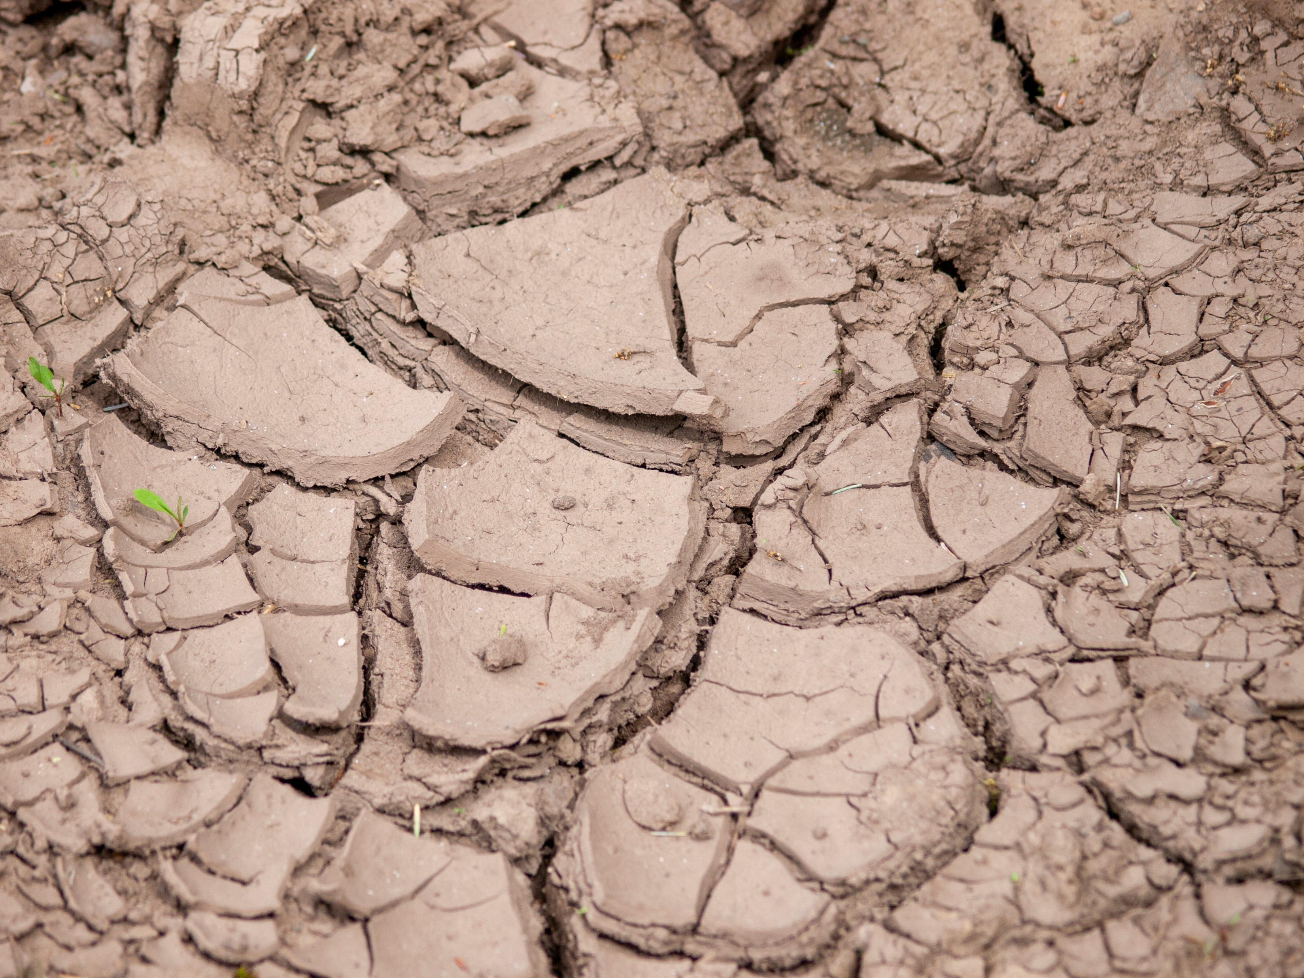
How do we stop the climate ……..
… from going haywire?

Slide 10
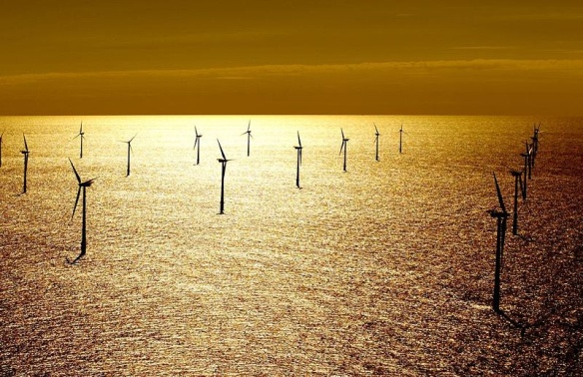
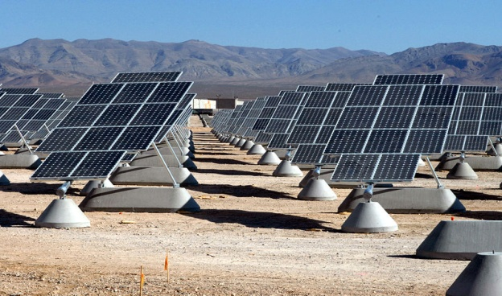
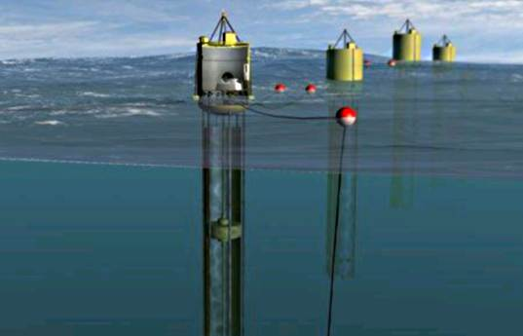
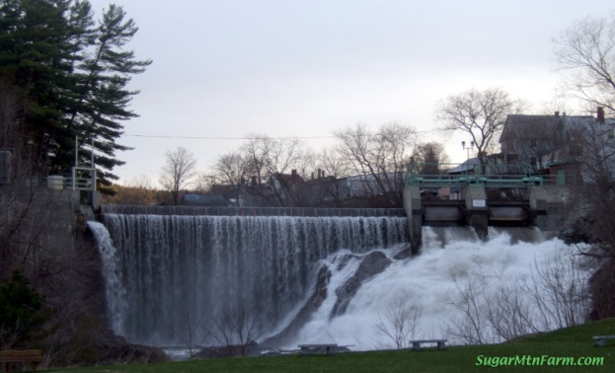
The Government is now focussed on producing electricity more and more renewably.
Wikipedia
Wikipedia
Picture Courtesy of Finavera

Slide 11
How will it be produced?
Wind? Wave? Solar? Hydro?

Slide 12
‘U Gotta Switch’
Concept of the workshop:
The initial scenario is based on issues related to climate change and diminishing fossil fuel supplies.
You are a part of an energy company tasked by the government with finding a suitable way of generating energy.
The workshop activities are in in three stages.
Your Company must:
Given a particular location, carry out studies on using renewable energy to supply the electricity. (costs, where it will be sited, environmental issues etc)
Construct and test models for these forms of renewable energy
Prepare and present your findings to other groups with reasoned explanations for why this choice is the best one for this area - and why others are not.

