Slide 1
Enzyme-controlled reactions
-
The SSERC Team
Notes:
SSERC – shared service of all 32 LAs
Established to support new practical science in schools.

Slide 2
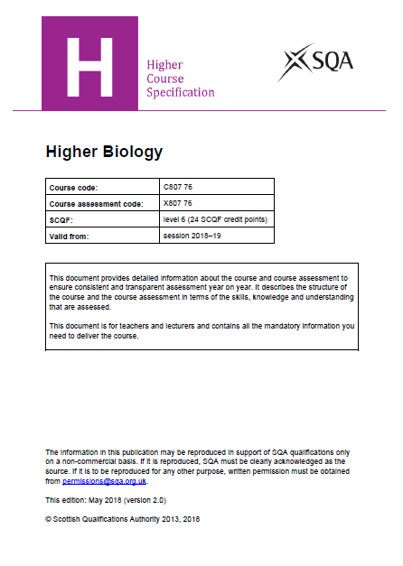
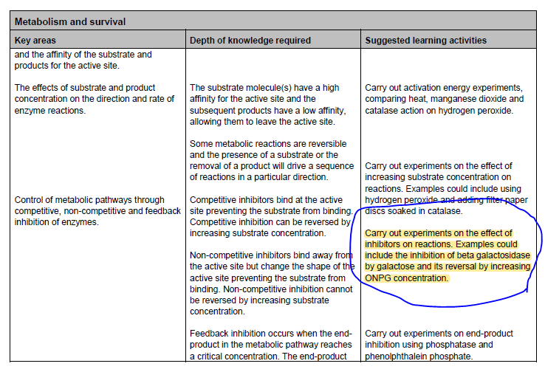

Slide 3
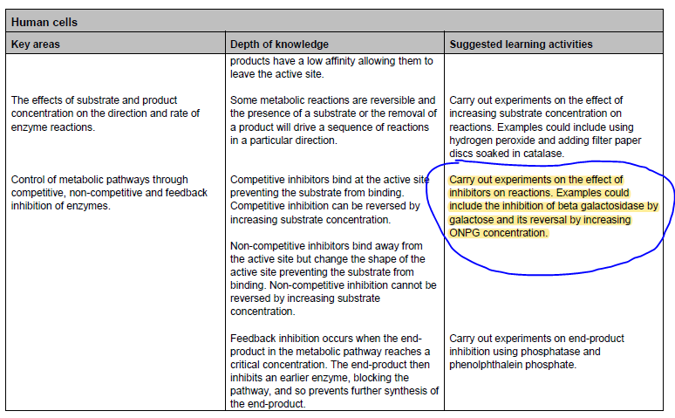
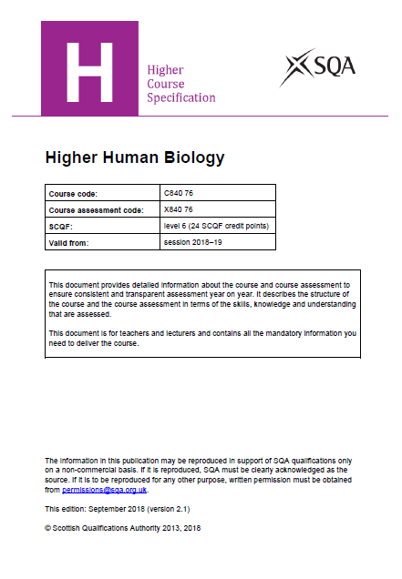

Slide 4
Effect of competitive and non–competitive inhibitors on β‑galactosidase
Paul Beaumont / Kate Andrews /
Margaret Louis

Slide 5
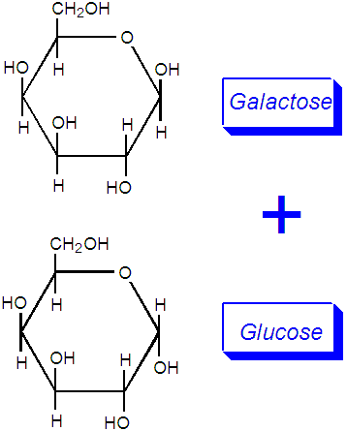
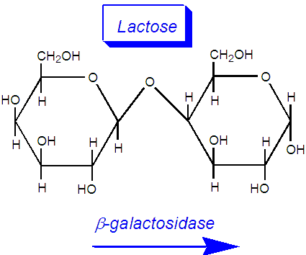
β-galactosidase

Slide 6
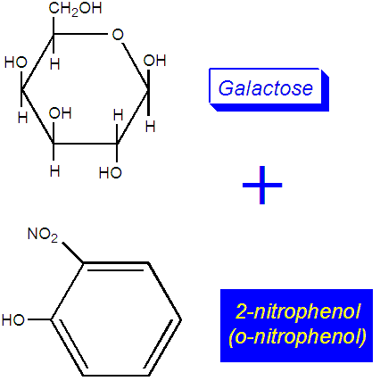
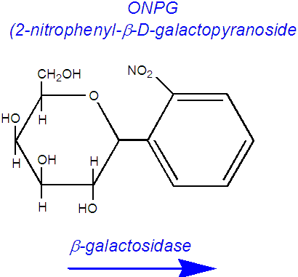
β-galactosidase

Slide 7
Competitive inhibition

Slide 8
Non-competitive inhibition

Slide 9
Effect of [substrate]
Competitive inhibitor:
Increasing [substrate] displaces inhibitor from active site
Non-competitive inhibitor:
Increasing [substrate] has little or no effect on enzyme activity

Slide 10
Method
Carry out reaction:
Without inhibitor at low [S] (ONPG)
In presence of inhibitor
Galactose
Iodine
[I] chosen to inhibit reaction and look at the effect of increasing [S]

Slide 11
Method (steps 1-5)
Dilute β-galactosidase (enzyme)
Dilute stock ONPG (substrate)
Mix buffer and diluted ONPG in test tube, zero colorimeter
Add diluted enzyme to test tube
Read absorbance (blue diode) after two minutes

Slide 12
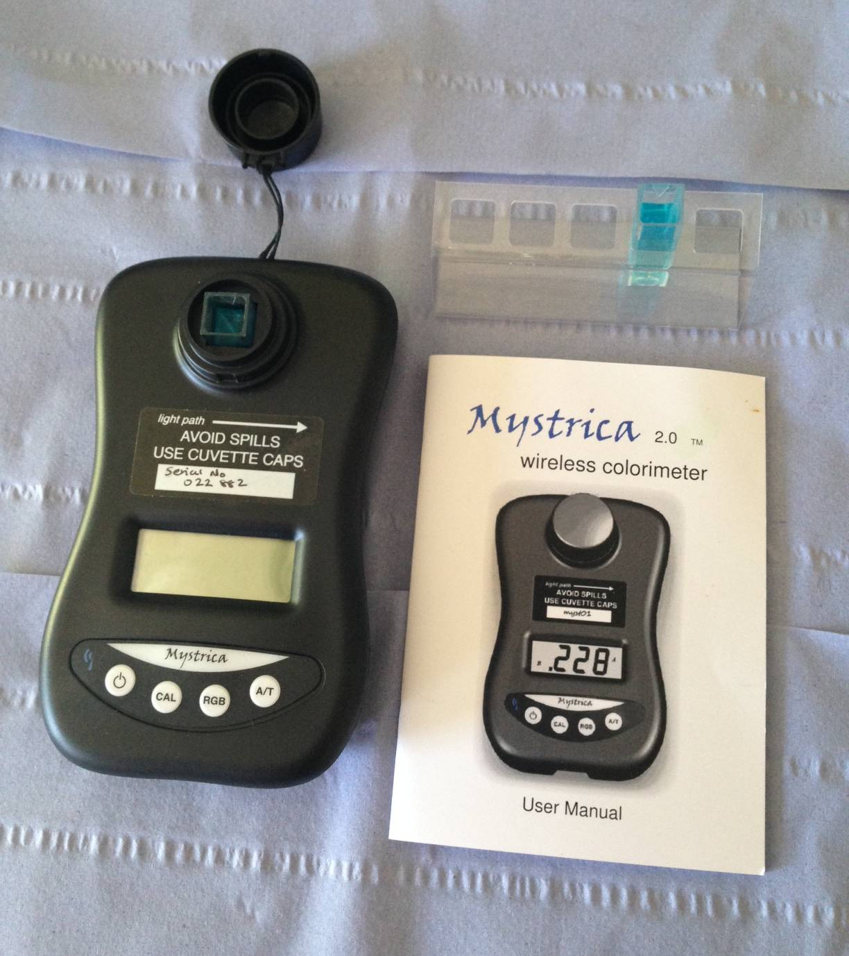
Set to blue diode (toggle RGB button)
Cuvette from step 3 of protocol as blank
Calibrate (CAL) colorimeter
Measure & record absorbance after 2 min(step 5)
Direction of beam

Slide 13
I = Galactose (steps 6-7)
Prepare test tubes
Each tube contains 2 cm³ galactose (I)
Tubes 1 – 6 contain increasing [S]
Mix buffer, galactose and substrate
Cuvette in colorimeter – zero
Return solution to test tube
Add 0.5 cm³ diluted enzyme, start timer & mix, read in colorimeter after 2 min

Slide 14
Test tube Nº | Galactose (20%) in buffer (cm³) | ONPG stock (cm³) | Buffer (cm³) | Absorbance | [ONPG] in cuvette
1 | 2 | 0.1 | 0.9 |  | 8.0 x 10⁻⁴
2 | 2 | 0.25 | 0.75 |  | 2.0 x 10⁻³
3 | 2 | 0.5 | 0.5 |  | 4.0 x 10⁻³
4 | 2 | 0.75 | 0.25 |  | 6.0 x 10⁻³
5 | 2 | 1.0 | 0.0 |  | 8.0 x 10⁻³

Slide 15
I = Iodine (steps 8-9)
Prepare test tubes
Each tube contains 1 cm³ iodine/KI (I)
Tubes 1 – 4 contain increasing [S]
Mix buffer, galactose and substrate
Cuvette in colorimeter – zero
Return solution to test tube
Add 0.5 cm³ diluted enzyme, start timer & mix, read in colorimeter after 2 min

Slide 16
Test tube Nº | I₂/KI (cm³) | ONPG stock (cm³) | Buffer (cm³) | Absorbance | [ONPG] in cuvette
1 | 1 | 0.25 | 1.75 |  | 2.3 x 10⁻³
2 | 1 | 0.5 | 1.50 |  | 4.7 x 10⁻³
3 | 1 | 0.75 | 1.25 |  | 7.0 x 10⁻³
4 | 1 | 1.0 | 1.0 |  | 9.3 x 10⁻³

