Slide 1
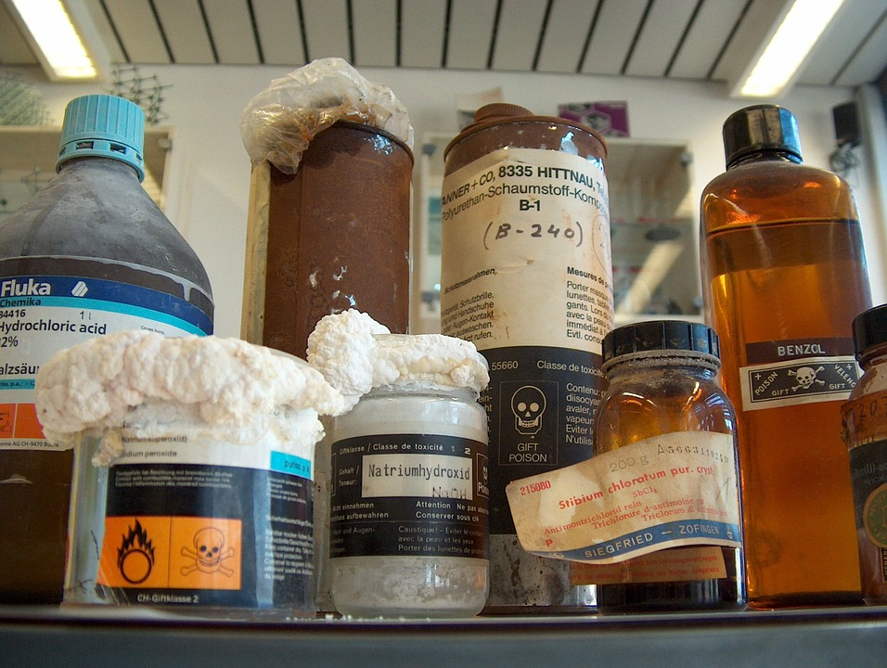
Disposing of Chemicals

Slide 2
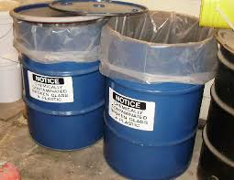
What to dispose of?
Past Safe Shelf Life
Past Shelf life
Excess stock
Waste from experiments
Notes:
Substances, such as potassium, that become hazardous on storing should be disposed of after a certain amount of time – their safe shelf life – SSERC has a list
Some other substances, such as hydrogen peroxide, simply stop being any use after a while. They have a Shelf Life – SSERC has a list of these too.
Excess stock shouldn’t really be an issue if proper control of the purchasing has been happening but there are occasions – new technician moving in after a ‘hoarder’, moving to a new building with smaller storage space, having a clearout of things bought in of AH projects and not used for years.

Slide 3
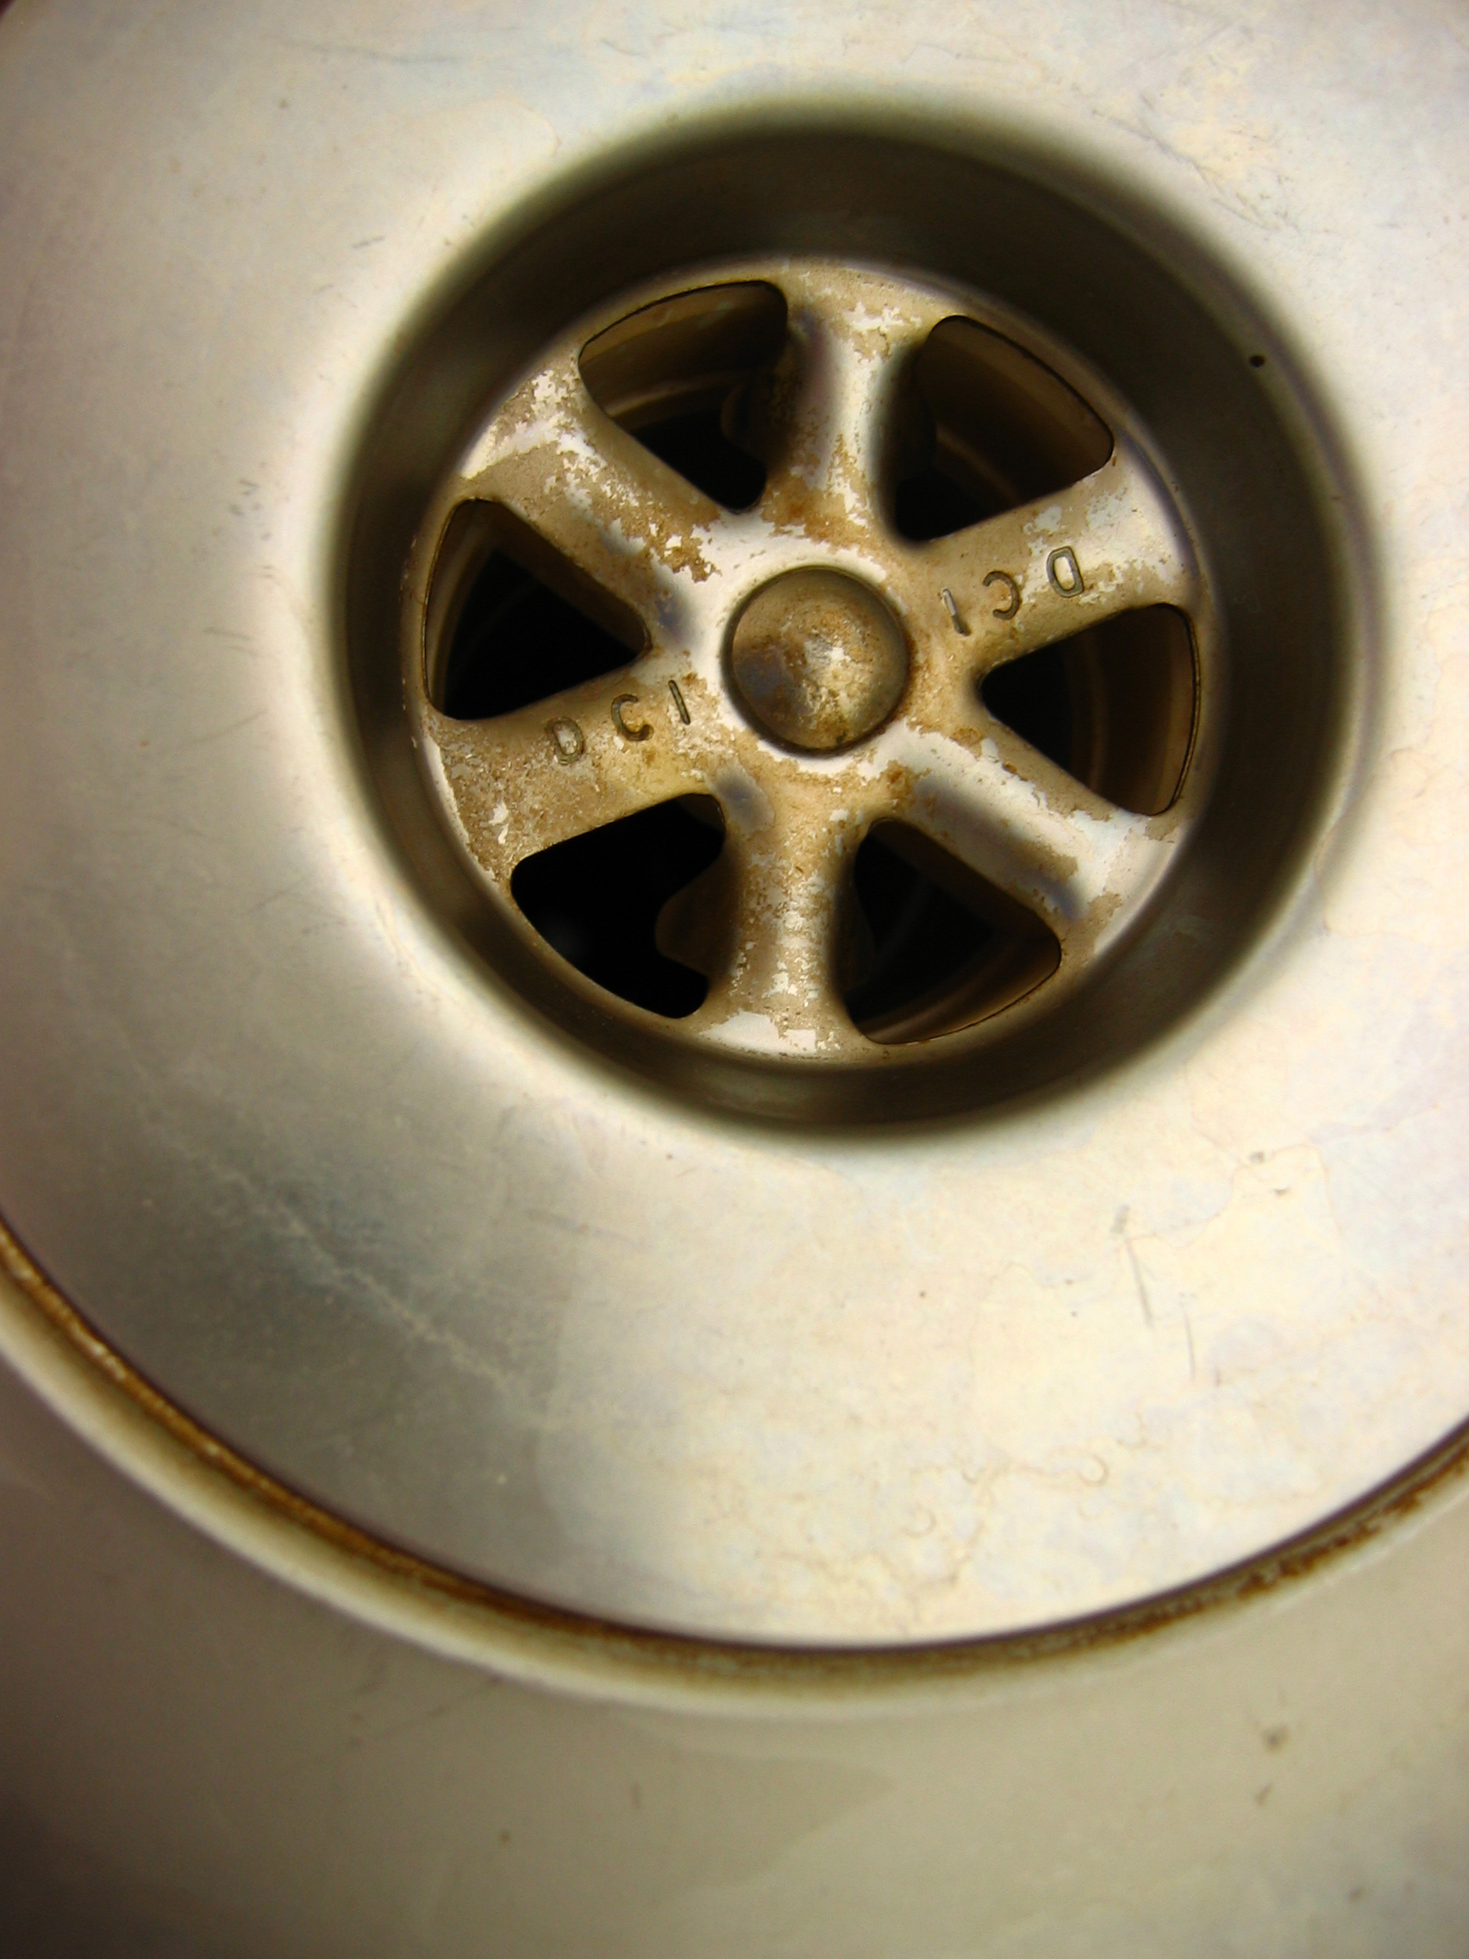
Down the sink
Many chemicals can be washed to waste.
Some need to be treated first
‘washings’ from glassware are fine, no matter what.
Notes:
Washing to waste involves diluting greatly with water and then washing down the sink with the cold tap running to dilute it further.
Some will need to be treated first – for instance, acids and alkalis should be neutralised.

Slide 4
Organic Waste
Where possible, use substances that can simply be washed to waste
If not possible, reduce the quantities if you can
Mixed waste bottles are not a good idea, particularly in a classroom.
Notes:
Replacing substances with ones that are easier to dispose of is a good idea from everyone’s point of view. For instance, caffeine is commonly isolated using dichloromethane. It can, however, he isolated using propan-1-ol or ethyl ethanoate – both of which can simply be diluted and run to waste.
Reducing quantities is always a good idea – try a microscale approach.
Waste bottles are generally not a good idea. There is always the risk of something inappropriate being added. This is even more likely in a classroom. (Storage of organic waste in a classroom is in breach of COSHH anyway.

Slide 5
Waste bottles
SSERC don’t like them
Possible mixing of incompatibles
Needs a good record of contents.
Especially not in classrooms
Notes:
Best to keep segregated where possible.
That said, a single bottle for saturated hydrocarbons (hexane, octane, decane etc) is fine, likewise, halogenated hydrocarbons.

Slide 6
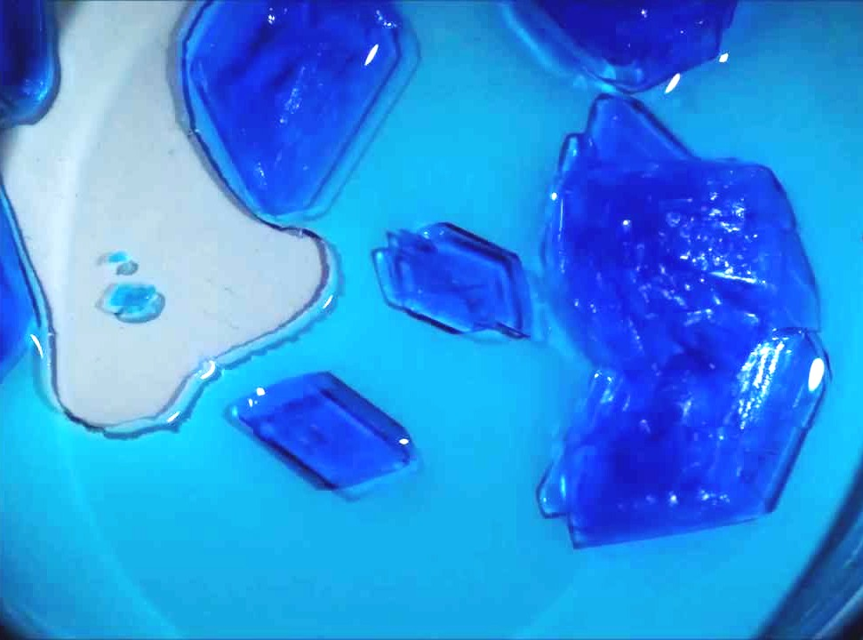
Inorganic waste
Substitute where possible.
Reduce scale where possible.
Precipitate to reduce volume.
Notes:
If iron or calcium compounds can be used instead of copper then they should be.
Likewise, a microscale (or at least small scale approach can reduce the problem).
When you get your solution back then it is best to precipitate it and filter to give you a much smaller amount to store. Eg, Cobalt chloride can be mixed with sodium carbonate to precipitate cobalt carbonate
Copper likewise – or it can be reacted with steel wool to precipitate metallic copper.

Slide 7
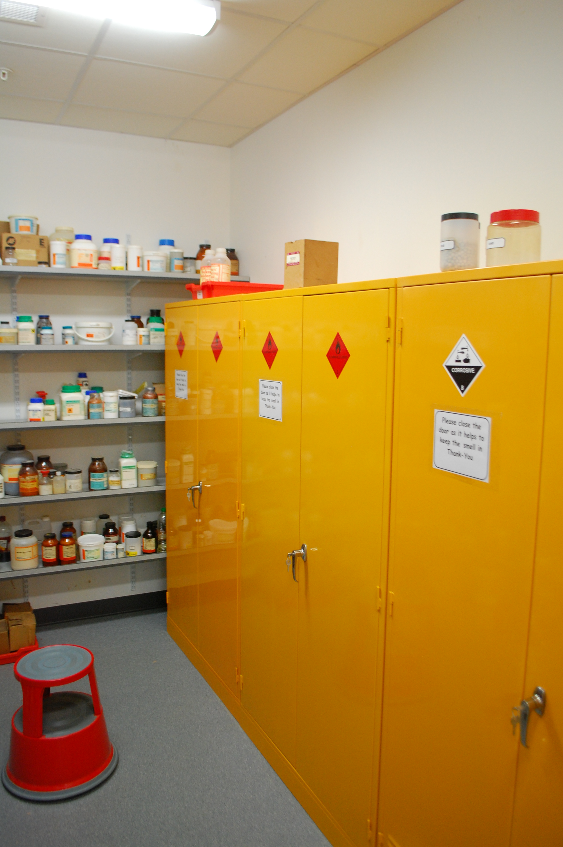
Storing waste
In the chemical store
Solvents in the flammable cabinet
For 12 months – though it is very unlikely any regulator would kick up a fuss if it were kept for longer.
Notes:
Flammables – particularly Class 1 & 2 should be kept in a flame proof metal cabinet – at the furthest end of chemical store away from the door
Alkali metals should be kept in a separate box
Corrosives cabinets tend to corrode (surprise) and are not needed.
No need for a poisons cabinet – can interfere with segregation which is more important
There is no actual problem with cabinets but they tend to take up a lot of room.

