Slide 1


National 5 Assignment:
SSERC support

Slide 2
Health and Safety Advisory Service
Guidance / advice on experiments and investigations
Publications
Online resources

Slide 3
CPD@SSERC
Technical Staff
Curriculum Leaders
Primary & Secondary
Teachers
Student
Teachers

Slide 4
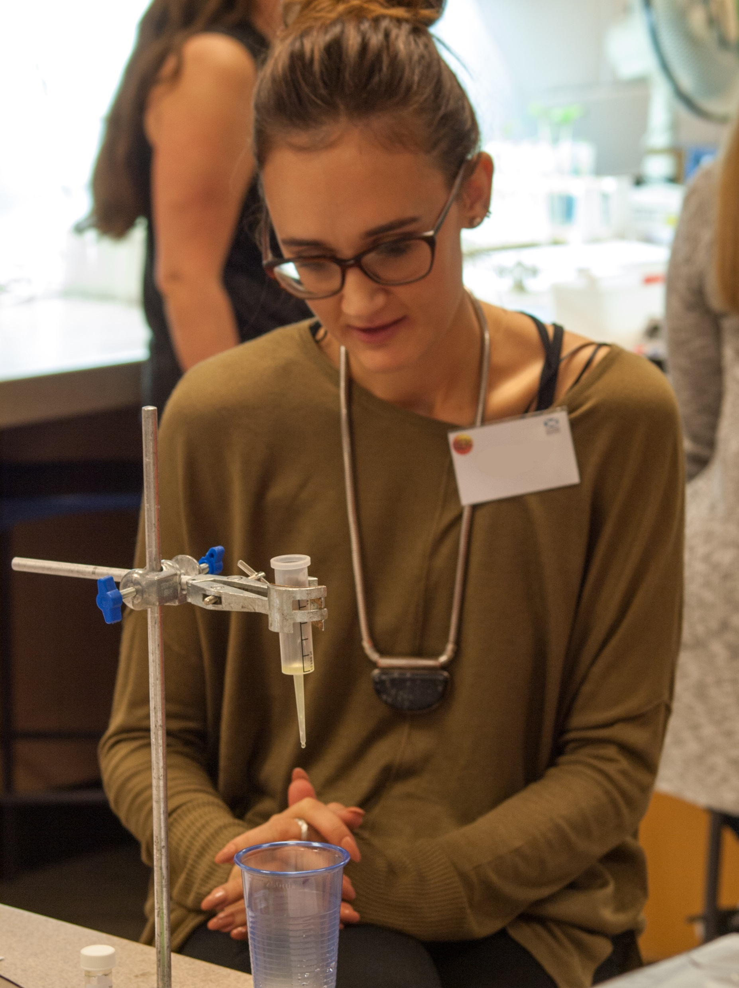
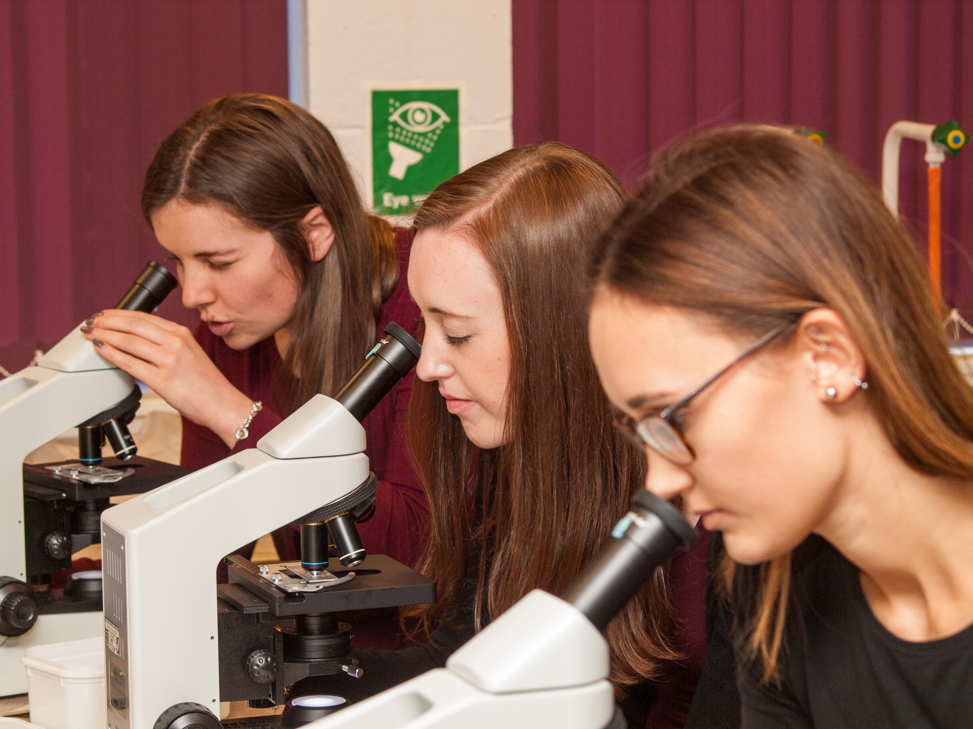
CPD Opportunities:
Practical workshops
Residential Courses
Summer Schools
Health and Safety Training
On-line ‘SSERC meets’

Slide 5
2017/2018 - practical / experimental / fieldwork - mandatory feature
SSERC commissioned - 2 Resource Packs
These exemplars not mandatory

Slide 6
Investigating limiting factors in photosynthesis
Investigating the effect of plant fertilisers on algal growth

Slide 7
Each consists of 3 elements:
Teacher / Technician Guide
Student Guide
Generic risk assessment
  Teacher / Technician Guide - links to information / data sets - may be provided to students

Slide 8
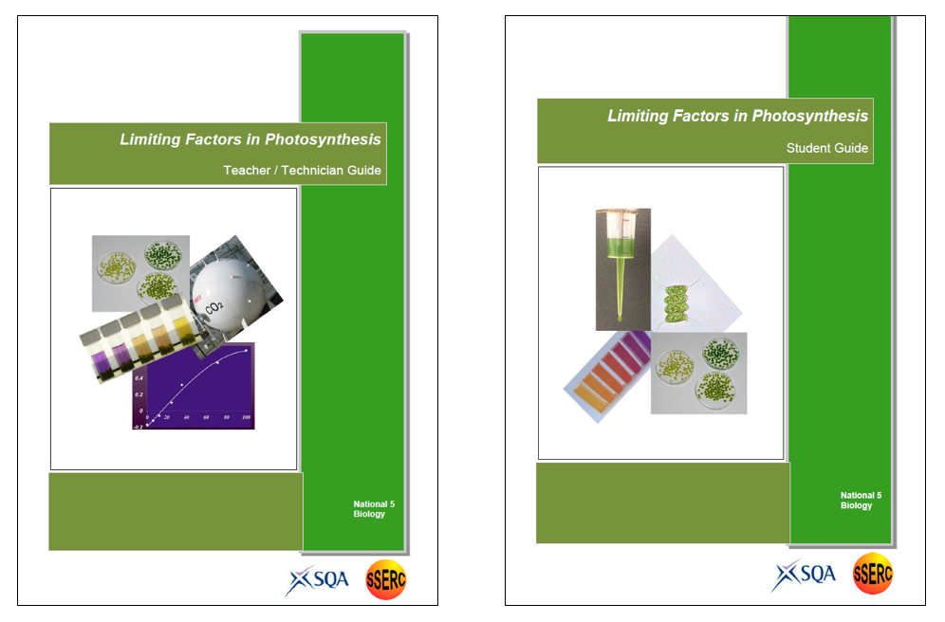

Slide 9

  Photosynthesis
  -
  Debbie Eldridge
  School Sci. Rev. (2004), 85, 37-45.

Slide 10
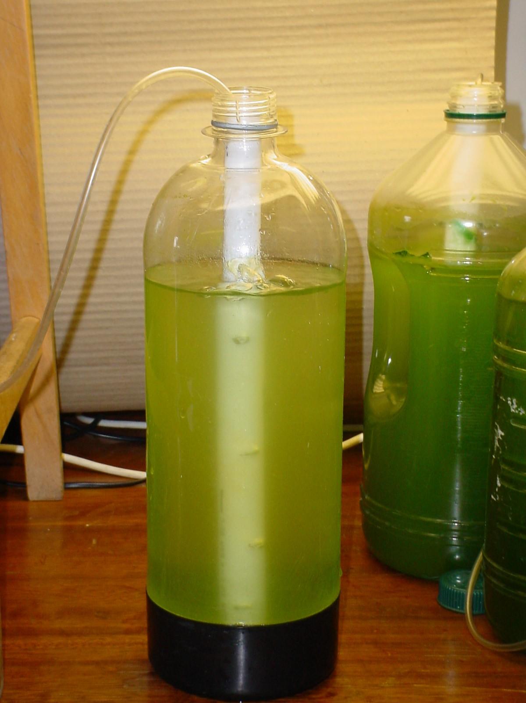
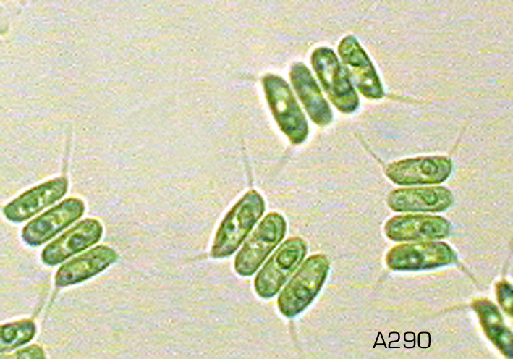
Algae
Scenedesmus quadricauda

Slide 12
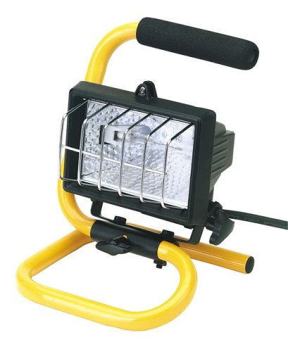
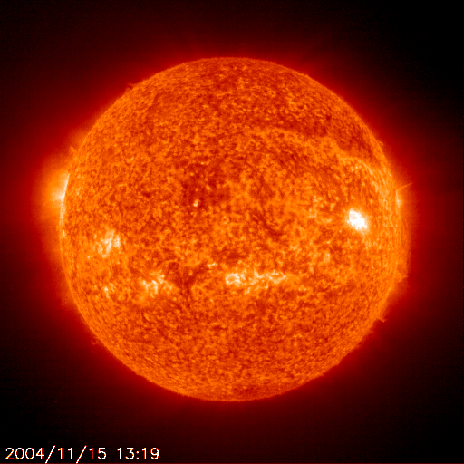
Light Sources
Notes:
Buffers 7.6 –9.2

Slide 13
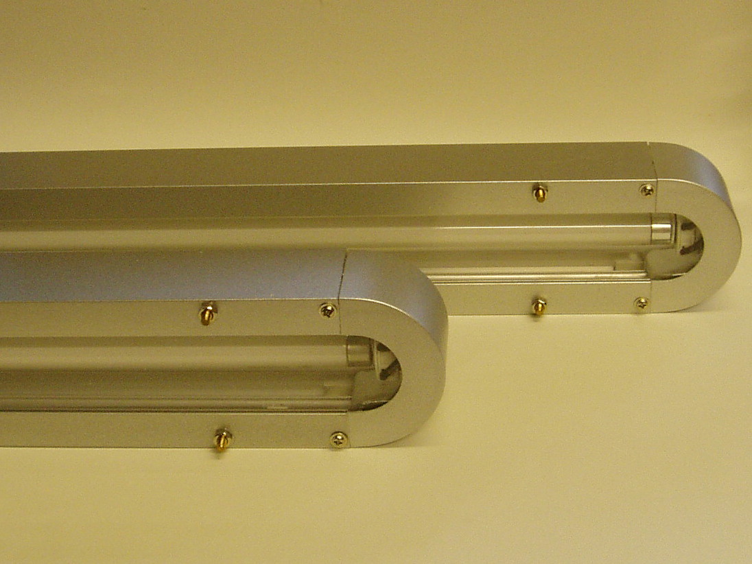

Slide 14
What might you observe?
Notes:
The colorimeter we recommend for key stage 4 use is the WPA colorimeter

Slide 15
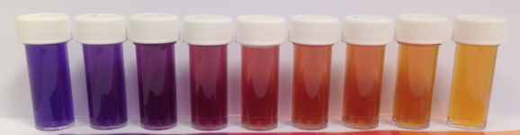

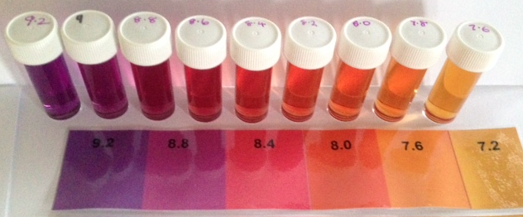

Slide 16
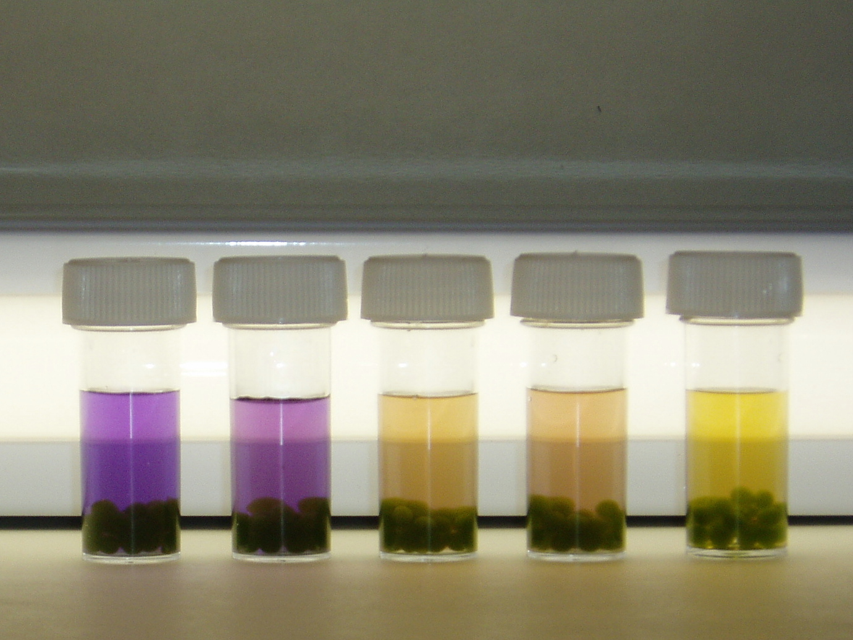
Dark control
60-90 min irradiation

Slide 18
Variables?
Colour of light
Light Intensity
  Distance from lamp
  Neutral density experiment
Number of balls
Ball size
Concentration of algae
Temperature
Notes:
The colorimeter we recommend for key stage 4 use is the WPA colorimeter

Slide 19
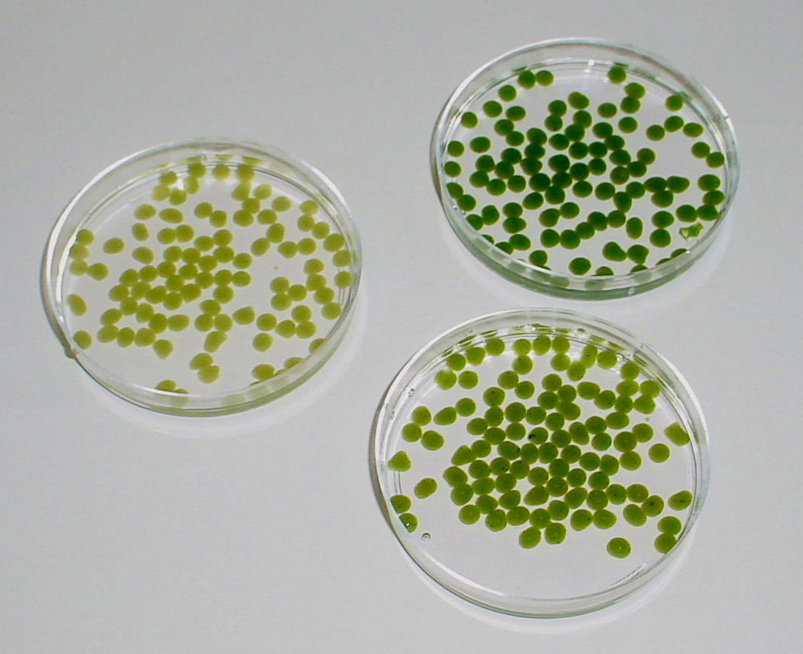

Slide 20
Variables?
Colour of light
Light Intensity
  Distance from lamp
  Neutral density experiment
Number of balls
Ball size
Concentration of algae
Temperature
Notes:
The colorimeter we recommend for key stage 4 use is the WPA colorimeter

Slide 21
Light Intensity I
Notes:
The colorimeter we recommend for key stage 4 use is the WPA colorimeter

Slide 22
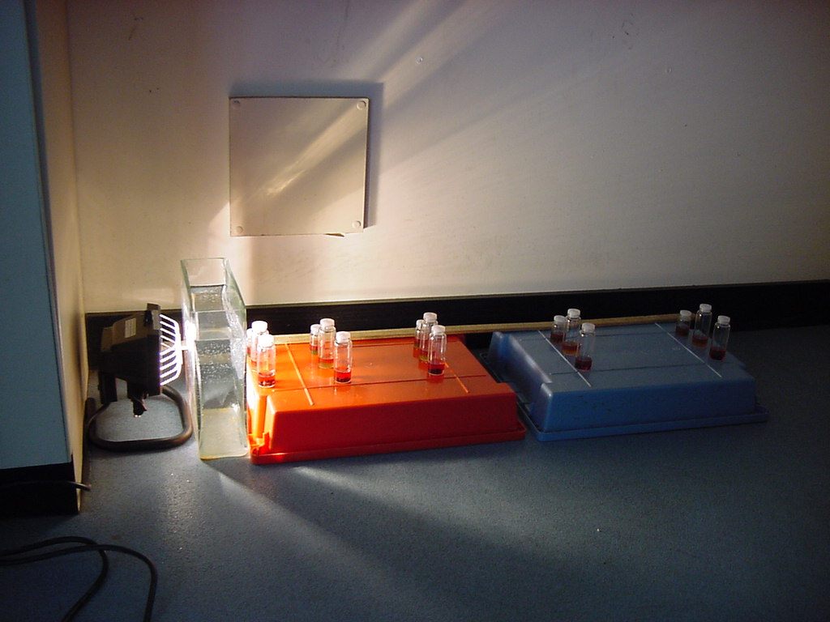

Notes:
The colorimeter we recommend for key stage 4 use is the WPA colorimeter

Slide 23
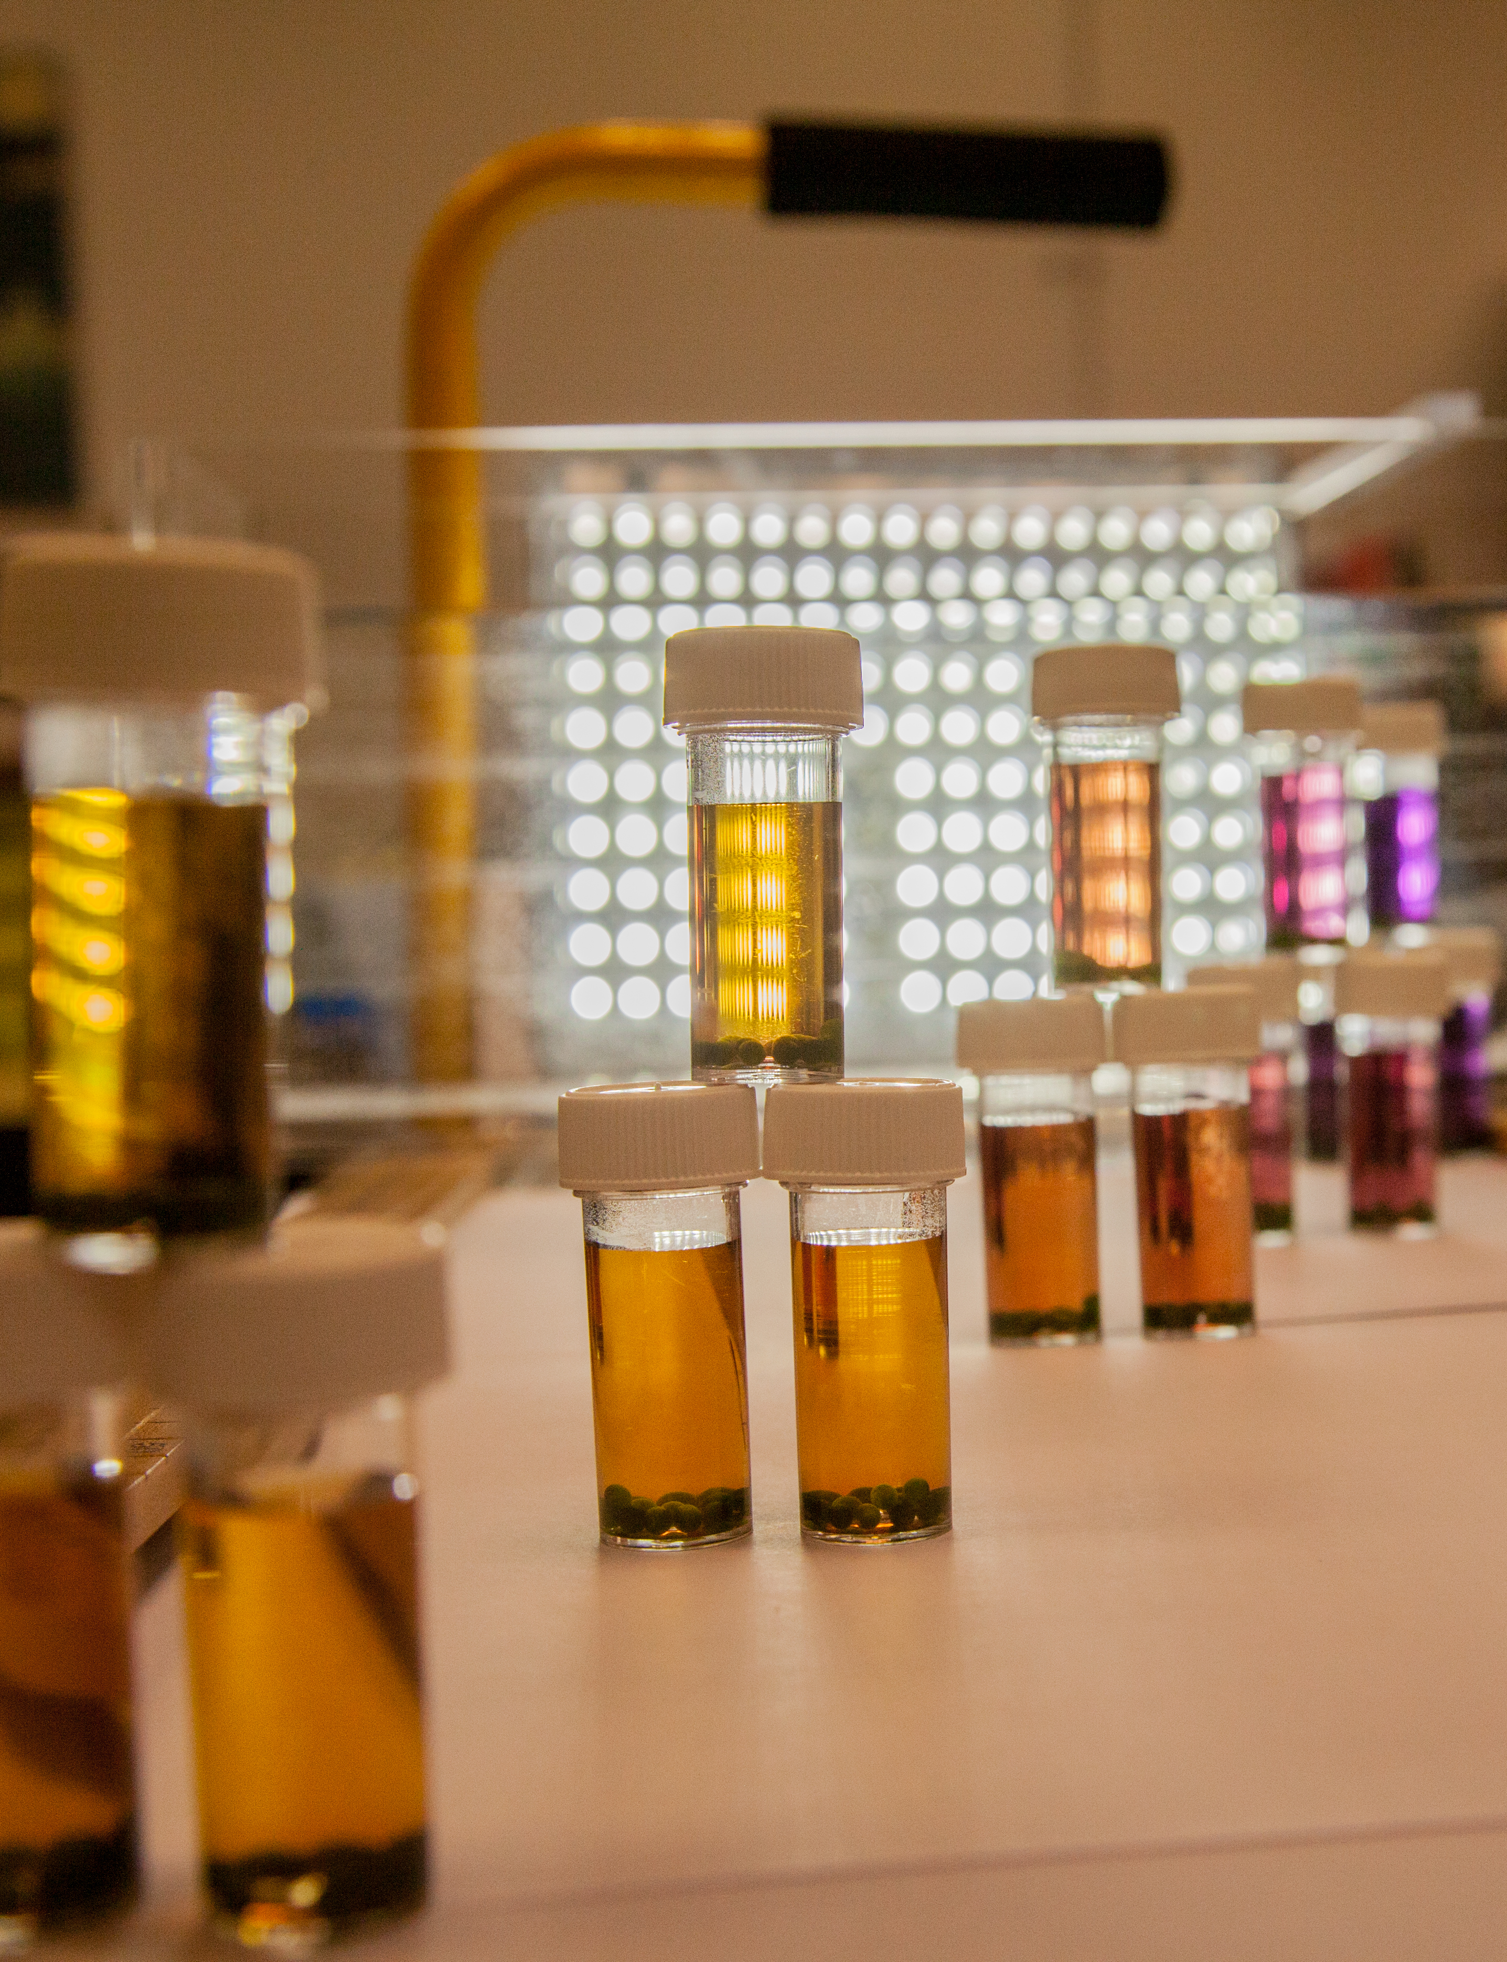
Notes:
The colorimeter we recommend for key stage 4 use is the WPA colorimeter

Slide 24
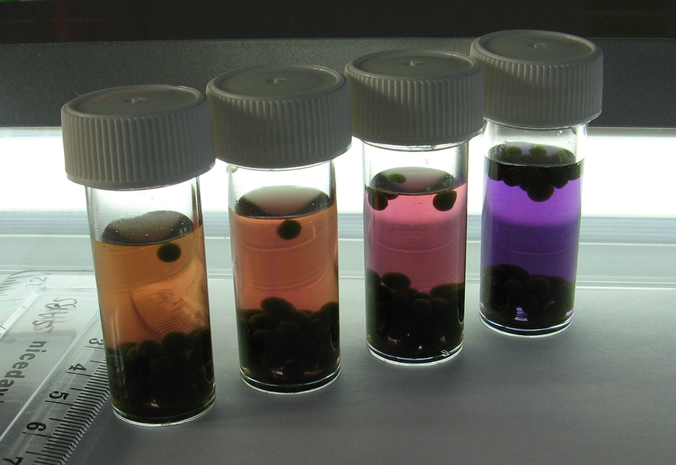

Slide 25
Light Intensity II
Notes:
The colorimeter we recommend for key stage 4 use is the WPA colorimeter

Slide 26
Filters
LEE Filters – range of filters
Neutral density options
www.leefilters.com
Notes:
The colorimeter we recommend for key stage 4 use is the WPA colorimeter

Slide 27
Transmission data
Filter Nº | %T
298 | 71
209 | 50
210 | 25
211 | 12.5
299 | 6.25
Notes:
The colorimeter we recommend for key stage 4 use is the WPA colorimeter

Slide 29
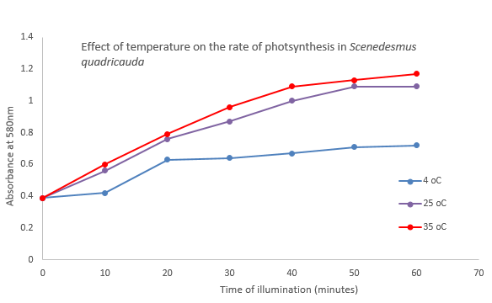

Slide 30
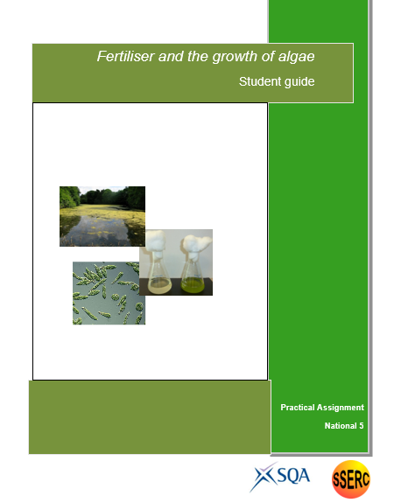
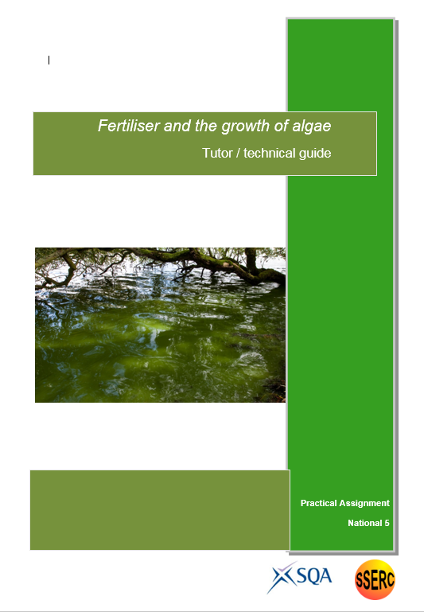

Slide 31

Life on Earth 5 Food production
c. Fertilisers can leach into fresh water, adding extra, unwanted nitrates. This will increase algal populations which can cause algal blooms. Algal blooms reduce light levels, killing aquatic plants. These dead plants, as well as dead algae, become food for bacteria which increase greatly in number. The bacteria use up large quantities of oxygen, reducing the oxygen availability for other organisms.
Investigate the effect of fertilisers on plant growth.
Investigate the effect of fertiliser concentration on algal growth.

Slide 32
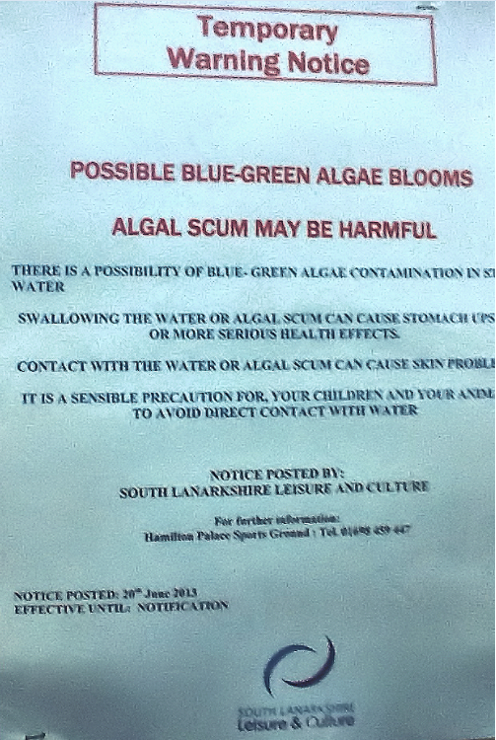
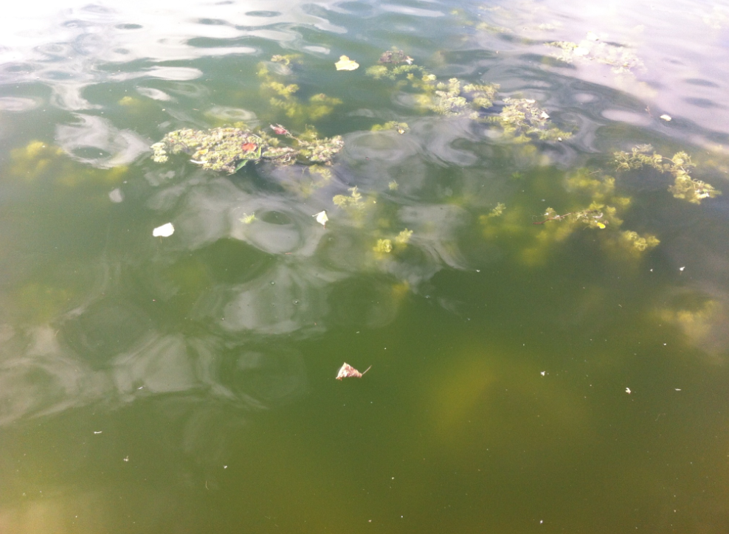

Slide 33

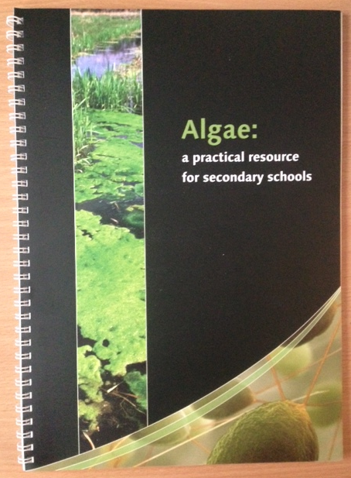
Grow algae for 7 – 10 days in distilled water and in fertiliser
Take colorimeter readings of absorbance at regular intervals

Slide 34
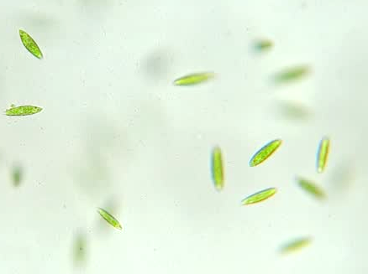
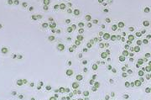
Euglena
Unicellular freshwater eukaryote algae
Shape variable from long and thin up to 100 μm to spheres of ~ 20 μm
Motile (2 flagella)
Chlorella
Unicellular freshwater eukaryote algae
Spherical, non-motile, 2 – 10 μm
Used by Calvin - CO₂ assimilation in plants

Slide 35
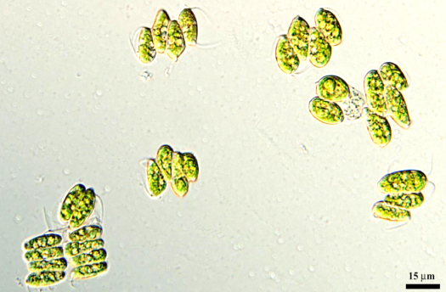
Scenedesmus
- Freshwater eukaryote
Can exist as unicells; also as coenobia of four or eight cells, 11 – 18 μm long
Used by SSERC to make ‘algal balls’ for the study of photosynthesis and respiration

Slide 36
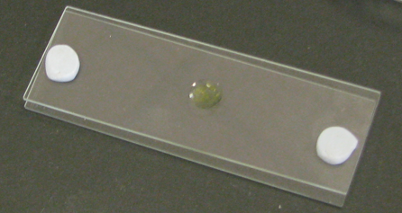
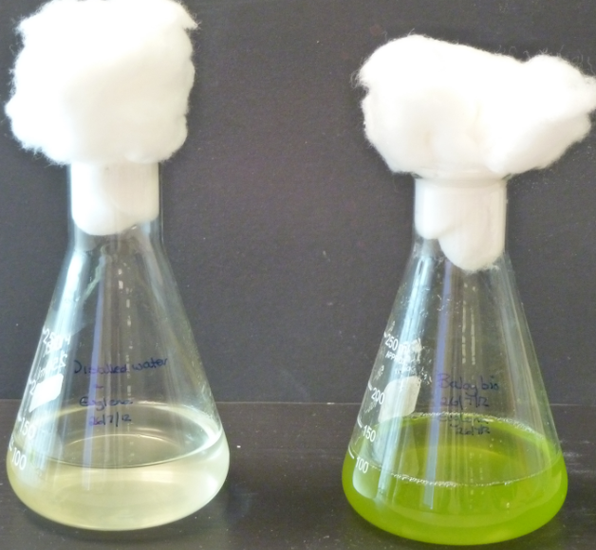
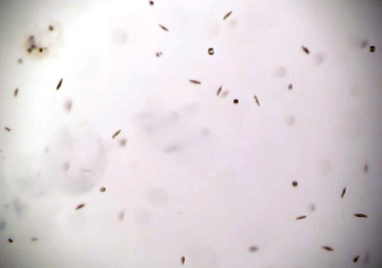
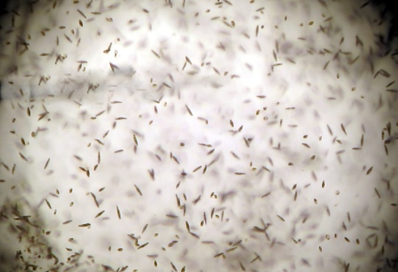
Observing algae
Hanging drop / cavity slide
Euglena gracilis
Distilled water Baby BioTM

Slide 37
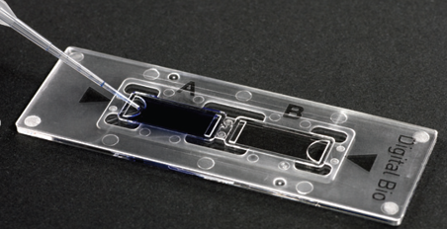
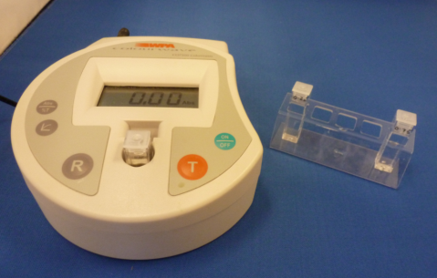
Counting algae - estimating population size
Direct – count cells using a haemocytometer
Indirect – absorbance using a colorimeter
Notes:
Flasks each containing a culture of algae and different concentrations of liquid plant fertiliser are set up.
Flasks are placed near a light source - cultures left to grow for ~ 10 days
Population size estimated at regular intervals by measuring the absorbance of samples of the cultures using a colorimeter.
In this case, absorbance is the extent to which cells in the culture scatter a beam of light of particular wavelength as it passes through the culture.
A ‘control cuvette’ for each is used to zero the colorimeter each time readings are taken.
Control cuvettes are frozen after the first colorimeter readings are taken and thawed out for use when subsequent readings are taken.

Slide 38
Counting algae - estimating population size
Direct – count cells using a haemocytometer
Indirect – absorbance using a colorimeter
Notes:
Flasks each containing a culture of algae and different concentrations of liquid plant fertiliser are set up.
Flasks are placed near a light source - cultures left to grow for ~ 10 days
Population size estimated at regular intervals by measuring the absorbance of samples of the cultures using a colorimeter.
In this case, absorbance is the extent to which cells in the culture scatter a beam of light of particular wavelength as it passes through the culture.
A ‘control cuvette’ for each is used to zero the colorimeter each time readings are taken.
Control cuvettes are frozen after the first colorimeter readings are taken and thawed out for use when subsequent readings are taken.

Slide 39
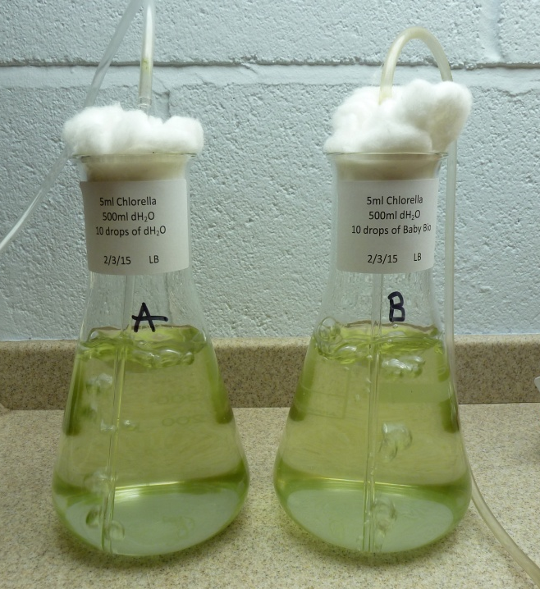
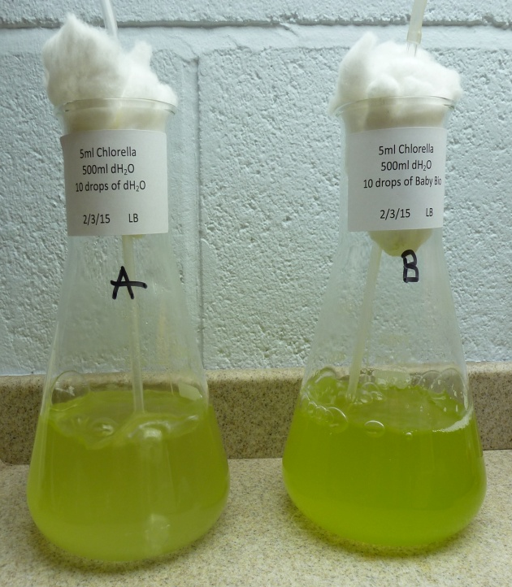
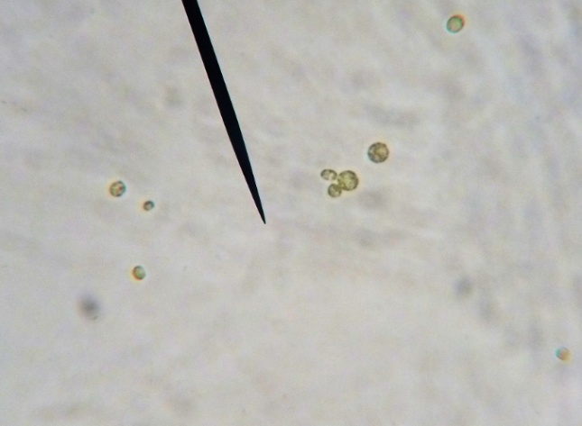
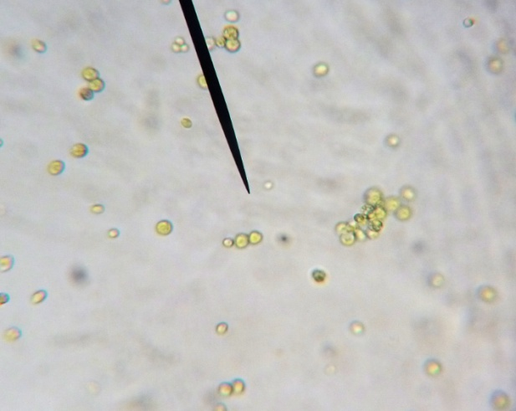
Chlorella
Day 1
Day 11

Slide 40
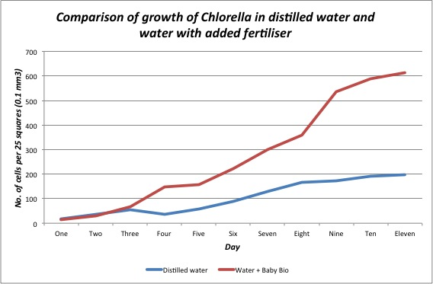

Slide 41
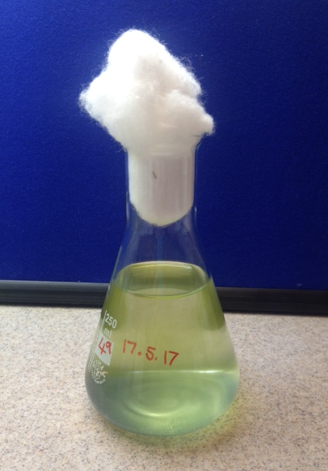
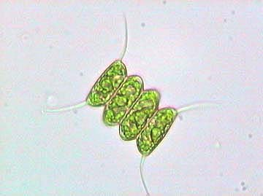
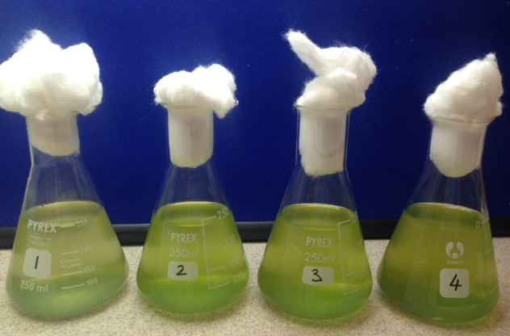
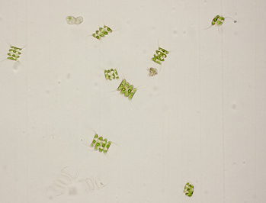
Scenedesmus quadricauda

Slide 42
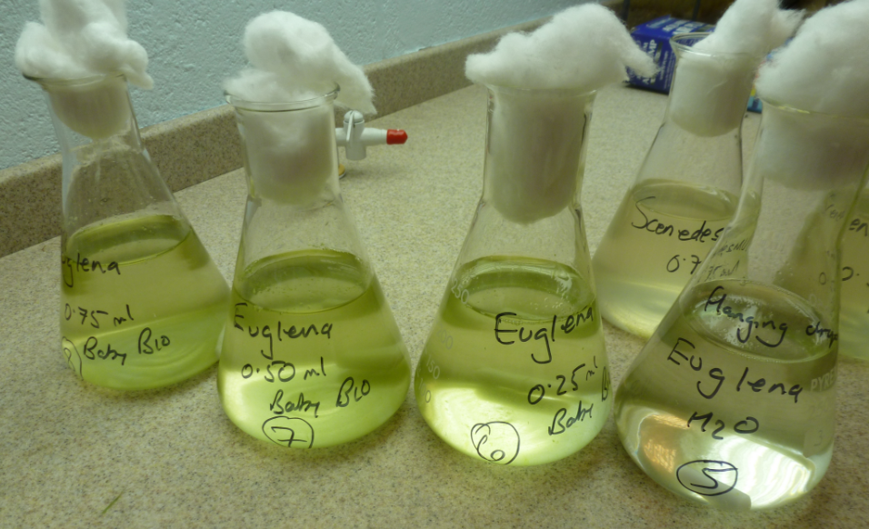
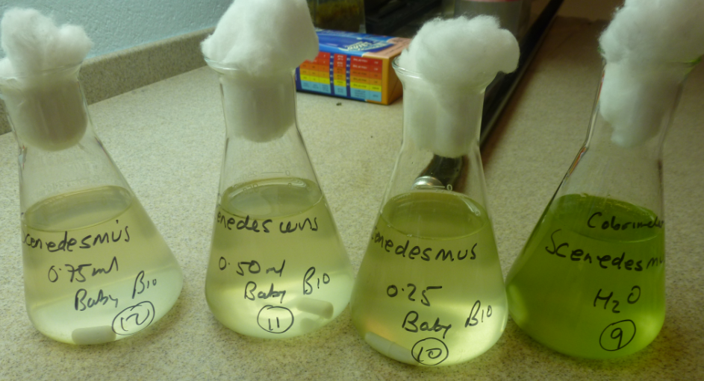
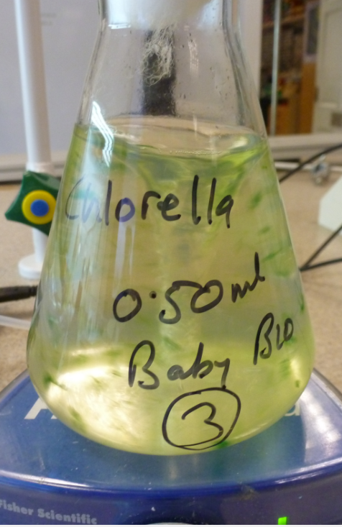
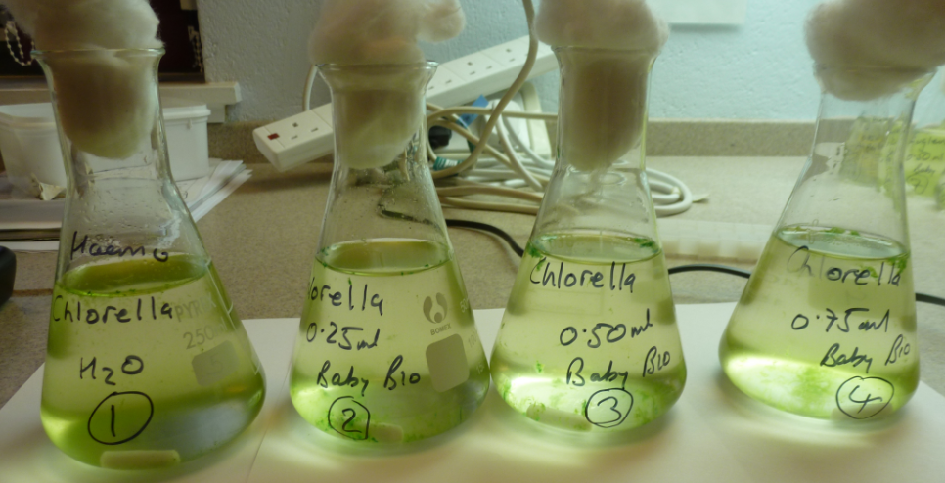

Slide 43
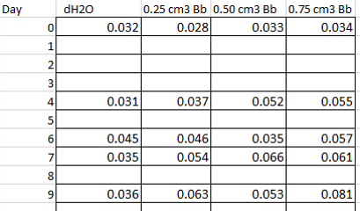
Scenedesmus grown in Baby Bio of varying concentration

Slide 44
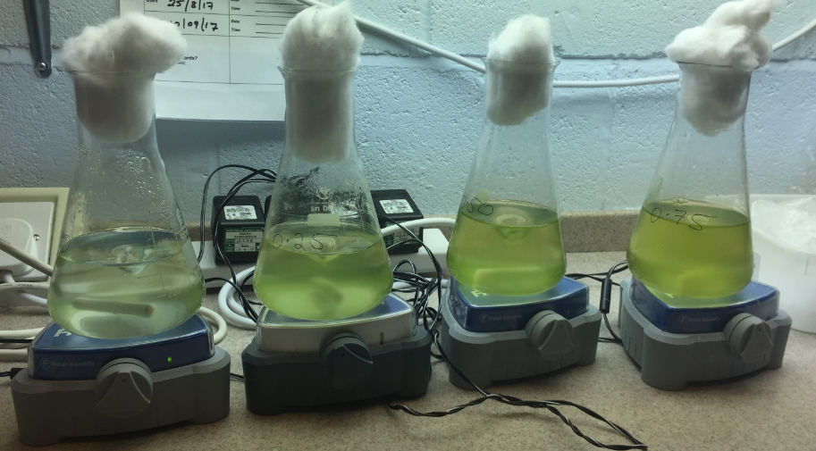
Chlorella – range of concentrations Day 11

Slide 45
www.sserc.scot
paul.beaumont@sserc.scot
sts@sserc.scot

