Slide 1
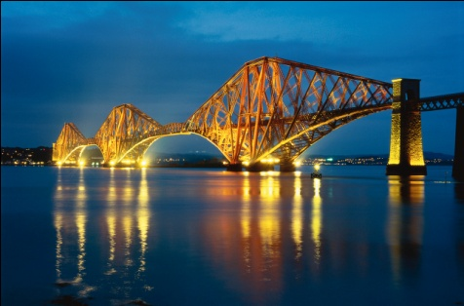
Sarah from Scotland
Hi – I am Sarah and I
live near Edinburgh in
Scotland

Slide 2
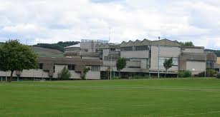
Sarah from Scotland
My house is near to the famous Forth Bridge
and I go to Inverkeithing High School.
Today I am writing an essay for a science competition – the title is ‘More than a 1000 years from now’. I am writing about a future where human beings have been able to use discoveries which they made from space travel and research to create a better world and to give hope for the future.
I find this topic really interesting and so I have done lots of research so that what I write is based on real possibilities. Here are some of the things which I have been finding out about and how I have imagined they have changed the world:

Slide 3
Sarah from Scotland
‘More than a 1000 years from now’ - The Earth in 3030
Here are some of the ways that the world has changed because of the space programmes which took place over a 1000 years ago:
Energy – we get half our energy now from reactors which use Helium-3 from the moon. The reaction gives out practically no radiation and we have plenty of fuel for the next 1000 years
Energy – we get almost half the energy we need from giant solar panels which orbit the earth above the equator. The energy they generate beams to earth using lasers

Slide 4
Sarah from Scotland
‘More than a 1000 years from now’ - The Earth in 3030
Clean air – As part of their space programme Russian scientists learned about using algae to recycle air – now we use this living technology to give us clean air all over the world (and it looks nice too!)
Clean land – we use molecules which were found on Mars to absorb pollutants from the land creating much cleaner green spaces
Cure for cancer – because of the study of how crystals grow in space scientists have been able to make new medicines which actually cure cancer – so even though you might still get cancer you get treated and you get better

Slide 5
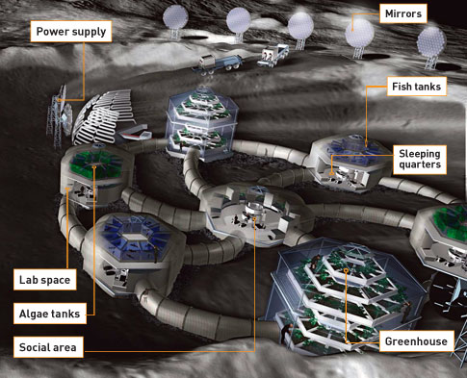
Sarah from Scotland
‘More than a 1000 years from now’ - The Earth in 3030
Life on the moon!
Most people still live on earth
but some people actually live on
the moon.
It took a long time but eventually
a group of scientists, engineers
and designers built a
sustainable moon town called
Moonsdale.
As a group write a few sentences about what it is like living in the world which Sarah is imagining:

Slide 6
Sarah’s info card (present day positives)
Scotland has companies involved in the space industry, producing everything from batteries to nano-satellites. This means good jobs for people in space science jobs. Some examples:
At the UK Astronomy Technology Centre in Edinburgh they developed a special kind of wiring that works at the cryogenic (very low) temperatures found inside an astronomy camera. This kind of camera is used to look into the furthest regions of space
Kinotex: this is a sensor technology which, like human skin, registers pressure and differences in pressure and gives feedback. This was developed by for the robotic arm on the International Space Station but is now being used by car companies for crash sensing to improve pedestrian safety

