Slide 1

Alvy from America
Hello there – my name is Alvy and
I live in New York in the USA

Slide 2
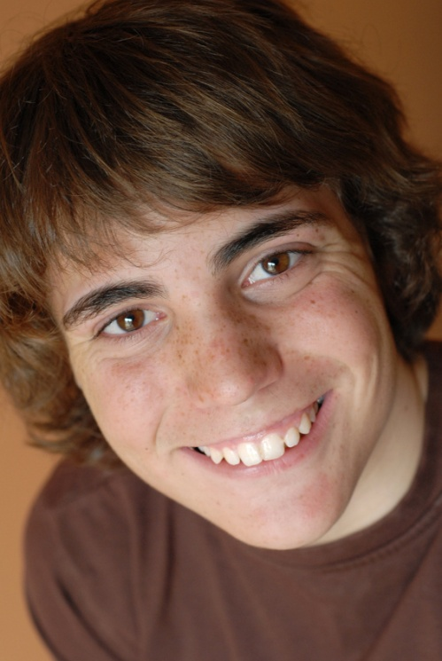
Bernard from Belgium
Bonjour – I am Bernard and I live in Brussels in Belgium

Slide 3

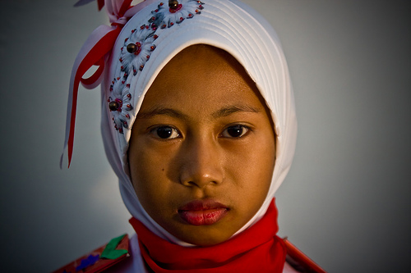
Ira from Indonesia
Hi – I am Ira and I am from Indonesia

Slide 4
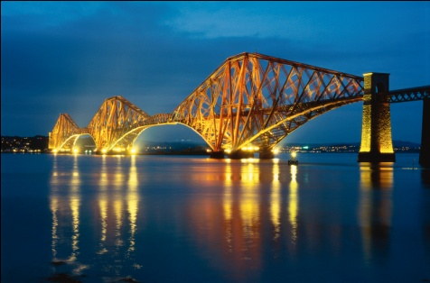

Sarah from Scotland
Hi – I am Sarah and I
live near Edinburgh in
Scotland

