Slide 1
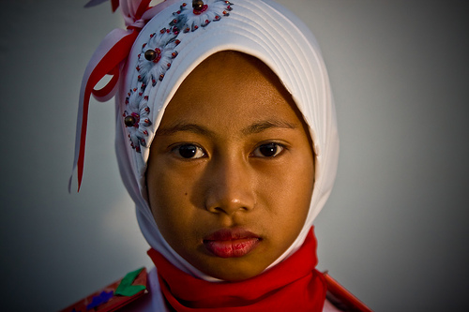
Ira from Indonesia
Hi – I am Ira and I am from Indonesia

Slide 2
Ira from Indonesia
Indonesia is in South East Asia. I actually live
in the capital of Indonesia – Jakarta.
I go to school in an area called Kemang
which is in South Jakarta. Did you know that
Barak Obama went to school in Jakarta?
Last week at school we were learning about space and space travel and exploration. It was so cool. I knew a few things before –like the planets in our solar system and that there had been a man on the moon and a bit about the ‘big bang’- but there is so much more to learn.
I want to know more.

Slide 3
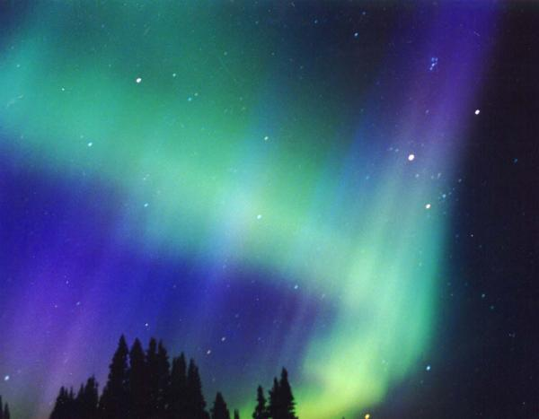
Ira from Indonesia
Last night we were given some space news stories to read
I read that Astronomers have discovered a young galaxy in the distant universe, with stars that formed 13.5 billion years ago, that is just 200 million years after the Big Bang!
I found out about meteor showers which are bit of comets raining down on earth
Then I read about the final launch of the
space shuttle Endeavor
Wow it is all so amazing

Slide 4
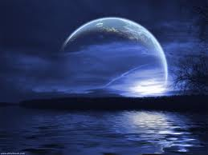
Ira from Indonesia
I know that some people think that all this space research is costing too much but I think that, although it is expensive, the world needs to make progress in science and we need to open our minds to new discoveries and ideas
I keep looking up at the stars now and wondering
where I am and what is happening here and
what might be happening billions of miles away
We may not be alone in this universe but how can we ever find out if we do not research and look beyond our world?

Slide 5
Ira from Indonesia
Indonesia is a poor country and I don’t think we can do much
research about space but that does not mean that it is not
interesting. I thought I would ask my family what they thought
about it and here is what the said:
Dad Your head is full of nonsense Ira – how can I worry about
space when I don’t even know if I have enough money for food,
schools fees and the electric bill
Mum I am glad you are working hard at school and thinking
about what you learn Ira. I often look up at the stars and I feel
so small and wonder what is happening out there. I also often
think how beautiful they are.

Slide 6
Inra from Indonesia
My brother – you are lucky Ira we did not learn about that
when I was at school we just did maths and language. I do know
that there is a observatory in Indonesia near to Bandung. Now
that I have a job and a motor bike maybe I could take you. I
wonder what it costs?
My sister – you are mad Ira – you say such strange things. I
don’t think about space at all! All I think about is how much I
want a mobile phone and that has got nothing to do with
science or space has it.
I tried to tell my sister she was wrong but I could tell she was not
in the mood.

Slide 7
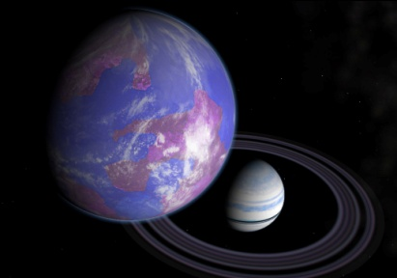
Ira’s Help Card
An exoplanet, is a planet outside our Solar System. In the last few years more than 450 exoplanets have been discovered. They orbit stars other than our sun. Being able to find these planets means that there is much more chance of finding a planet like our earth
Under the ice on Europa, one of Jupiter’s Moons is a huge Ocean which may harbour life!
Comets are giant city sized snowballs with a rocky core; imagine making a snowball the size of Glasgow in Scotland!
Olympus Mons is a volcano found on Mars. It is the largest volcano found in our solar system. It is 370 miles across and rises up for 15 miles

