Slide 1
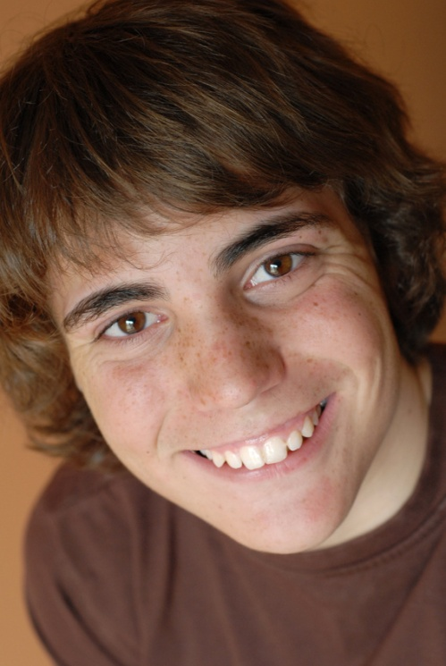
Bernard from Belgium
Bonjour – I am Bernard and I live in Brussels in Belgium

Slide 2
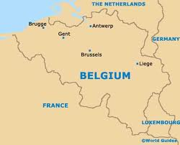
Bernard from Belgium
Last week we had a class trip to the Space Centre in Liege, a University town in Belgium only about an hours drive from where I live. It was very interesting and I was amazed at all the developments and technology almost on my doorstep.
I think quite a few people in my class felt
that maybe they would like to study here
when they leave school.

Slide 3
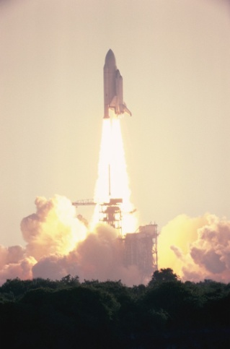
Bernard from Belgium
When I got back home I started to think more about all the money which goes into space research and the whole space industry. I did a bit of research and found out that worldwide government expenditure for space is more that $68 billion.
That is so much money I can hardly imagine it and I
cannot help wondering if it can possibly be right to
spend so much money on space when there are so many
other things we could do to help people all around the
world.
Maybe space research needs to wait until we have a more stable, more equal society?

Slide 4

Bernard from Belgium
Last year my school gave some money to a worldwide children’s charity. We were told that about $5 pays for life-saving treatment for eight children with diarrhoea. When you compare that with the space programme it makes you really wonder.
In RME we sometimes get a chance to talk about
things like this so I decided to ask my RME teacher
if we could do a sort of class survey and try to get
everyone to say what they feel about how money should be spent.
You could even try it with your class.

Slide 5

Bernard from Belgium
Last week we went to learn about the space programme where billions of dollars are spent on research and development.
Last year we raised money to save children from poor countries who die from diarrhoea – 5$ can save 8 children
What do you think?
Write down 5 things which you think our school should raise money for: | Write down 5 ways in which you feel that spending money on space programmes is more important than spending money on saving children from illness | Write down 5 ways in which you feel that spending money on saving children from illness is more important than spending money on space programmes

Slide 6
Bernard’s Help Card about Space
(Examples of what some countries spend)
Nigeria Program Founded: 1998
Budget: $93 million
Yes, Nigeria actually has its own space agency. The organization sent up its first satellite, a weather unit in 2003. In May 2007, China assisted in the launch of NigComSat-1, which helps provide Internet access to rural areas of the country
Japan Program Founded: 2003
Budget: $2.5 billion
Japan has yet to build a spacecraft fit for humans. But it did send the first journalist into space. The Japanese are planning a lunar landing in 2020 and hoping to build a base on the moon by 2030
European Space Agency Program Founded: 1975
Budget: $5 billion
The ESA are launching the James Webb Space Telescope (with NASA and Canada) in 2013. Then the ESA Rosetta spacecraft will be involved with the first long-term analysis of a comet.

