Slide 1

Alvy from America
Hello there – my name is Alvy and
I live in New York in the USA

Slide 2
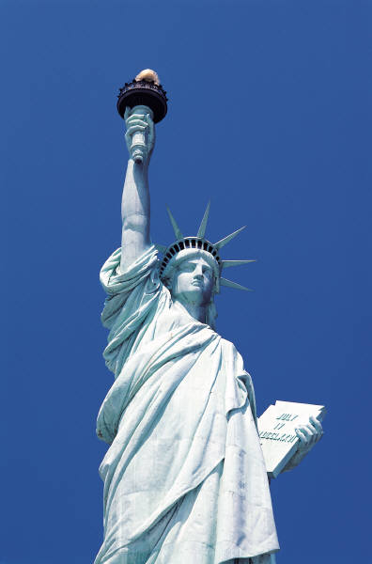
Alvy from America
New York is an amazing city and I feel pretty lucky to be living here. Everyone always talks about 9/11 and that is certainly something we will never forget.
A while ago I visited the Space Zone at the Intrepid
museum in New York. You can find out more about it
by following this link:
http://www.intrepidmuseum.org/
There was a Q and A at the end of the visit and I asked about the pollution of space. They said – ‘yes that was VIP and lots was being done’ but somehow I did not feel convinced.

Slide 3
Alvy from America
I asked the scientists:
Are we wasting resources in the quest for space travel and polluting space at the same time?
Do we have the right to pollute space?

Slide 4
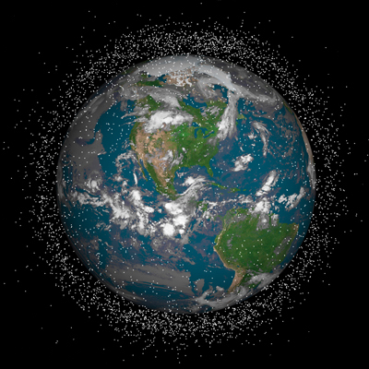
Alvy from America
There are 3 things which I heard about which are really bothering me:
Firstly I have discovered that there
are millions of pieces of man-made
junk circling the earth. At least
100,000 pieces of old satellites
and rockets and other debris orbiting the earth at 18,000 mph. This is a huge hazard which we are adding to every day. We have polluted our planet and now we are polluting space!

Slide 5
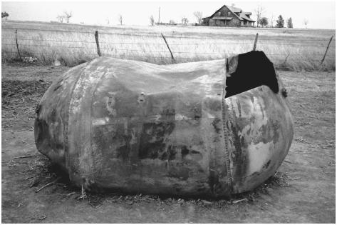
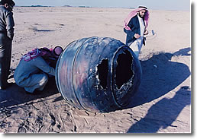
Alvy from America
Next some of this junk could end up on earth. It seems to me that we do not really know enough about what will happen to all the stuff. Some scientists seem to say that it will not cause any harm but stuff does land on earth from space. I’ve seen the pictures:

Slide 6
Alvy from America
Also some satellites which have been launched are causing new problems. They are causing electronic interference and stopping important radio signals.
One group of scientist said that this is: ‘potentially really dangerous and could cause temporary or permanent failures of the wireless data links and the information which they carry’.
http://www.scribd.com/doc/33402986/Disruptive-Effects-of-Electromagnetic-Interference

Slide 7
Alvy’s Fact file
The chance of being hit by space junk on Earth is 20 billion to one. Most debris burns up during re-entry, and no one has ever been killed
Orbiting Space debris can be anything, from old satellites, to hatches from spacecraft, and flecks of paint. In 2005, at least 13 nuclear fuel cores, eight thermoelectric generators and 32 spacecraft nuclear reactors were in Earth orbit!
Weighing around 135 tons, the Russian owned Mir Space Station was the largest pieces of manmade space junk ever to fall to Earth, landing in the South Pacific Ocean on
March 23rd 2001

