Slide 1
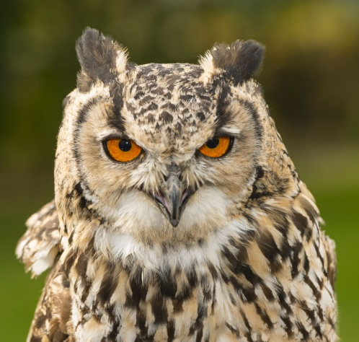
Owl pellets
For Nat 4 / 5
Kate Andrews
Lorraine Bruce
Marjorie Smith

Slide 2
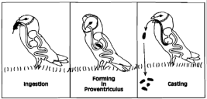
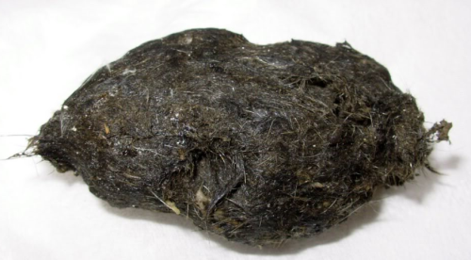
Why study Owl pellets?
Prey swallowed whole
Soft parts digested in stomach
(proventriculus)
Indigestible parts formed into pellet
Pellet regurgitated through mouth

Slide 3
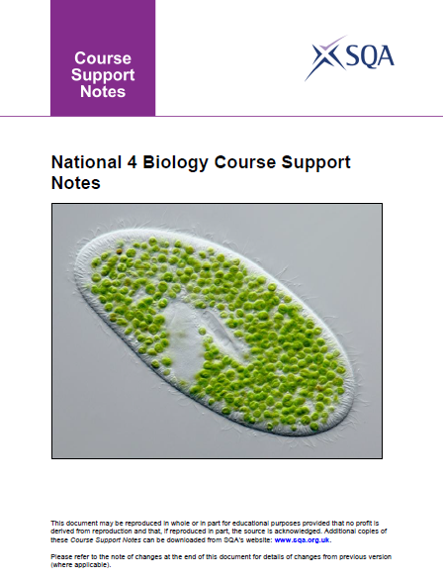
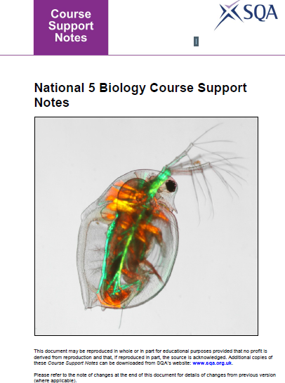
Life on Earth
1 Biodiversity and the distribution of life
5. Adaptations for survival.
Research examples of structural and physiological adaptations which lead to species survival
Life on Earth
1 Biodiversity and the distribution of life
Grazing and predation are biotic factors; pH and temperature are abiotic factors.
Interpret predator prey interaction graphs.
Analyse Barn owl pellets......
A niche is the role that an organism plays within a community. It includes the use it makes of the resources in its ecosystem and its interactions with other organisms in the community including competition, parasitism, predation.....

Slide 4
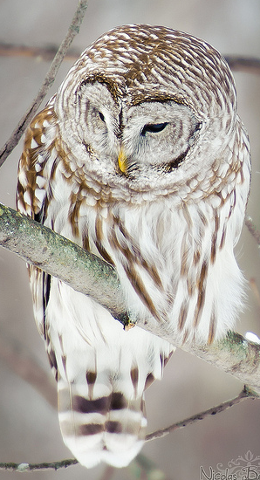
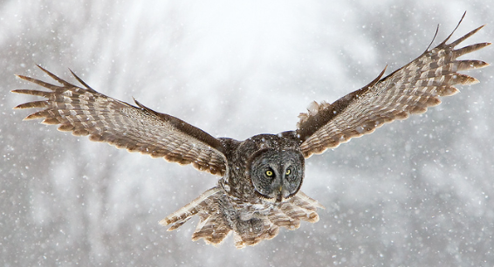
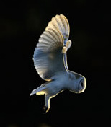
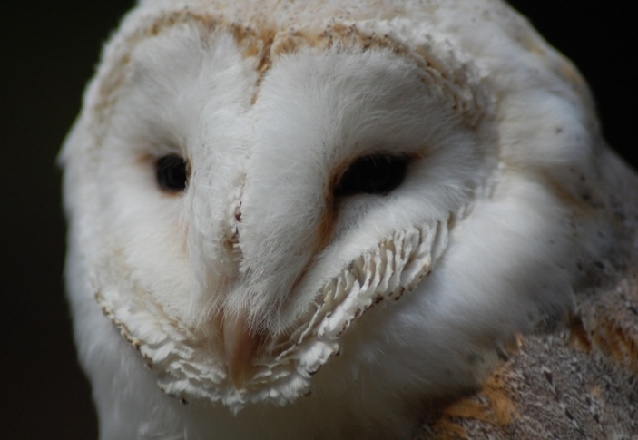
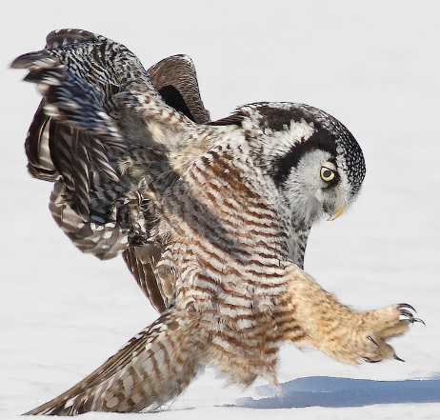
A good predator?
Adaptations

Slide 5
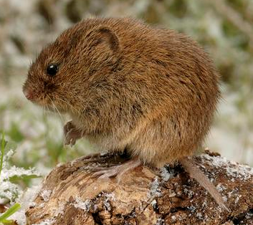
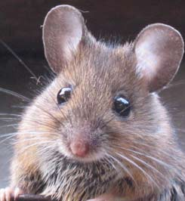
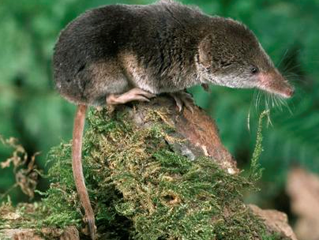
What might an owl eat??
vole
mouse
shrew

Slide 6
Also:
insects
spiders
amphibians
small birds

Slide 7
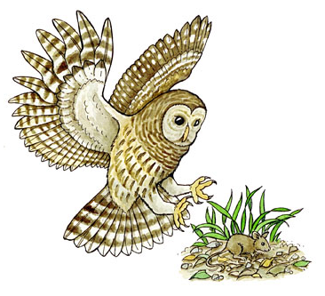
energy
Food chain.....?

Slide 8
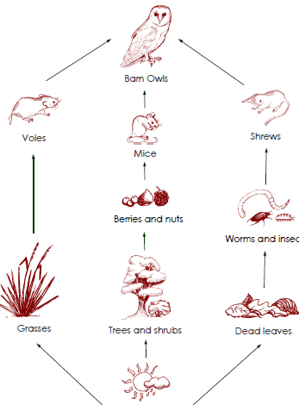

Slide 9
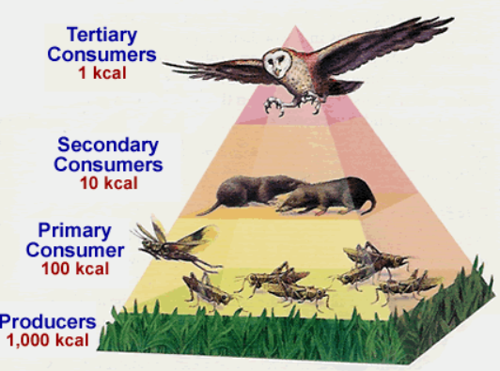
Definitions and comparison of pyramids of biomass, energy and numbers.
Investigate examples of pyramid of energy (as measured in kJ/m2/year), pyramid of biomass (g/m2) and pyramid of numbers.

Slide 10
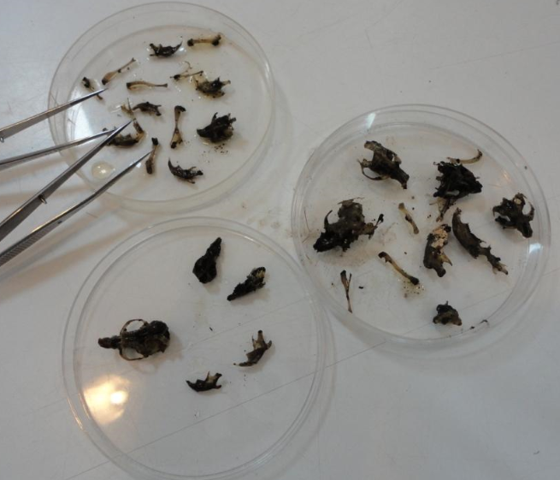
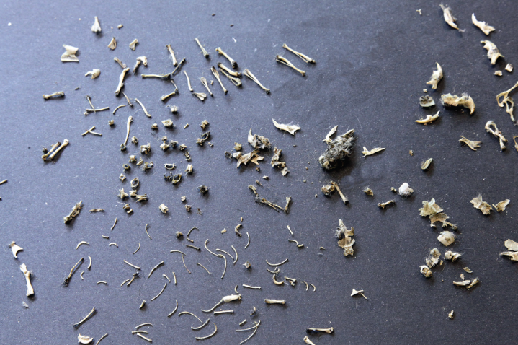
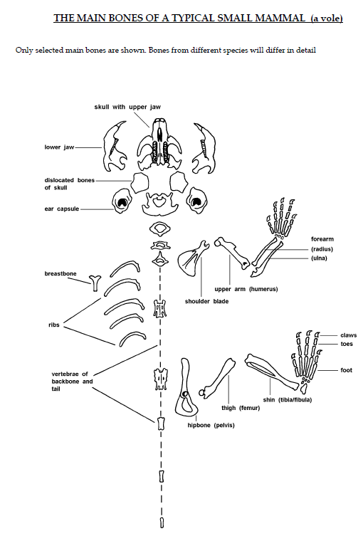
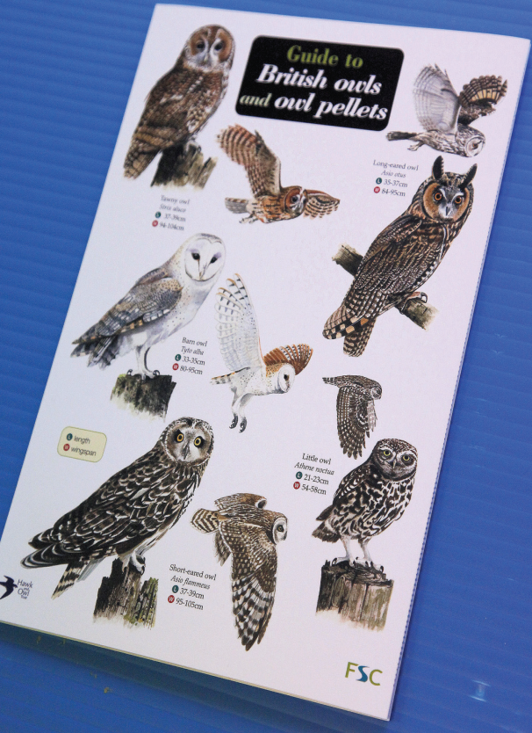
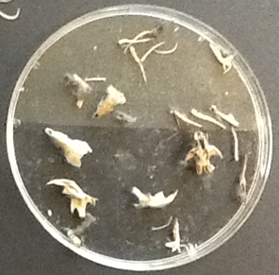

Slide 11
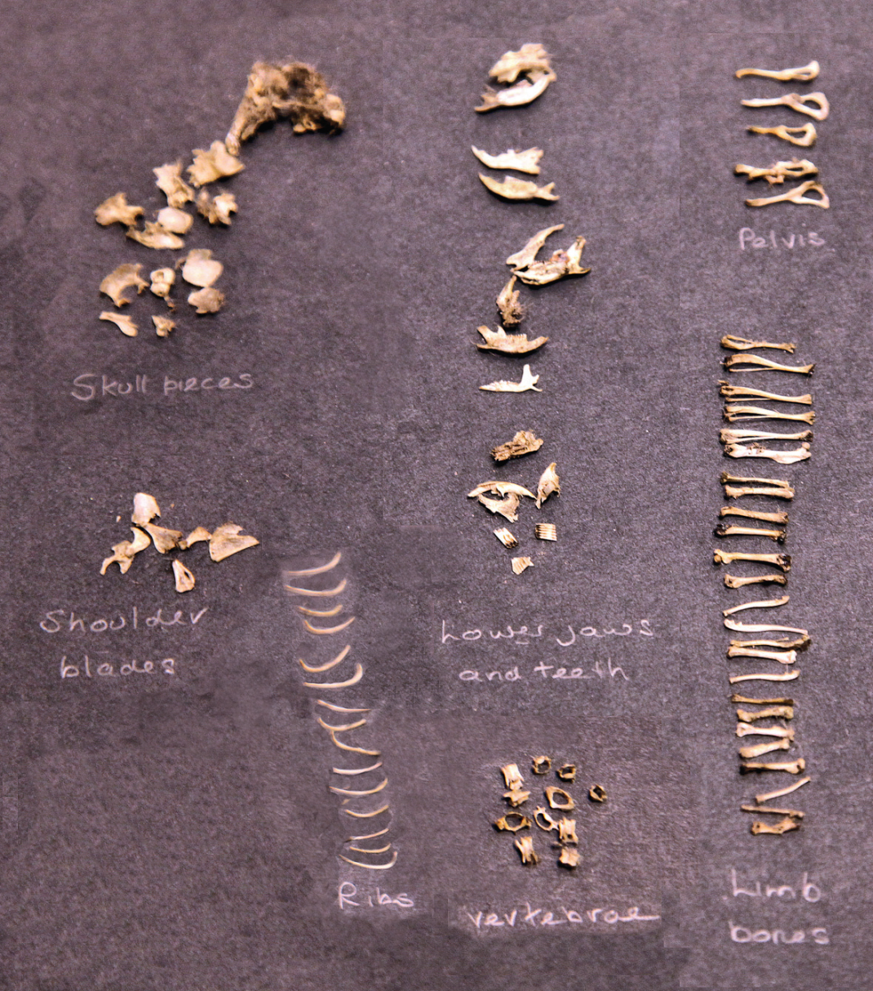
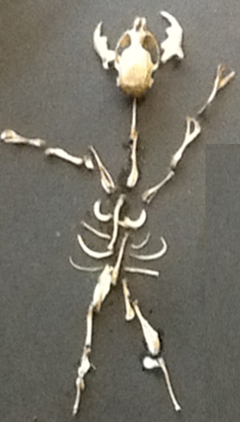

Slide 12
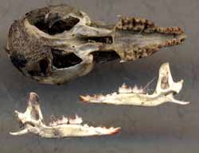
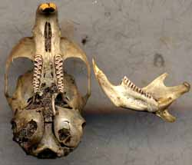
Carnivores
Herbivores
Common shrew skull
Field vole skull

Slide 13
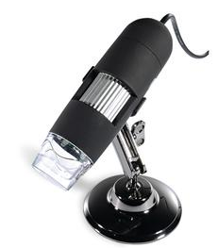
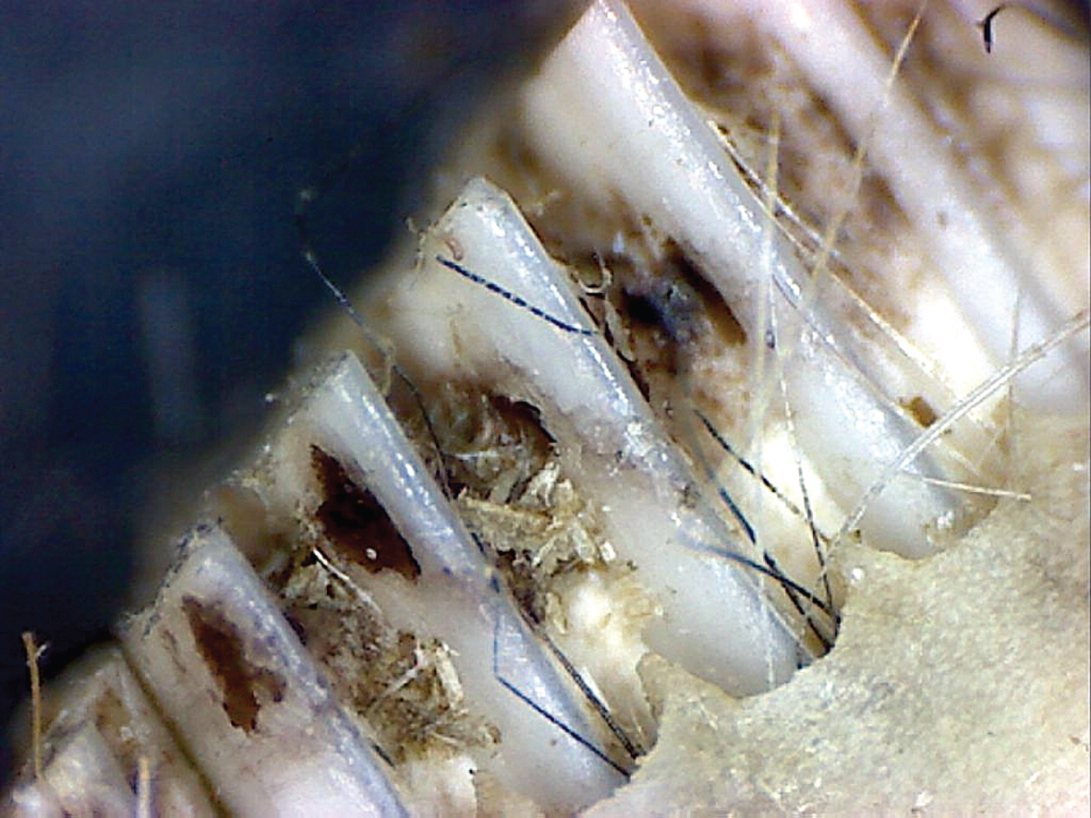
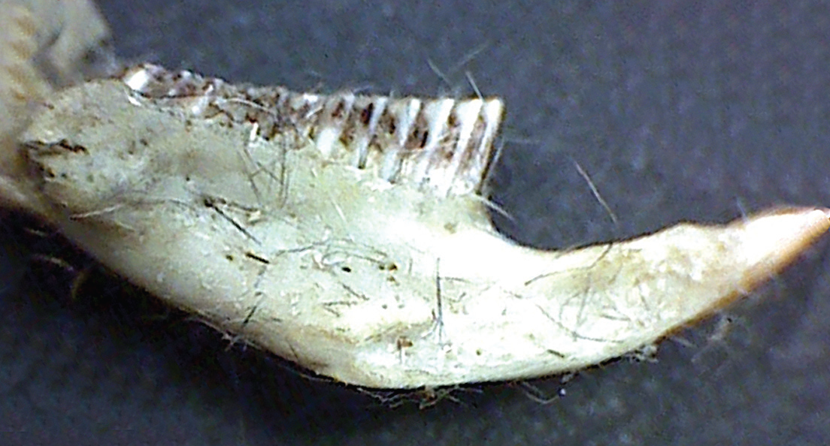
Vole molars
Vole lower jaw

