Slide 1

National 4, National 5 Biology
Microbiology Activities
30th October 2014
Kath Crawford
Lorraine Bruce

Slide 2
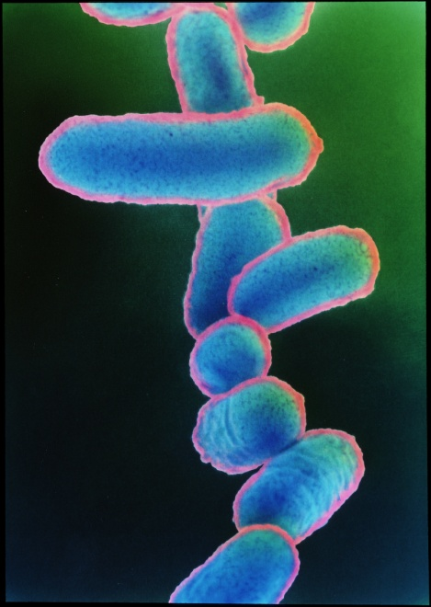
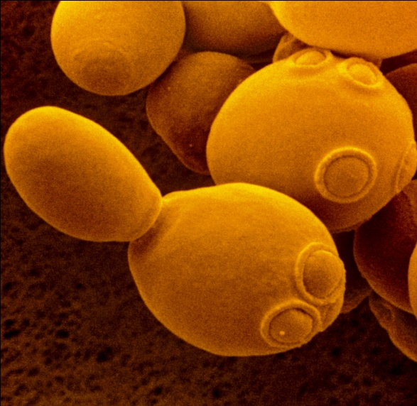
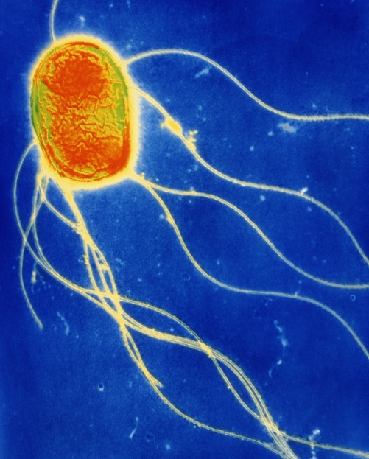
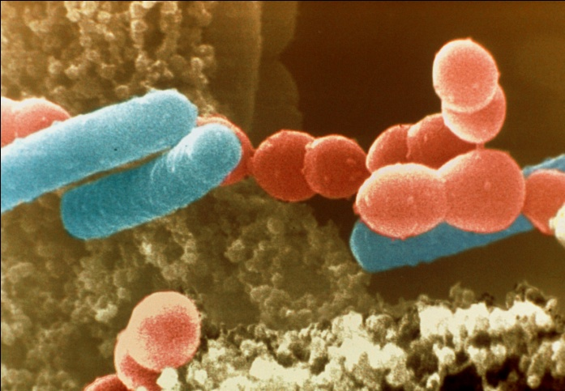
Why school microbiology?
Estimation- microbes make up more than 60% of the Earth’s living matter
Earth’s cycles (carbon, nitrogen, sulphur etc.)
In humans, 10 x more bacterial than human cells
Recycling
Disease, infection
Food production

Slide 3
Prior knowledge of micro-organisms?
From Experiences and Outcomes
‘Germs’ can cause disease (level 1)
Role of micro-organisms in producing and breaking down materials (level 2)
Control of growth of microorganisms (level 3)
Microorganisms’ properties and use in industries (level 4)

Slide 4
Today’s workshop
Activity | Key areas Nat 4 Nat 5
Aseptic technique / sub-culturing | Cell division and its role in growth and repair Controversial biological procedures | Cell production by cell culture requires aseptic techniques, an appropriate medium and control of other factors
Microbes and food spoilage | Properties of microorganisms and use in industries
Cauliflower cloning | Propagating and growing plants Commercial use of plants Growth and development of different organisms | Specialisation of cells, in animals and plants, leads to the formation of a variety of tissues

Slide 5
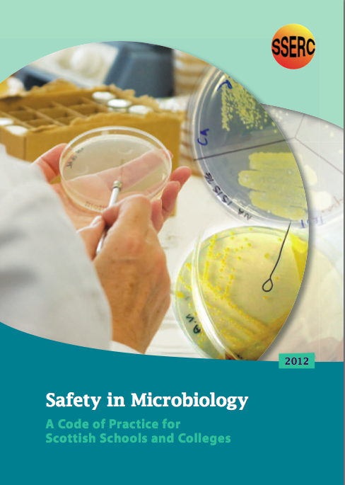
Safety in Microbiology
Code of Practice for Scottish Schools and Colleges:
www.sserc.org.uk

Slide 6
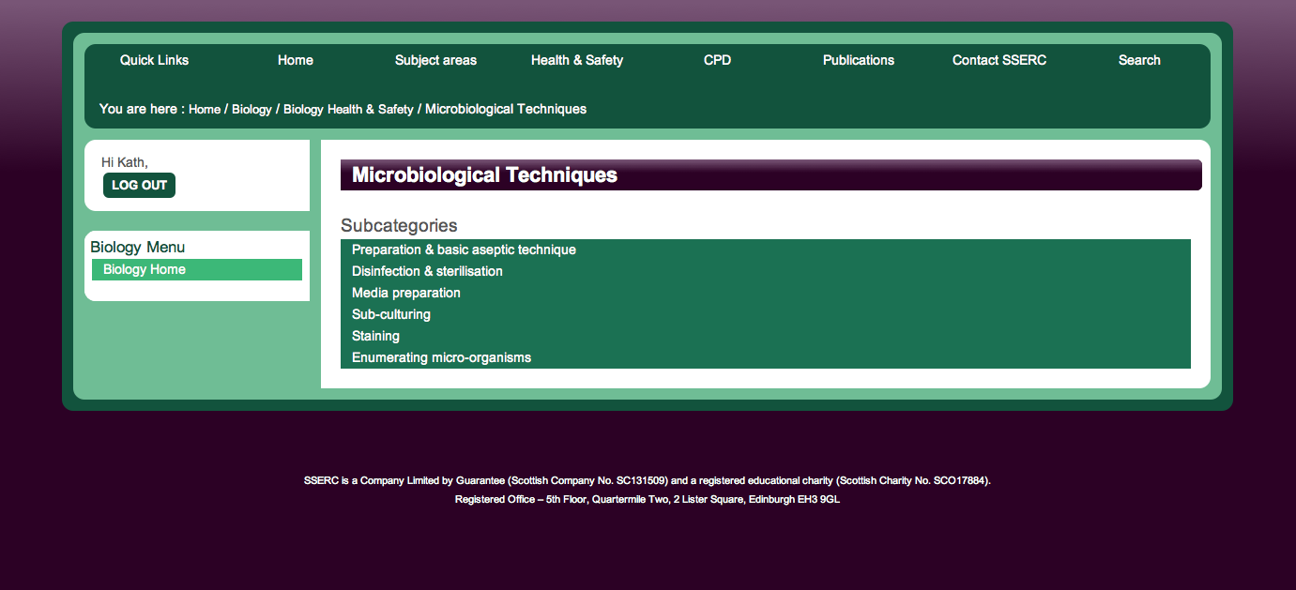
Microbiological techniques:
www.sserc.org.uk

Slide 7
Cauliflower cloning
1. Place forceps in a pot of sterilising solution
SDICN
SDICN = Sodium Dichloroisocyanurate (i.e. dissolved Milton tablet)

Slide 8
What does aseptic technique mean?

Slide 9
Aseptic technique
a method of working which incorporates precautionary measures to prevent contamination
  disinfection and sterilisation
  flaming of equipment

Slide 10
Aseptic Technique - Good Working Practice
All organisms must be treated as potential pathogens

Slide 11
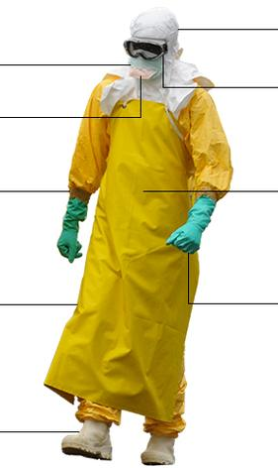
Personal Protection
http://www.cdc.gov/vhf/ebola/hcp/procedures-for-ppe.html Oct 21st 2014
Principles of PPE
Healthcare workers must understand.. basic principles to ensure safe and effective PPE use, which include that no skin may be exposed while working in PPE:
Doffing
The removal of used PPE is a high-risk process that requires a structured procedure, a trained observer, and a designated area for removal to ensure protection. PPE must be removed slowly and deliberately in the correct sequence to reduce the possibility of self-contamination or other exposure to Ebola virus.
Image: www.bbc.co.uk

Slide 12
Aseptic Technique - Good Working Practice
Safety procedures aim to avoid:
bringing contaminating organisms to laboratory bench
contaminating laboratory cultures
contaminating yourself, your colleagues or your surroundings
taking contaminating organisms out of the laboratory

Slide 13
Personal Protection
Leave bags and cases outside door or in corner of room
Wash hands (then cover any cuts)
Put on, in order:
  Clean labcoat
  Goggles
  Gloves
Personal protective equipment used as is appropriate by teachers, technicians and students

Slide 14
Laying out the work area
Equipment placed so that there will be as little air movement as possible while you work.

Slide 15
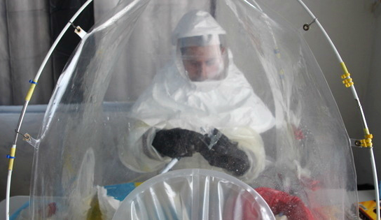
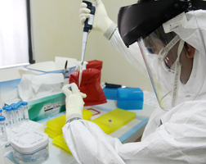
“The first thing we do with a blood sample is inactivate the Ebola virus, making the virus non-infectious and safer for testing”, says US Navy Lieutenant Jose Garcia. As the blood sample might be contagious, this process happens in a very protective environment by using a portable biological safety hood to avoid any direct contact.
Dr Patel extracting genetic material from a blood sample.
Images:
http://www.who.int/features/2014/liberia-mobile-ebola-lab/en/

Slide 16
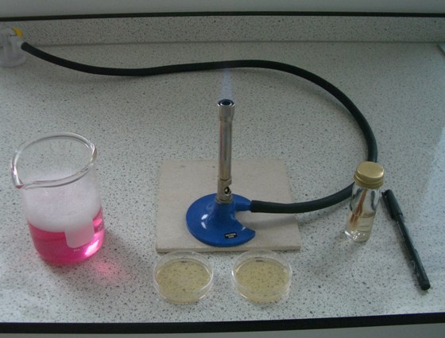
Equipment placed in the same order that you will work through the process
Bunsen at the edge of the mat
Items being dealt with as close to the updraught as possible
All equipment close to where you will sit

Slide 17
What would we want learners to gain from doing these experiments?
Notes:
SSERC – shared service of all 32 LAs
Established to support new practical science in schools.

Slide 18
Knowledge and understanding
  Basic aseptic technique
  Basic microbiological techniques
  Media appropriate for type of microorganism (growth requirements)
  Temperature requirements for growth of micoorganisms
Notes:
SSERC – shared service of all 32 LAs
Established to support new practical science in schools.

Slide 19
Skills
    Planning, designing, safely carrying out experiments to illustrate particular effects
      Basic aseptic technique
      Basic microbiological techniques
    Observing, recording
    Presenting information
    Draw valid conclusions supported by evidence
Notes:
SSERC – shared service of all 32 LAs
Established to support new practical science in schools.

Slide 20
The importance of aseptic technique
(relevant applications of biology)
Microbiology
Cell / tissue culture – animals, plants
Medical /clinical – prevention of disease, infection
Forensic – e.g. DNA analysis
Good Manufacturing Practice (GMP) – food, pharmaceuticals etc.

Slide 21
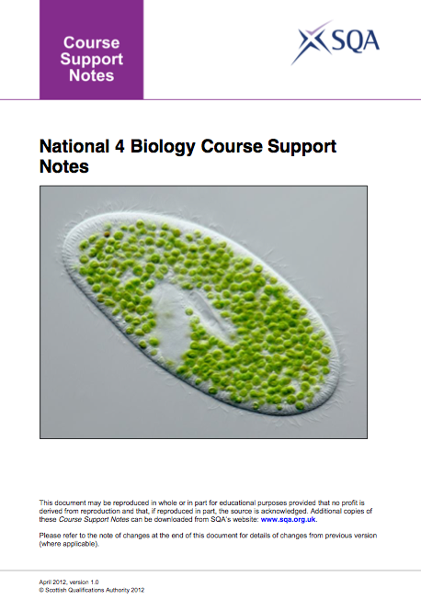
National 4 Biology
Unit: Cell Biology
5 Properties of microorganisms and use in industries.
Notes:
SSERC – shared service of all 32 LAs
Established to support new practical science in schools.

Slide 22
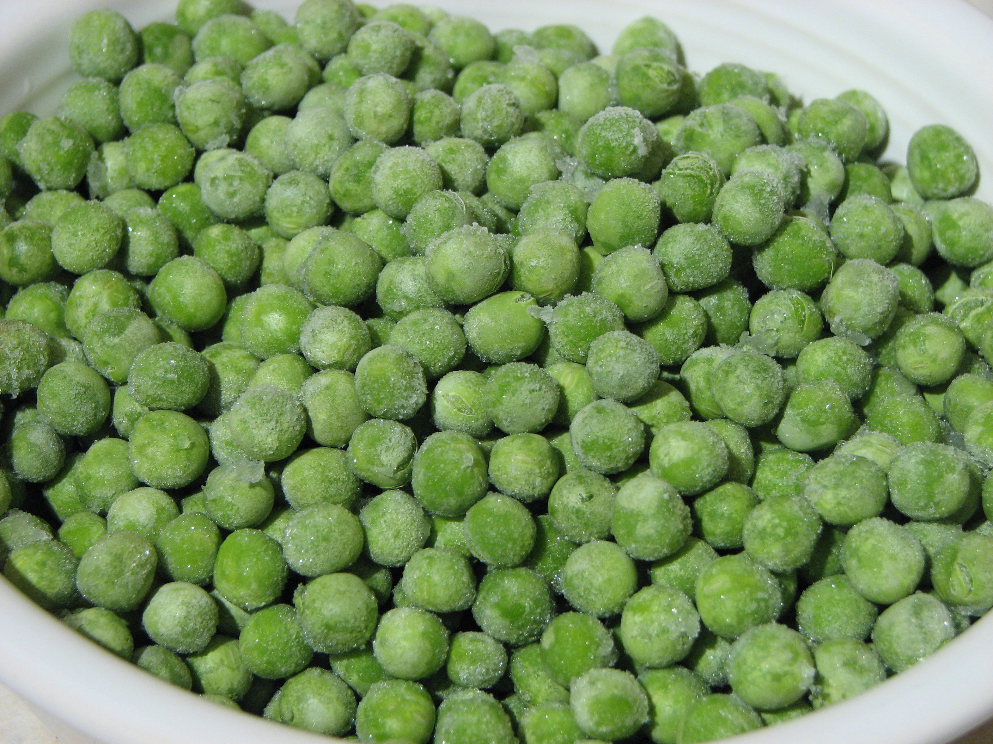
Exemplification of key areas
Properties include rapid growth and diverse use of food source…..
Context:
Food spoilage
Notes:
SSERC – shared service of all 32 LAs
Established to support new practical science in schools.

Slide 23
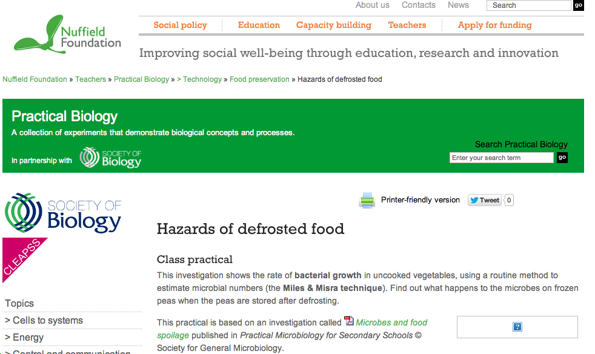
Hazards of defrosted food:
http://www.nuffieldfoundation.org/practical-biology

Slide 24
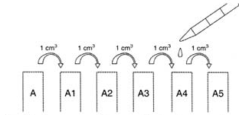
3 peas, defrosted for 24 hours (1DP)
[groups 1,3,5,7,9]
3 peas, freshly defrosted (FP) [groups 2,4,6,8,10]
Add 5 cm³ distilled water to each tube (tube A)
Mash peas and mix well
Carry out a tenfold serial dilution to 10⁻⁵

Slide 25
National 4 activity
Per pair – 1NA & 1YGA plate
Label plate
Streak with cotton bud
Dip same cotton bud into A5 & streak as shown
Dip same cotton bud into A and streak as shown
Seal
Incubate 48 h @ 30ºC
1 Day peas
Fresh peas
Cotton bud
Cotton bud
A5 (most dilute)
A5
A
A
Notes:
SSERC – shared service of all 32 LAs
Established to support new practical science in schools.

Slide 26
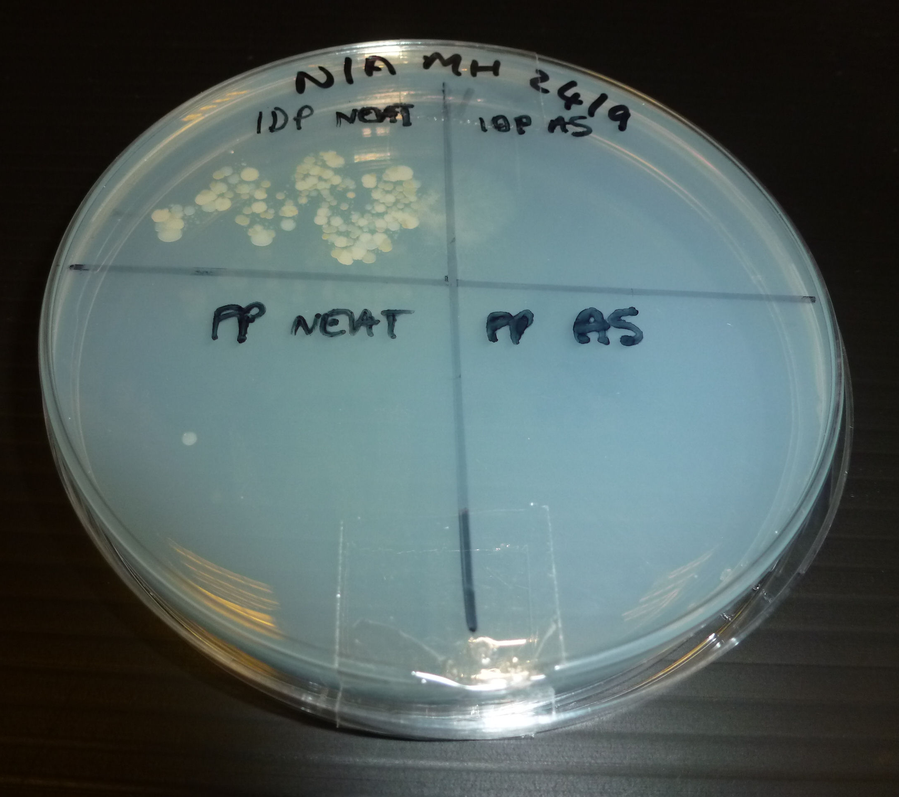
Examine plates for growth
Record results
Analyse results

Slide 27
Advanced Higher
Per pair: 1DP and FP
  Groups 1,3,5,7,9-NA
  Groups 2,4,6,8,10-YGA
Label plate
Starting with A5 A, place a single drop from each dilution on to appropriate circle (~ 0.02 cm³)
Seal
Incubate 48 h @ 30ºC
A2
A4
A3
A1
A5
A
Miles and Misra Technique
Notes:
SSERC – shared service of all 32 LAs
Established to support new practical science in schools.

Slide 28
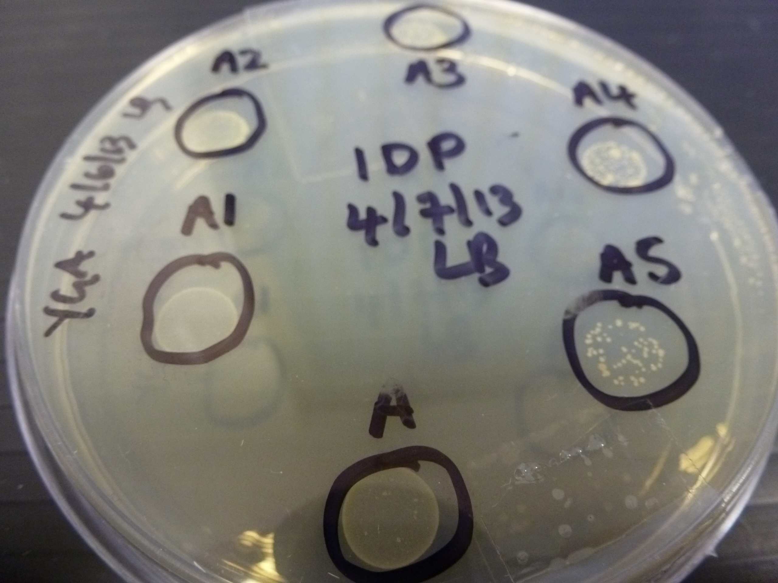
Record results
Count colonies
Calculate starting concentration
Notes:
SSERC – shared service of all 32 LAs
Established to support new practical science in schools.

Slide 29
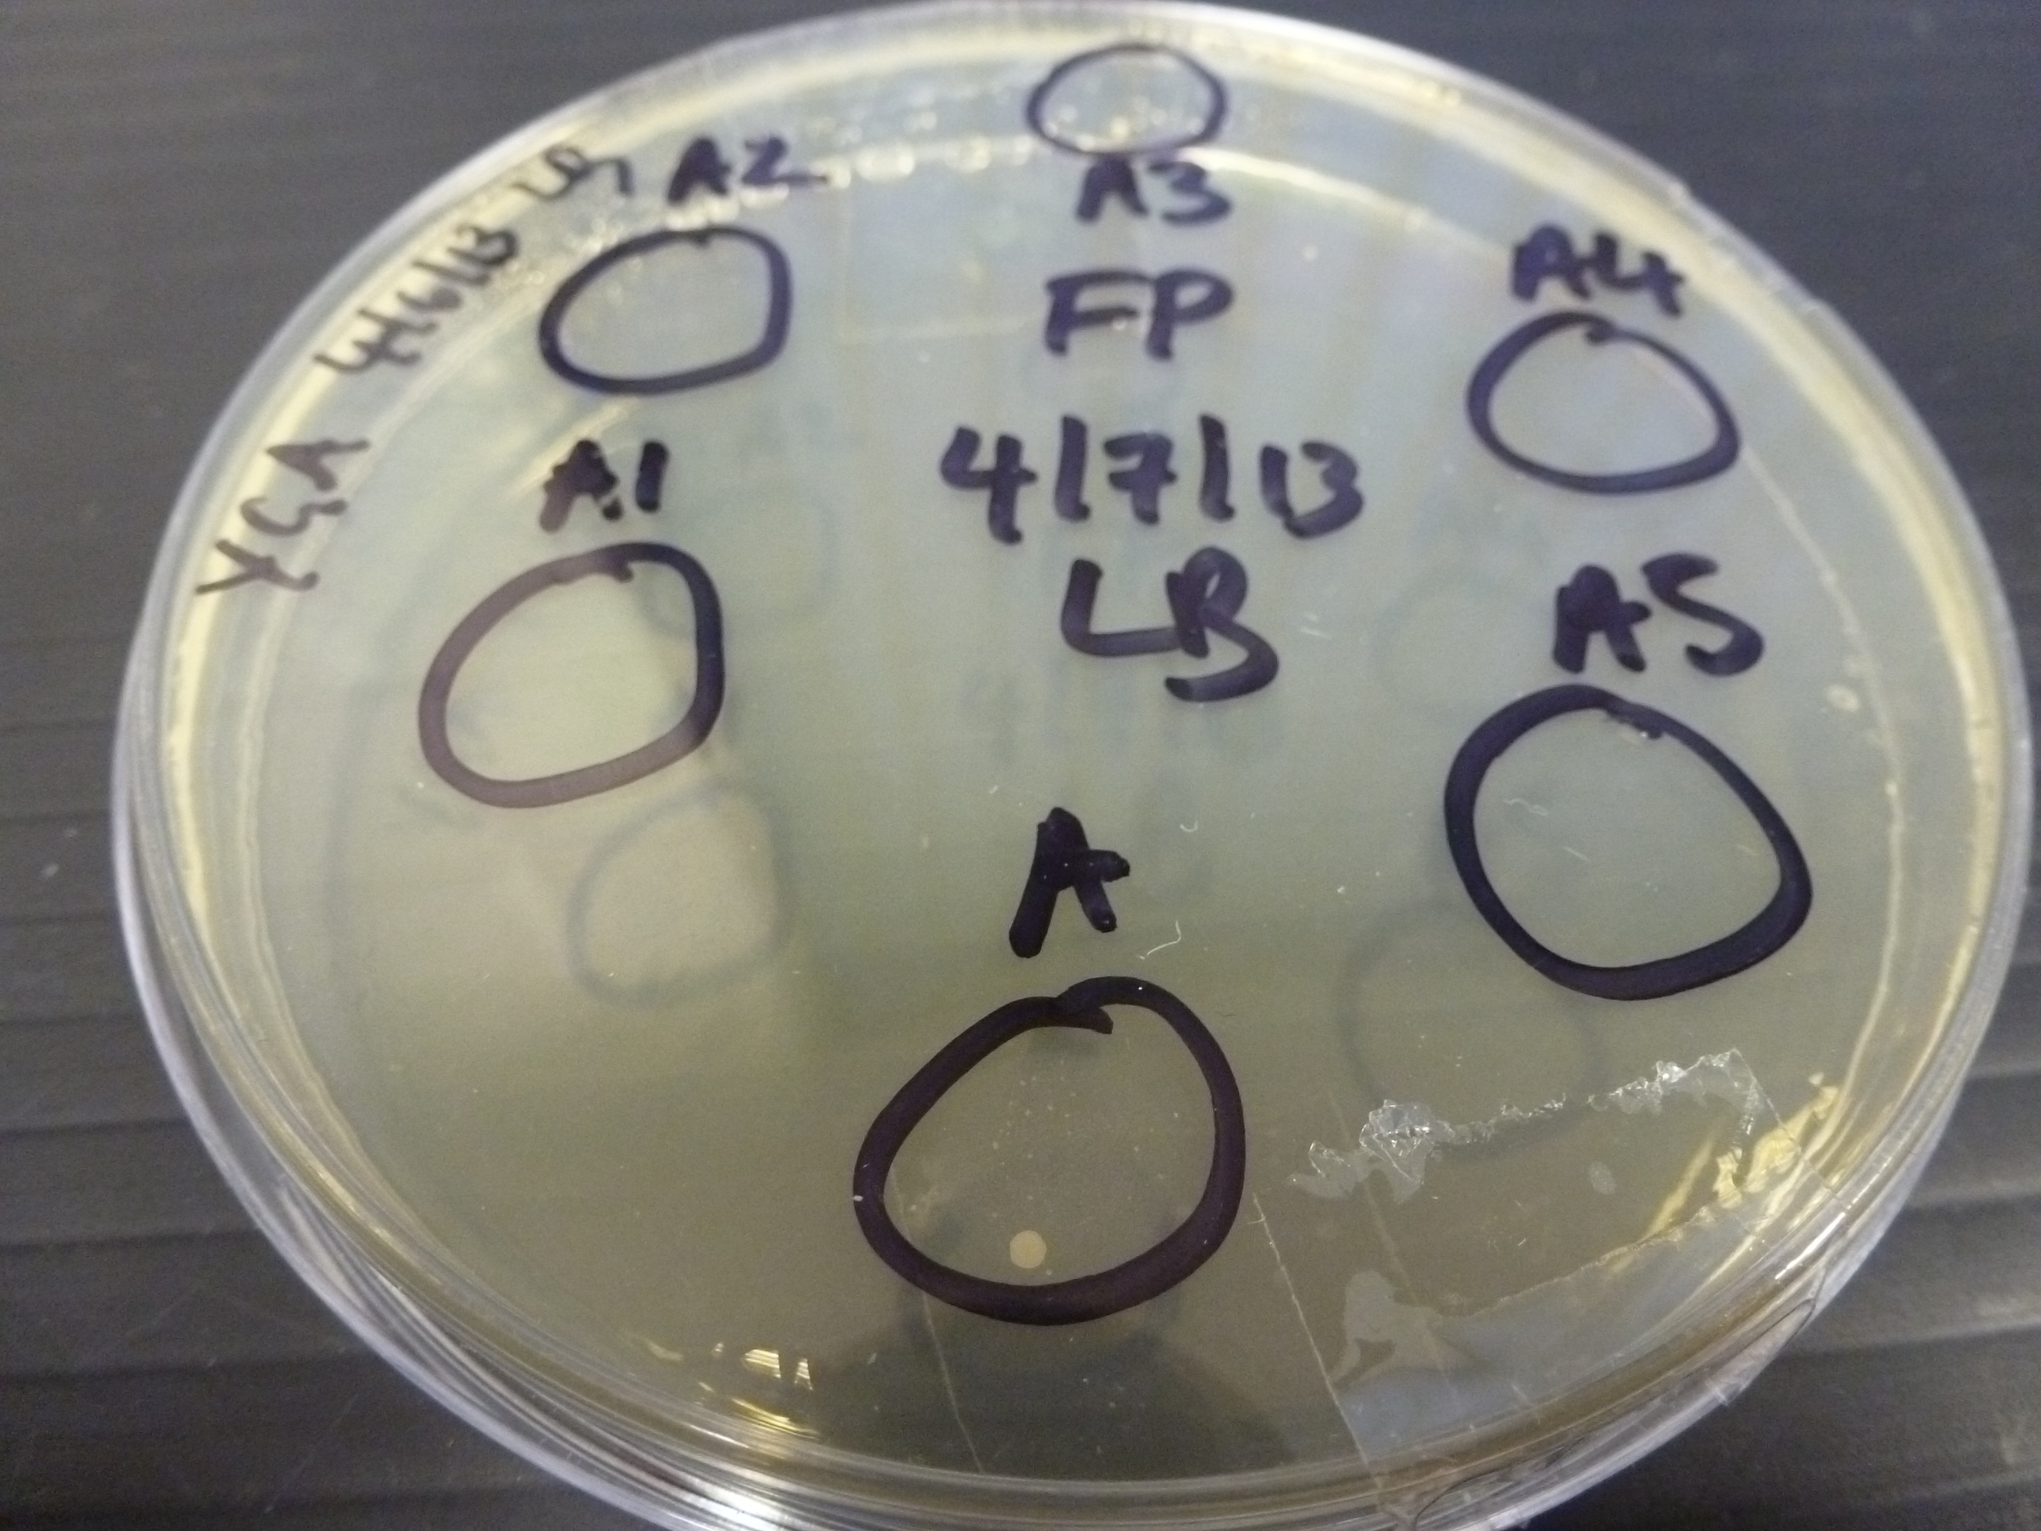

Slide 30
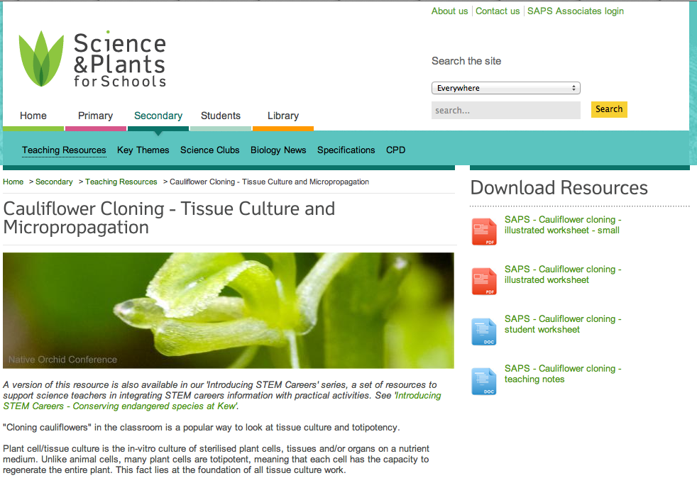
Cauliflower cloning:
www.saps.org.uk

Slide 31
Cauliflower cloning
Per pair
Collect a small mini-floret of cauliflower and place in a Petri dish.
Using a scalpel, cut the mini-floret into ‘micro-florets’ – small 3-5 mm pieces (‘explants’)
Transfer the explants to the jar of SDICN. Put the lid on and swirl the jar for 5 s. Replace forceps.
Swirl the jar gently for 5 s every 2-3 minutes for 15 minutes. (Do this whilst carrying out the next activity)

Slide 32
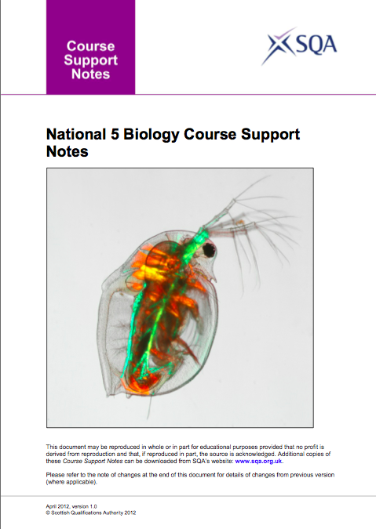
National 5: Mandatory Course Key Area
Unit: Cell Biology
3 Producing new cells
b. Cell production by cell culture requires aseptic techniques, an appropriate medium and the control of other factors.
Notes:
SSERC – shared service of all 32 LAs
Established to support new practical science in schools.

Slide 33
Subculturing
The aseptic transfer of micro-organisms from a culture to sterile medium
removal of inoculum from its culture medium
inoculation of sterile medium

Slide 34
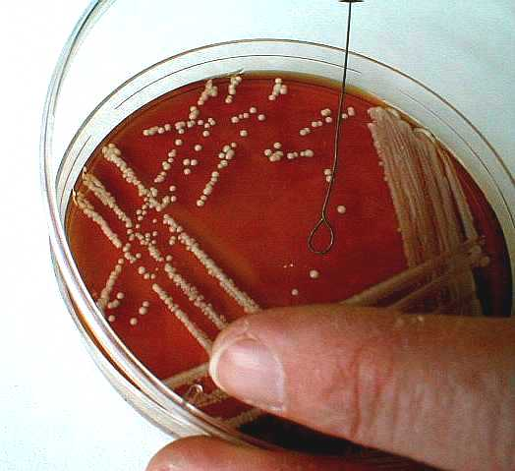
Subculturing :
Inoculum – single colony
Notes:
SSERC – shared service of all 32 LAs
Established to support new practical science in schools.

Slide 35
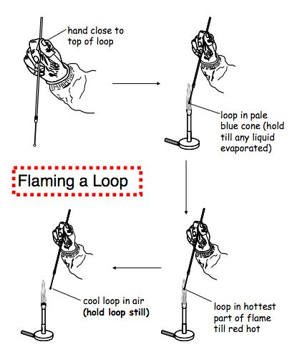
Sterilising a loop by flaming

Slide 36
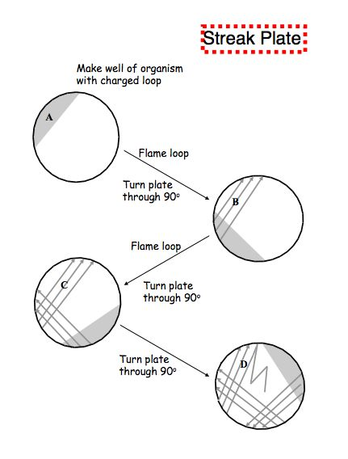
Subculturing -
streak plate from a single colony of
S cerevisiae

Slide 37
Nat 5: Exemplification of key areas
Appropriate growth media include various nutrient broths and agars.
Appropriate factors could include oxygen, temperature and pH.
Examples of how to achieve aseptic conditions.

Slide 38
Appropriate temperature
Organism: Saccharomyces cerevisiae
Media: Yeast glucose agar
Temperatures: 5°C (1 plate)
30°C (2 plates – 1 each person)
50°C (1 plate)
4 plates per pair

Slide 39
Appropriate temperature
Streak inoculation using sterile loop
Sellotape lid to base of plate with 2 small pieces Sellotape, opposite sides of plate
Incubate 48 hours at different temperatures as shown on previous slide
Compare growth at different temperatures

Slide 40
Test aseptic technique!
- streak plate
- no inoculum
- incubate 30°C
Notes:
SSERC – shared service of all 32 LAs
Established to support new practical science in schools.

Slide 41
Media preparation
Culture medium contains all the required nutrients for growth
liquid (broth) or solid
agar – solidifying agent
commercial or own recipe
must be sterilised before use

Slide 42
Appropriate growth media
Organism: Saccharomyces cerevisiae
Media: agar
nutrient agar
yeast glucose agar

Slide 43
Appropriate growth media
Type of organism | Growth medium
Bacteria | Nutrient agar (NA)
Yeast | Yeast Glucose Agar (YGA)
Cauliflower | Plant tissue culture media*
* Contains MS medium; granulated cane sugar; agar; kinetin; SDICN
See technical and teaching notes for full recipe

Slide 44
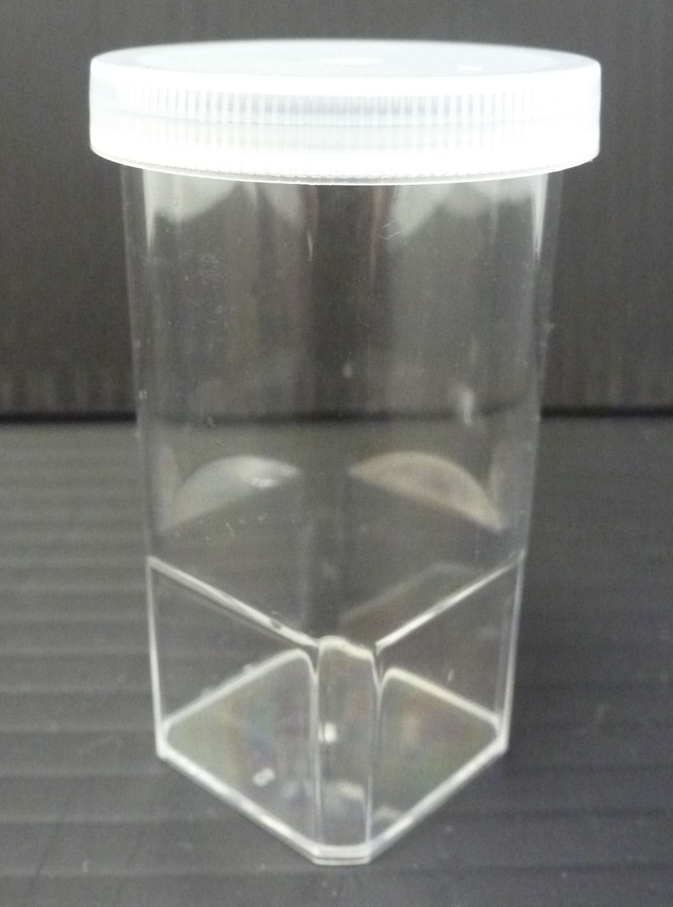
Cauliflower cloning
Each person
7. Take the lid off the vial of growth medium and place face-down on a clean tile.
Using sterile forceps, pick an explant from the SDICN and place into the agar. Press the stalk into the medium slightly. Replace the lid.

Slide 45
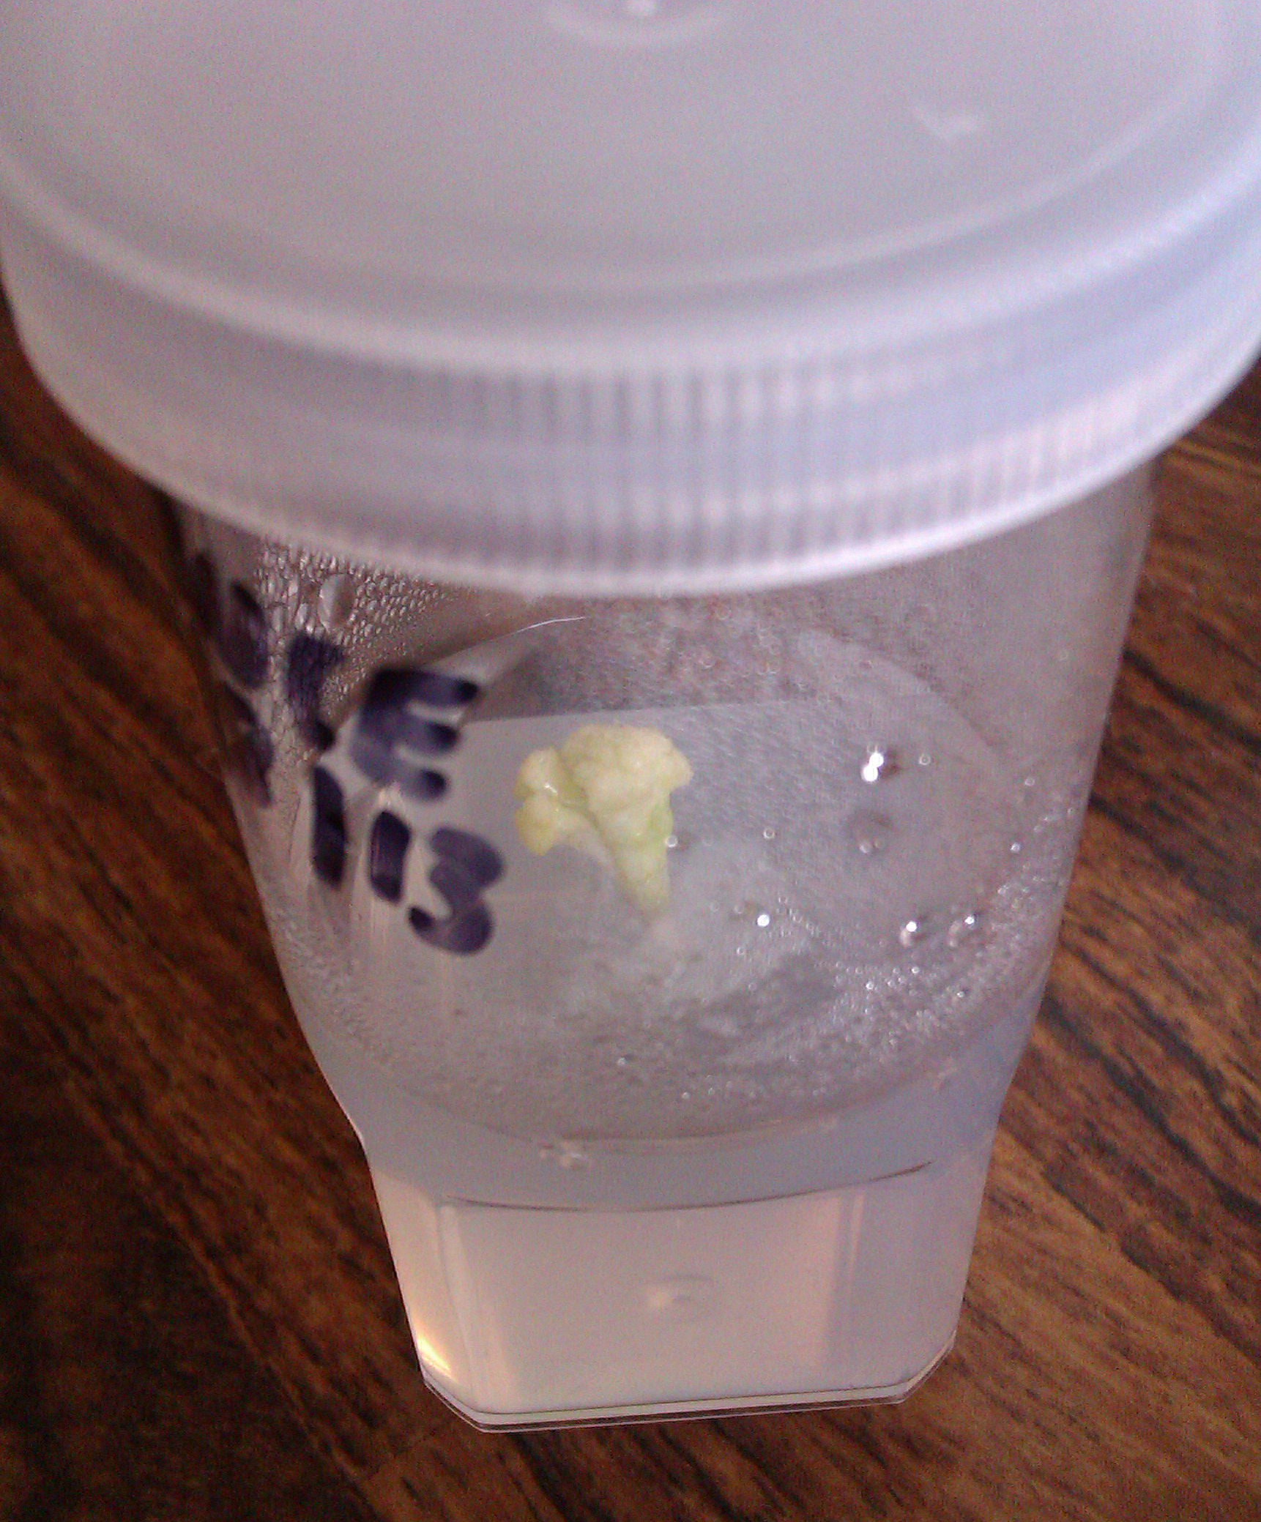
Cauliflower cloning
9. Label the vial with your initials and the date.
Incubate in a warm lab near window or light bank. Examine / photograph at regular intervals.

Slide 46
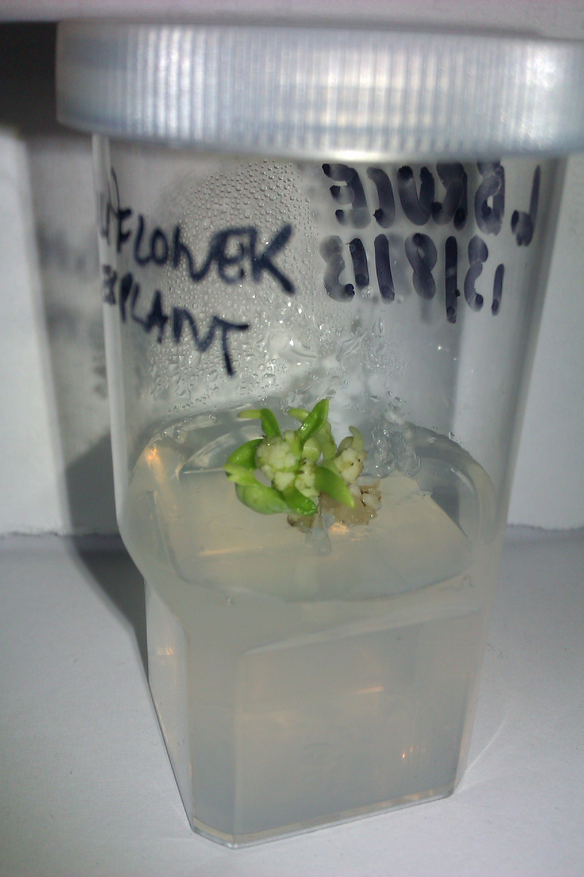
Cauliflower explant after 10 weeks’ incubation.

Slide 47
Simple fermentation
Conical flask
5 g baker’s yeast
4% or 8% glucose solution – 150 ml
Bubble trap
Bubble counter (Data harvest)
24-36 h

Slide 48
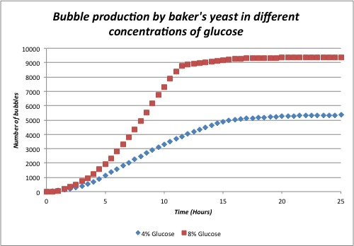

Slide 49
Personal Protection
Remove:
  Gloves
    Goggles
    Labcoat
Wash hands
Collect bags and cases from outside door or in corner of room

Slide 50
Additional Safety / Guidance / Resources
Microbiology in Schools Advisory Service (MiSAC)
http://www.misac.org.uk/
Society for General Microbiology (SGM)
http://www.microbiologyonline.org.uk/
National Centre for Biotechnology Education (NCBE)
http://www.ncbe.reading.ac.uk/
Notes:
SSERC – shared service of all 32 LAs
Established to support new practical science in schools.

Slide 51
Nat 4: Exemplification of key areas
Properties of microorganisms include rapid growth, diverse use of food source and wide range of products.
Examples of how some cells work and are used in industrial processes.
Yeast in baking and brewing.
Bacteria for yoghurt and biofuels production. Production of cheese.

Slide 52
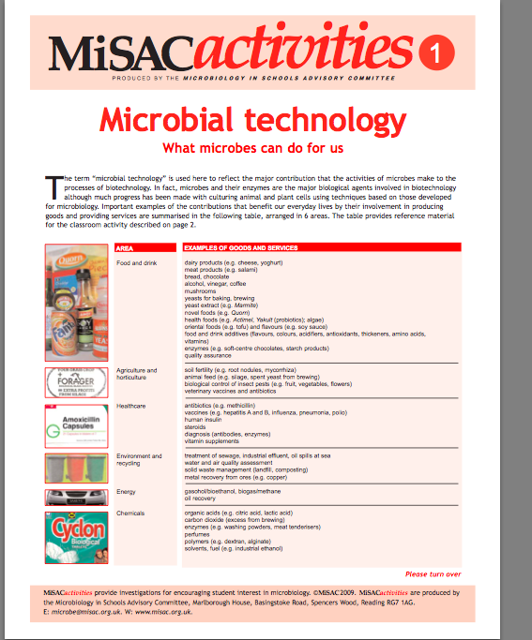

Slide 53
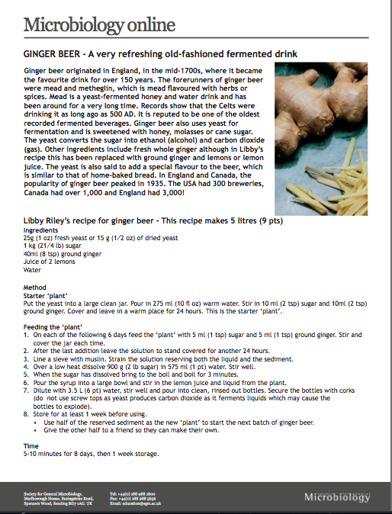
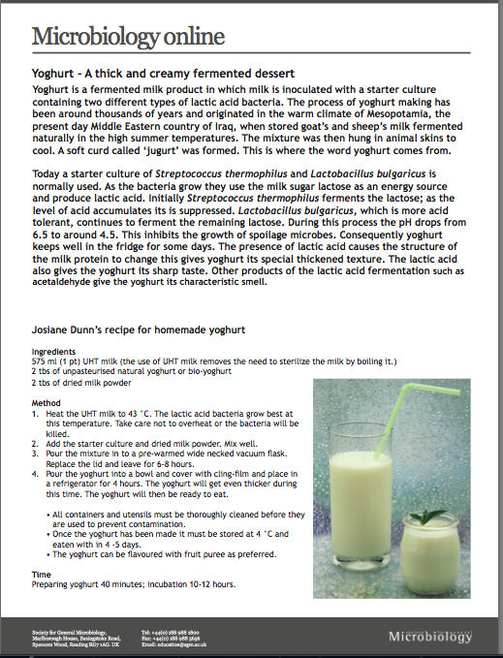

Slide 54
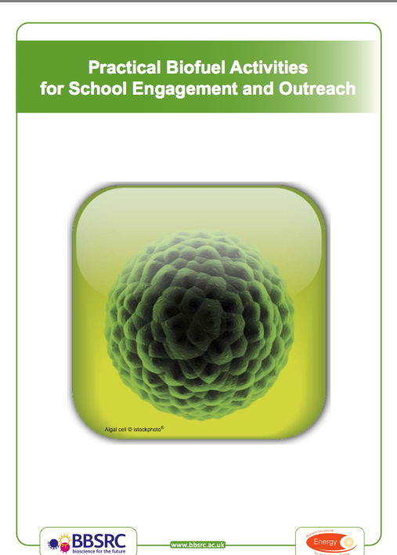
http://www.bbsrc.ac.uk/web/FILES/Resources/practical-biofuel-activities-complete.pdf

Slide 55

Culturing human cells
HeLa cells
Science content
Scientific method
Ethical issues

Slide 56
http://archive.org/details/AdamCurtisTheWayofAllFlesh
http://www.bbc.co.uk/blogs/adamcurtis/posts/the_undead_henrietta_lacks_and

Slide 57
Kath.Crawford@sserc.org.uk
Lorraine.Bruce@sserc.org.uk

